Slide 1

Implementing School Census Changes in Lambeth Schools.
Amanda Bellsham-Revell June 2016
abellsham@gmail.com

Slide 2
Statutory requirement
As the census is statutory:
  schools do not need to obtain parental or pupil consent to the provision of information
  it ensures schools are protected from any legal challenge that they are breaching a duty of confidence to pupils
  it helps to ensure that returns are completed by schools
(School census 2016 to 2017 guide, DfE)
https://www.gov.uk/government/uploads/system/uploads/attachment_data/file/522546/2016_to_2017_School_Census_Guide_V1_0.pdf
(See pages 10, 61-65 and Proficiency in English grid on p 144

Slide 3
Changes in School Census
From Autumn Census and then annually from Spring Census onwards.
EXISTING ITEMS EXTENDED to include nursery schools
Ethnicity
Language code
NEW ITEMS
Proficiency in English
Country of birth
Pupil nationality
Information and codes on Lambeth RSU website
http://www.lambeth.gov.uk/rsu/school-census
sort_by=created&sort_order=DESC&page=2

Slide 4
NEW – Country of Birth
ALL SCHOOLS
For all pupils
Records the country in which the child was born as stated by parent/guardian or child if without the above.
Expected to derived from birth certificate or passport, although doesn’t have to be seen.
If born outside national boundaries – stateless.
Can also use following categories:
  Refused
  Not yet obtained
  Not known
Where a child transfers school, will be transferred via Common Transfer File (CTF)

Slide 5
NEW – Pupil Nationality
ALL SCHOOLS
For all pupils, as stated by parent/guardian and/or child if without the above.
Expected to be derived from passport or European economic identity card, although no requirement for school to see these. More than one nationality can be recorded.
If born outside national boundaries, may be classified under parent nationality or ‘stateless’.
Can also use codes:
  Refused
  Not yet obtained
  Not known
Also transferred via CTF

Slide 6
Remember ….
‘Where parents have not responded or where a pupil’s first language is not known with absolute certainty, but the school can judge with a high degree of confidence whether it is English or not.’
Use codes:
ENB (Not known but believed to be English)
OTB (Not known but believed to be other than English)
(School census 2016 to 2017 guide, DfE)

Slide 7
Admission form
Place of birth?
Nationality?
Ethnicity?
Language?
  Which languages heard and spoken - with parents/carers/siblings/wider family/other?
  Which languages read/written?
  Any supplementary schools attended?
  Proficiency in English?
  How long exposed to English?
Previous schooling?

Slide 8
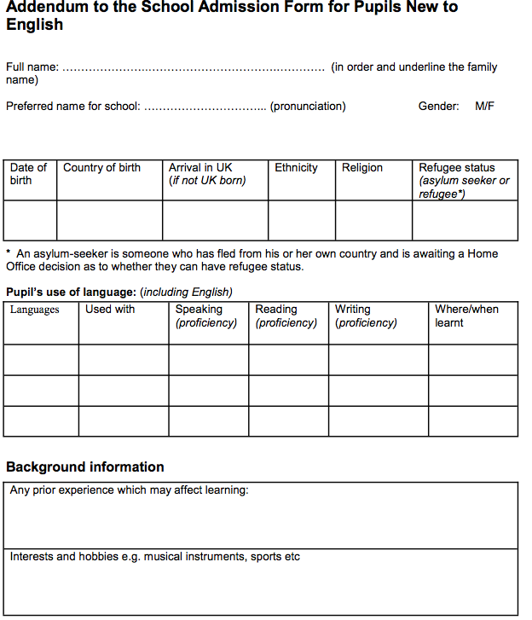
‘Guidance for schools admitting pupils who are new to English’
Cambridgeshire Race Equality and Diversity Service

Slide 9
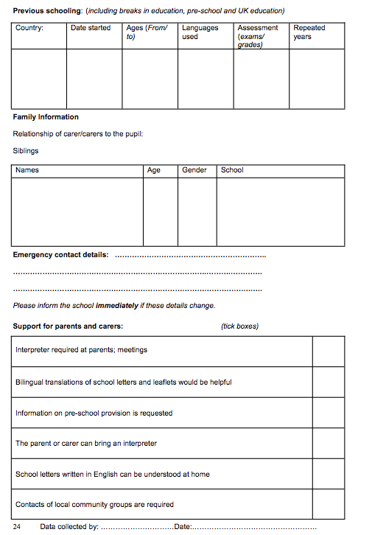
Guidance for schools admitting pupils
^{who are new to English}
Cambridgeshire Race Equality and Diversity Service

Slide 10
DfE definition of child with EAL
YOU MUST PUT THE LANGUAGE THAT IS NOT ENGLISH IN THE FIRST LANGUAGE FIELD ON SIMS!!
How do you decide if a child is classified as having EAL?
‘A first language, where it is other than English, is recorded where a child was exposed to the language during early development and continues to be exposed to this language in the home or in the community.
Where a child was exposed to more than one language (which may include English) during early development, the language other than English is recorded, irrespective of the child's proficiency in English.
Where an older pupil is no longer exposed to the first language in the home, and who now uses only another language, the school should consult with the pupil or parent to determine which language is recorded.’ (School census 2016 to 2017 guide, DfE)
Notes:
!

Slide 11
The Iceberg Model
Up to 2 years
Sequencing
Describing
Retelling
(Cummins)
BICS
Basic
Interpersonal
Communicative
Skill
CALP
Cognitive and
Academic
Language
Proficiency
5 to 7 years Hypothesising
Generalising
Evaluating critically
Jim Cummins

Slide 12
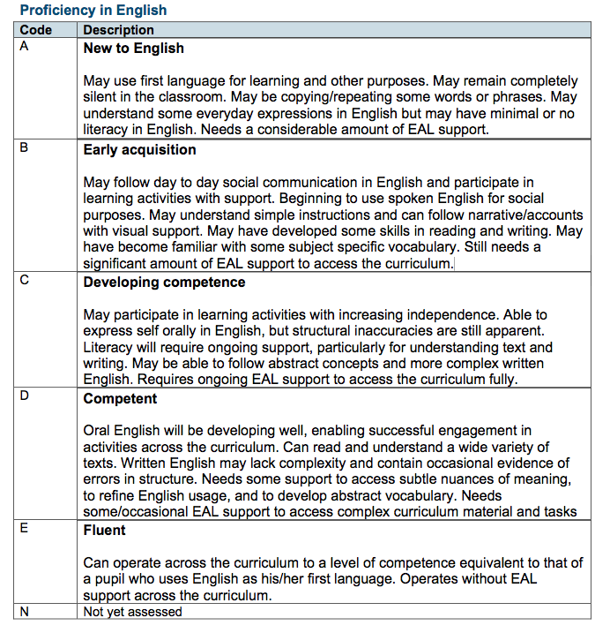
New DfE 5 stage scale

Slide 13
Similarities and differences between the Lambeth Stages and the Proficiency in English Scale?
The Lambeth scale has 4 stages of fluency, whilst the new scale has 5.
The Lambeth scale has different descriptors for each key stage whilst the new scale has only one set of descriptors to be used for children in reception classes to those in KS4.
Both scales are based on the best-fit principle. However, the Lambeth scales measure development and progress in three separate areas – speaking and listening, reading and writing, whilst the new scale has one set of generic descriptors, which are basic and only touch on each of these areas.
Lambeth scales show numbered progression, stages 1 to 4, in contrast to the new scale which uses the letters A to E.

Slide 14
Unpicking the new scale
Generic descriptors which will need to be unpicked for each year group.
‘May have developed some skills in reading and writing’
Interpret this for each year group from reception to year 11

Slide 15
Grammatical inaccuracies
Descriptors refer to grammatical and structural inaccuracies.
‘Uses spoken English confidently but structural inaccuracies still apparent.’ (stage C)
‘Written English may lack complexity and contain occasional errors in structure.’ (stage D)
Which are the areas of grammar that research shows are challenging for children with EAL?
How are age and level of English development
reflected in the above?
During assessment use this knowledge to determine how EAL is affecting a child’s writing.

Slide 16
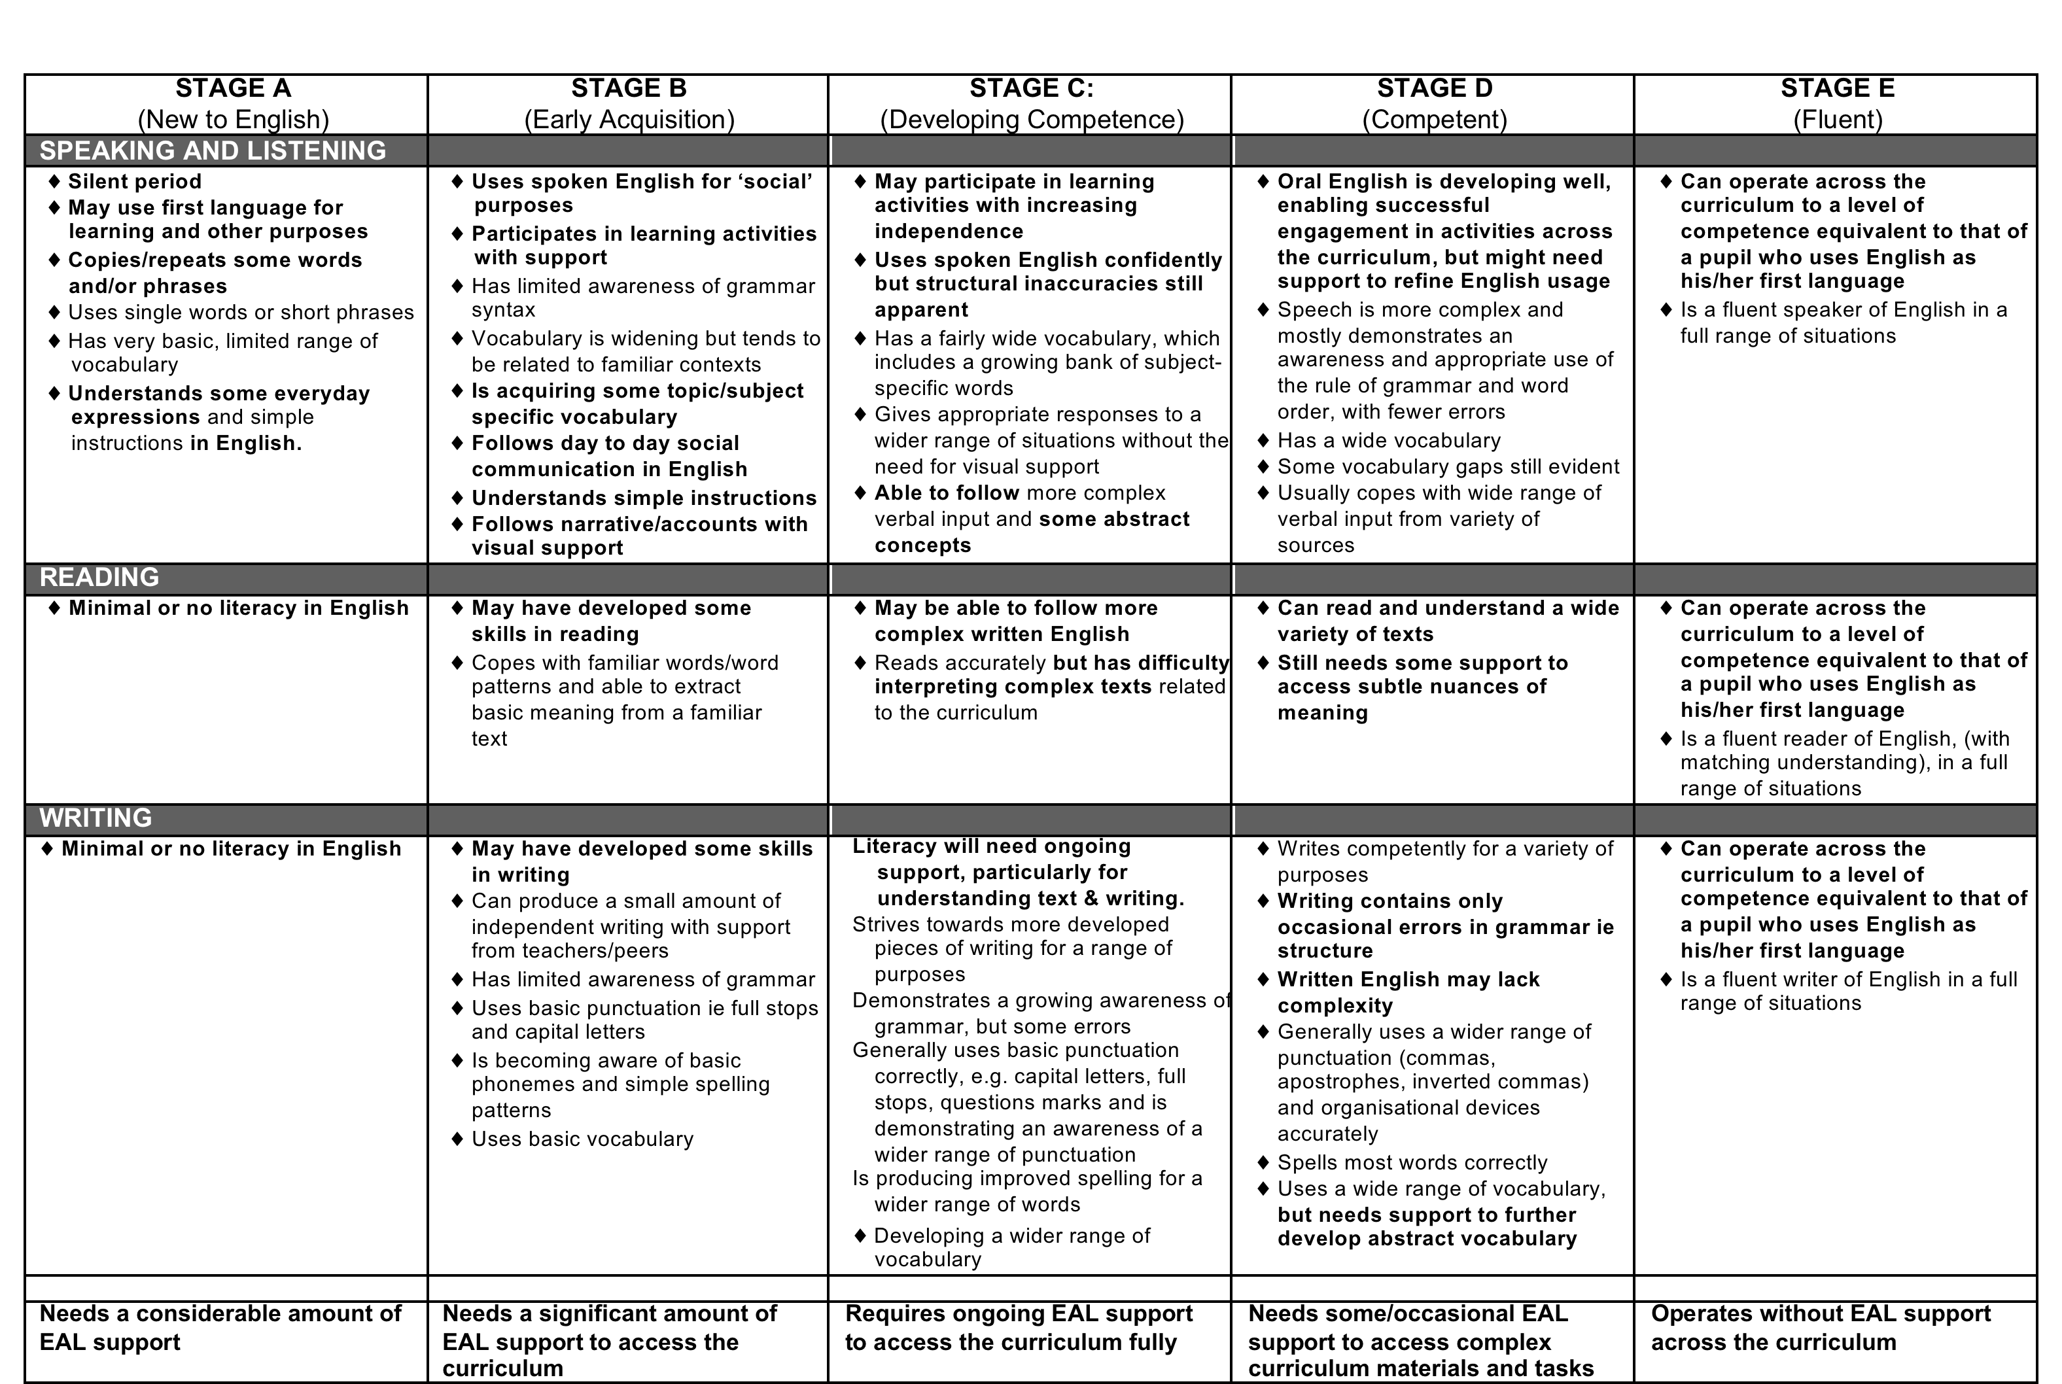
Nexus grid
PROFICIENCY IN ENGLISH - 5 STAGE MODEL OF EAL ACQUISITION – RECEPTION TO KS4 (Support materials adapted from EAL Nexus

Slide 17

The transition

Slide 18
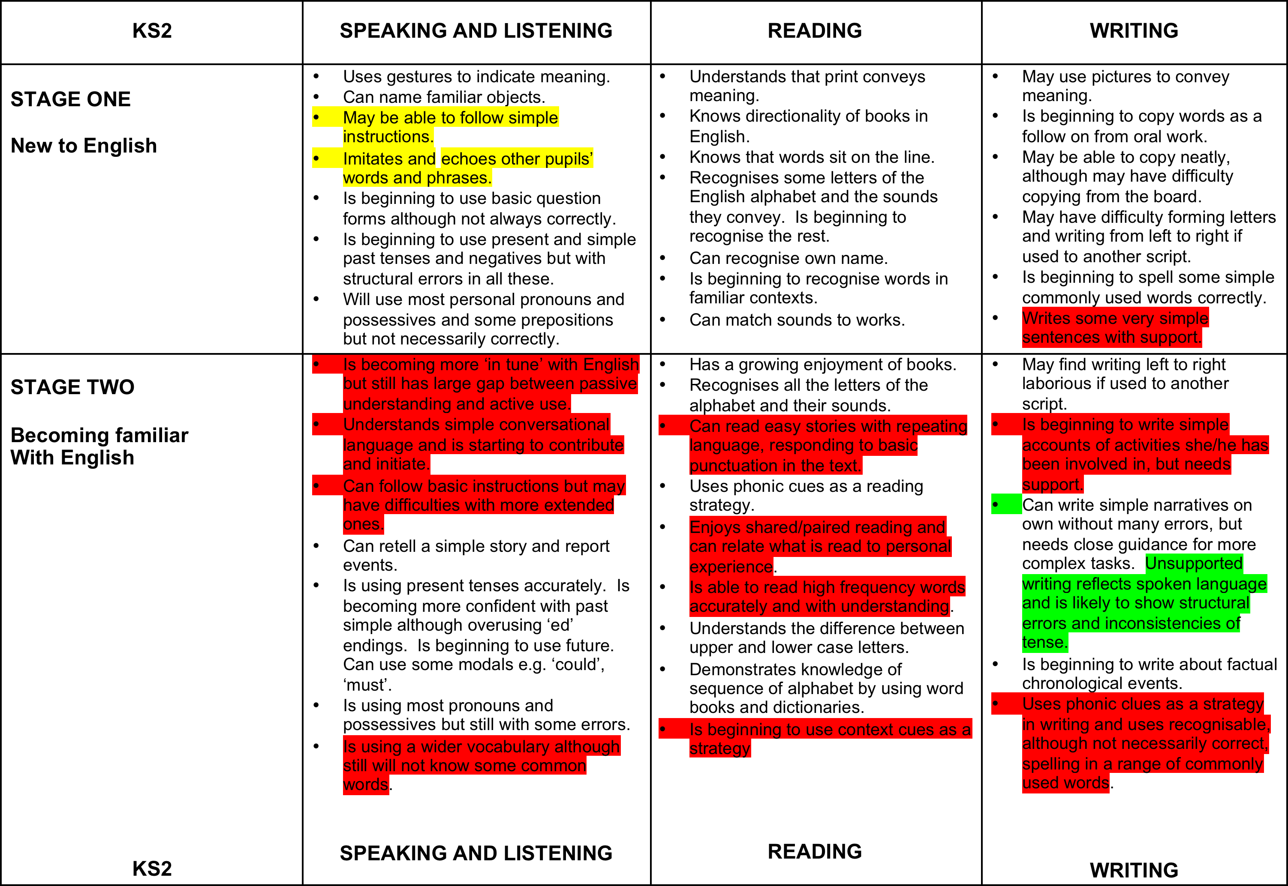

Slide 19
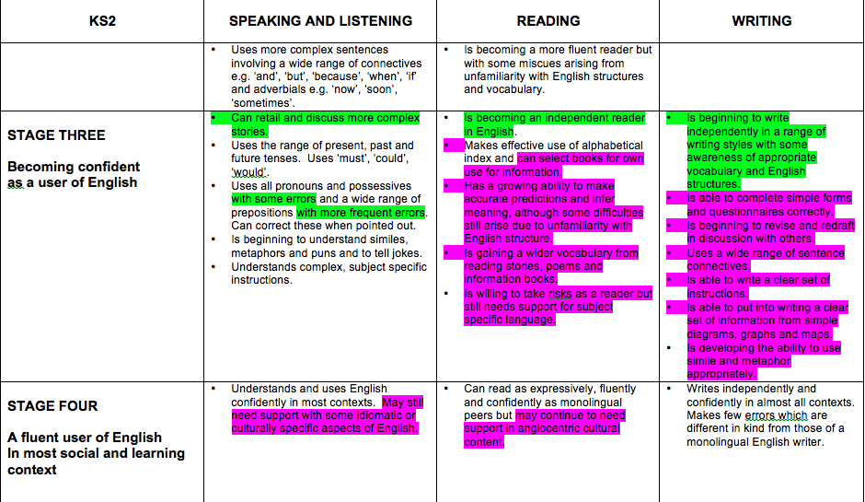

Slide 20
The transition
Existing Lambeth Stage of English for children with EAL | New National Proficiency in English Code for children with EAL
Stage 1 | Code A
Stage 2 | Code B
Stage 3 | Code C Code D
Stage 4 | Code E
Early stage 3
Higher level stage 3

Slide 21
Key Principles of EAL Assessment
Spoken: ‘That man did it.’
Written: The man wearing the brown
coat broke the window.

Slide 22
Spoken Language
In academic as well as social contexts – ask the child to explain or justify
Planned activity must allow for use of focus language
Need context in which collected
Identifies strengths and areas for development
Comparison of oral and written language informs assessment of development and possible targets

Slide 23
Reading
Look at context of book – culturally familiar, prior experience
Remember children with EAL often use phonics successfully
Ensure ‘think about questions’ are used to assess understanding
Code D – as for monolingual peers, but may have some difficulty with idioms/culturally specific references & nuances

Slide 24
Writing
Ensure writing is truly independent and ideally without scaffolding ie oral rehearsal
Assess in different curricular areas to include the more academic language structures
Look for those difficulties that research shows are specific to their English language acquisition, especially but not solely in grammar
Don’t focus on handwriting, spelling and punctuation.

Slide 25
Key points
Need a rounded picture drawn from independent work in many contexts
Use the principle of ‘best fit’ to make sense of disparate information
Needs to be age-related
Note strengths and areas for development
Should explicitly inform teaching and learning
Should be an ongoing process – ideally update termly and can build into school’s assessment cycle

Slide 26
English Language Fluency Coding
If the child is learning English as an Additional Language (EAL), then their fluency level is assessed as being one of five stages. (National Proficiency Scale A – E) and a language that is not English is selected in the first language field.
No child given a stage A to E, should have English recorded as their language.

Slide 27
Tips
Update records regularly
On average it takes 5 -7 years to achieve fluency and sometimes longer, so don’t try and move pupils through stages quickly or over-assess to show progress. It won’t benefit pupils in the long run.
Depending on age and background, most will move through A and B in a couple of years and then stay on C and D for a long time.
Stages A, B and C pupils will not be attaining age-related expectations in English. A child at stage D might be working at typical levels, because this child will be working above expectations once fully fluent in English (code E).

Slide 28
Next steps
Review admissions form.
Review how information is collected.
Train staff in school.
Support them through the process.
Moderate within school.
Work closely with administrative staff who will be inputting the data.

