Slide 1
Front Page
Good Practice to Raise Achievement and Narrow The Gap

Slide 2
Who am I and what qualifies me to be here ?

Slide 3
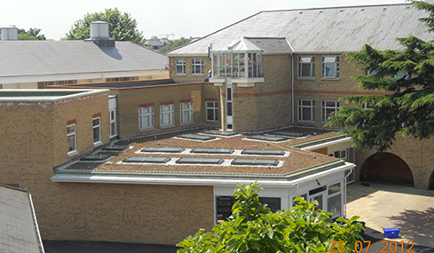
A little about the school …
Comprehensive / girls / 48% pp
Inner City London (Lambeth)
3 year 5 A*-C inc EM average is 82%
Value added 1031.1
2014 pp v non-pp gap = 0
Successive OFSTED ‘Outstanding’
Top of Family of Schools

Slide 4
What do we do about narrowing the gap ?
Whole school practice
Specific targeting of eligible pupils

Slide 5
Whole School Practice
Confident and innovative – not afraid of our own ideas
Focus on teaching
Excellent assessment / monitoring / intervention
Focus on making everything we do as strong as possible
Never complacent

Slide 6
Example 1 : Action Research

Slide 7
Example 2 : Teaching and Learning
10 MOP

Slide 8
Example 3: Brown Envelope /
Golden Ticket

Slide 9
Example 4: Celebrating Cultural
Diversity

Slide 10
Example 5 : Spelling and General Knowledge

Slide 11
Example 6 : Ponchos

Slide 12
Specific Targeting of Eligible Pupils
Enhanced Maths and English staffing
Scholarship Programme and Russell Group from Year 10
Parallel Curriculum and Sister Circle – additional support
Wide range of visits
Homework clubs
House System
Extra-curricular provision

Slide 13
The whole school can benefit …
eg clubs / sets

Slide 14
The answer is in the room
‘I have lost count of the number of times that I have been faced with what has seemed an intractable problem and started to panic, felt anxious, worried even. But no more. Now, when these feelings seem near, I take the problem to my senior team without fear. When I reveal the problem to the team, I have no idea how the problem will be solved but I know the solution is in the room, always. This is the best feeling in the world. Total confidence in the team. Sometimes the problem is solved in seconds, sometimes minutes, sometimes longer but the problem is always solved.’

Slide 17
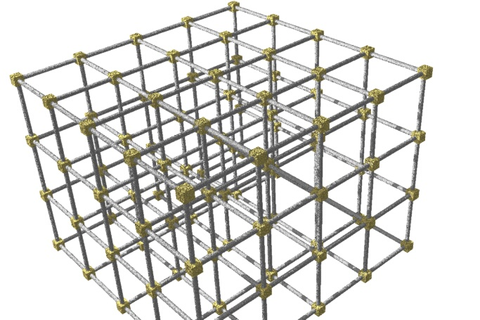
+ = Liberation Leadership
Structure + Freedom (to lead)

Slide 18
Any Questions ?

