Slide 1
The Pupil Premium: Raising attainment and accelerating progress
Nicola Edwards
Department for Education
London
18 June 2015

Slide 2
Areas I plan to cover today
1. The context
What is the pupil premium?
2. The key components of the Pupil Premium
Pupil Premium funding
Accountability
The evidence of what works
3. What works?
Overcoming barriers
What does Ofsted say?
What effective schools are doing

Slide 3
“Excellence and equity in student performance are less related to a country’s income or expenditure on education than to how those educational resources are allocated, and to the policies, practices and learning environments that determine the conditions in which students work.”
Equity, Excellence and Inclusiveness in Education Policy: Lessons from Around the World’ , Andreas Schleicher, OECD, 2014

Slide 4
Pupil Premium: why?
Pupil premium pupils’ attainment is lower than their peers
67.4% of pupil premium pupils and 83.5% of their peers achieved level 4+ in reading, writing and maths at age 11 (2014). Disadvantaged pupils ‘ attainment has improved more rapidly than their peers but is still much lower.
36.5% of pupil premium pupils and 64.0% of their peers achieved 5+ A*-C grades including English and maths GCSEs at age 16 in 2014. It is not possible to compare 2013 and 2014 because assessment changed between the two years.
Big variations between LAs
KS2 reading, writing, maths gap: Newham 3ppts, Bracknell Forest 26ppts
GCSE 5+ A*-C inc. English and maths gap: Tower Hamlets 11.8ppts, Buckinghamshire 41.7ppts

Slide 5
Weakest and strongest performing local authorities by attainment of disadvantaged pupils and the attainment gap by percentage of pupil premium eligibility, 2014

Slide 6
Funding
£2.545 billion in 2015-16:
£1320 primary-aged pupils
£935 secondary-aged pupils
£1900 for all looked-after children, adopted children and care leavers
Protected in real terms 2015-16
£50m early years pupil premium from 1 April 2015

Slide 7
Funding
Specialist provision and the Pupil Premium
The virtual school heads (VSHs) in local authorities are now responsible for managing pupil premium funding for the children they look after, and for allocating it to schools and non-mainstream settings. For more information, see the VSH Pupil Premium guidance.
Pupil Premium funding is always paid to maintained and non-maintained special schools. For other alternative provision, the funding can be allocated to the setting where the child is being educated or held by the local authority to spend specifically on additional educational support.

Slide 8
School interventions
Schools should choose the interventions they consider to be most effective and cost-effective, and need to publish online:
the school’s pupil premium allocation for the current academic year
details of how you intend to spend the allocation
details of how you spent the previous academic year’s allocation
how it made a difference to the attainment of disadvantaged pupils
Schools can identify pupils with Key to Success tool.

Slide 9
Inspection
Since Sept 2013, there have been sharper “Section 5” inspections, more focussed on attainment of disadvantaged pupils:
schools will now not normally be judged “outstanding” if – among other things – disadvantaged pupils are not making good progress
In July 2014 there were two amendments made to the inspection handbook relating to the pupil premium
Read the framework document

Slide 10
Pupil premium reviews
Any school can commission a pupil premium review. The review:
aims to identify effective action for raising the attainment of disadvantaged pupils
should be led by an experienced and independent system leader, usually from the National College for Teaching and Leadership (NCTL), with a strong track record in improving outcomes for disadvantaged pupils
can be paid for using pupil premium funding
NCTL has a directory of system leaders

Slide 11
Evidence of effectiveness
Since February 2012, the Education Endowment Foundation (EEF) has awarded £54m to 94 projects – involving over 5,000 schools and 600,000 pupils.
They are rigorously evaluated, mostly using randomised controlled trials (RCTs)
Knowledge gained is published on a termly basis – 27 reports since January 2014
EEF teaching and learning toolkit provides accessible evidence and advice on the effectiveness of a range of approaches.
There are on-going updates to the toolkit
You can also find other schools similar to your own on the EEF families of schools database at https://educationendowmentfoundation.org.uk/toolkit/families-of-schools/

Slide 12
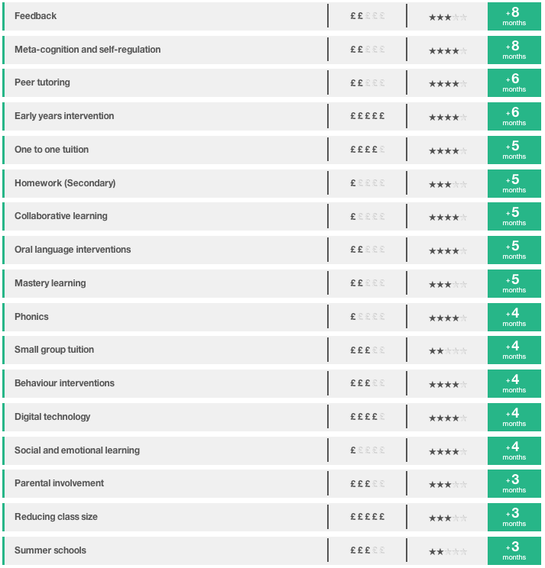
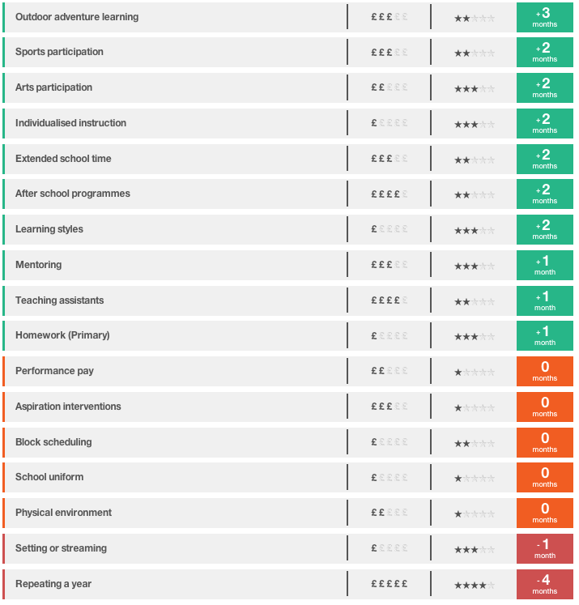
EEF Toolkit

Slide 13
Feedback
Approach | Average impact | Cost | Evidence estimate | Summary
Feedback | 8 months | ££ |  | Very high impact for low cost
Research suggests that providing effective feedback is challenging. To be effective, it should be:
About challenging tasks or goals rather than easy ones.
Given sparingly so that it is meaningful.
About what is right more often than about what is wrong.
Specific, accurate and clear, e.g. not just “correct” or “incorrect”.
Provide examples of what is correct and not just tell students when they are wrong.
Encouraging and supportive of further effort without threatening a learner’s self-esteem.

Slide 14
“Our data shows that it doesn’t matter if you go to a school in Britain, Finland or Japan, students from a privileged background tend to do well everywhere. What really distinguishes education systems is their capacity to deploy resources where they can make the biggest difference.
“Your effect as a teacher is a lot bigger for a student who doesn’t have a privileged background than for a student who has lots of educational resources”
Andreas Schleicher, Times Educational Supplement, 2013

Slide 15
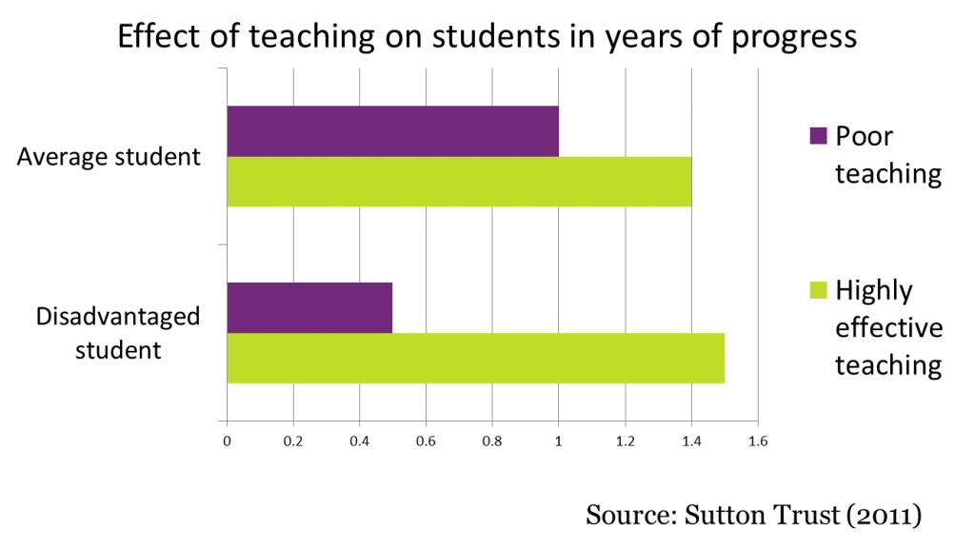

Slide 16
Missing Talent
Sutton Trust report, June 2015
http://www.suttontrust.com/researcharchive/missing-talent/
Key findings:
15% of highly able pupils who score in the top 10% nationally at age 11 fail to achieve in the top 25% at GCSE
Boys, and particularly pupil premium eligible boys, are most likely to be in this missing talent group
Highly able pupil premium pupils achieve half a grade less than other highly able pupils, on average, with a very long tail to underachievement
Highly able pupil premium pupils are less likely to be taking GCSEs in history, geography, triple sciences or a language

Slide 17
What Works: overcoming the barriers
Identify the barriers to learning for disadvantaged pupils
Decide your desired outcomes
Set success criteria for each outcome
Choose your strategies
Tell the story: create an audit trail

Slide 18
What works: what does Ofsted say effective schools are doing?
Maintained high expectations of target group
Thoroughly analysed which pupils were under-achieving and why
Used evidence to allocate funding to big-impact strategies
High quality teaching, not interventions to compensate for poor teaching
Used achievement data to check interventions effective and made adjustments where necessary
Highly trained support staff
Senior leader with oversight of how PP funding is being spent
Teachers know which pupils eligible for PP
Able to demonstrate impact
Involve governors

Slide 19
What works: Park Junior School – 2014 national primary school winner
The school introduced a number of strategies and wanted pupils to drive their own learning, in a structured and supported way. Working with the EEF Teaching and Learning Toolkit (on feedback, meta-cognition, peer tutoring and collaborative learning) the school devised a 4 Steps strategy. This gives pupils a clear method to use when they encounter something in a lesson that they do not understand or cannot do.
Pupils are taught how to apply the approach by the head teacher and pupils study in small, self-selecting groups.
The strategy has transformed pupil learning in the school. Pupils are completely focused and engaged, and work independently of the teacher and support one another.

Slide 20
What works: Parkfield Community School, Birmingham – 2015 national primary school winner
The school relentlessly focuses on raising the attainment of its disadvantaged pupils, tracking, measuring and supporting pupils’ needs. In 2014 82% of the school’s disadvantaged pupils achieved L4 at KS2.
The school offers parents learning opportunities and engage them in their child’s learning.
To solve a punctuality issue the school launched a walking bus.
A maths breakfast club for pupil premium pupils without a computer at home has significantly improved those pupils’ attainment.
The school has established a maths academy and works with other schools in its region to provide maths education for pupils and CPD for teachers.

Slide 21
What works: Goffs School – 2014 national secondary school runner-up
As a first step Goffs School insists on consistently high quality teaching and learning. The school has applied research evidence from the EEF of what works across all aspects of their pupil premium interventions.
The school has set up a Pupil Premium Team to carefully monitor how the pupil premium is being spent and the effectiveness of the interventions. The team meets on a weekly basis to review the progress of the relevant pupils. Each member of the team has responsibility for a year group and works closely with the Directors of Learning to track pupil progress.
The progress of pupils is reviewed regularly and support adjusted to ensure it remains relevant and effective.

Slide 22
What works: Ark Charter Academy, Portsmouth – 2015 national secondary school winner
62% of the school’s pupils attract the pupil premium and in 2014 82% of pupil premium pupils achieved 5+A* to C including English and maths, 18ppt higher than the national average for non-PP pupils.
The school has been transformed in recent years with a strong curriculum focused on English and maths to make sure pupils have the core skills they need, with extra time given to these subjects through a longer school day.
The school also offers pupils wider experiences such as sailing and boxing, trips to universities and the theatre. A new theatre helps pupils develop their oral language skills and self confidence.
The school has taken part in an EEF trial on maths mastery and staff are encouraged to visit other schools to learn from their practices and share their expertise.

Slide 23
Questions for school leaders, teachers and governors to ask in their schools
Do we all know who our Pupil Premium pupils are? Do we know what those pupils need to improve their attainment? Have we accessed the Key to Success ‘download’? https://www.keytosuccess.education.gov.uk/schools/
How are we planning our activities and targeting them at Pupil Premium pupils and their specific needs?
Are we using robust evidence on what works to raise the attainment of disadvantaged pupils, such as that summarised in the Sutton Trust/Education Endowment Foundation toolkit, when deciding how to spend our pupil premium?
Could we benefit from a pupil premium review to reassess our approach?

Slide 24
Links, tweets and contacts
www.gov.uk/government/policies/raising-the-achievement-of-disadvantaged-children
www.education.gov.uk/schools/pupilsupport/premium
@educationgovuk @johndunford
nicola.edwards@education.gsi.gov.uk
www.pupilpremiumawards.co.uk/
Questions?

