Slide 1
Educational inequality in England’s schools Address to “Narrowing the Achievement Gap” National Conference, Jeffrey Hall, UCL-Institute of Education, 18 June 2015 Professor Steve Strand University of Oxford, Department of Education steve.strand@education.ox.ac.uk 01865 611071

Slide 2
Purpose of presentation
To present a picture of inequalities in educational achievement in England and how they have changed over the last 25 years
Considering the current gaps (particularly the socio-economic gap) what does the evidence suggest about policy for closing gaps further?

Slide 3
Trends over 25 years
Gaps - Race, sex and class
Focus on nationally representative data
Age 16
Two broad segments:
1988-2006 (Youth Cohort Study - YCS)
13,000 sample age 16+, every two years (approx), self reported data, broad ethnic groups ...
2004-2014 (National Pupil Database - NPD)
Whole population, annually, complete background
Notes:
Many possible achievement gaps (SEN, EAL, LAC etc) but weight of history on RSC (For Me Class=Douglas (1964) The home & the school 50% WC left at 15 but only 10% UC, despite control for IQ & ethnicity = Coard (1971) + equalities duties.

Slide 4
Gender (YCS)
Source: DCSF (2008). YCS & LSYPE: The activities and experiences of 16 year olds: England 2007

Slide 5
Ethnicity (YCS)
Source: DCSF (2008). YCS & LSYPE: The activities and experiences of 16 year olds: England 2007

Slide 6
Socio-economic (YCS)
Note: SEG then NS-SEC from 1999. England only from 1999. SEC Lower supervisory, semi-routine and routine. Source: DCSF (2008). YCS & LSYPE: The activities and experiences of 16 year olds: England 2007

Slide 7
Gender (NPD)
Notes:
2004 National Avgs: 52% 5AC & 41%5EM.

Slide 8
Ethnicity (NPD)

Slide 9
FSM (NPD)

Slide 10
Relative gaps over 25 years
1988-2003 = YCS (%5AC, Black-White, SEG/SEC, 13,000 sample)
2004-2014 = NPD (%5EM, WBRI-BCRB, FSM, full population)
Source: Strand (2015)
Notes:
Ethnic (BCRB) gaps was twice size of gender – now equal

Slide 11
Key messages
Things can change over 25 years
Most BME achieving better than White British
Biggest ethnic gap now no larger than gender gap
Even the residual ethnic gaps explained by SES

Slide 12
Achievement age 16 by ethnicity, SES & gender
Boys
Girls
Note: SES is first factor from a PCA of household SEC, parent highest educational qualifications, home ownership, FSM and neighbourhood deprivation. Source: Strand (2014a).

Slide 13
FSM by ethnic 2004-2014

Slide 14
Key messages
Things can change over 25 years
Most BME achieving better than White British
Biggest ethnic gap now no larger than gender gap
Even the residual ethnic gaps explained by SES
SES gap reduced 7:1 to 3:1 (but still large)
Funding matters
EMAG (£200M pa) / Excellence in Cities / National Strategies BCAP / MEAP / NAEP
PPG: £2.50 Billion
Change is gradual
No evidence big changes associated with school structures (GM schools, specialist schools, academies)

Slide 15
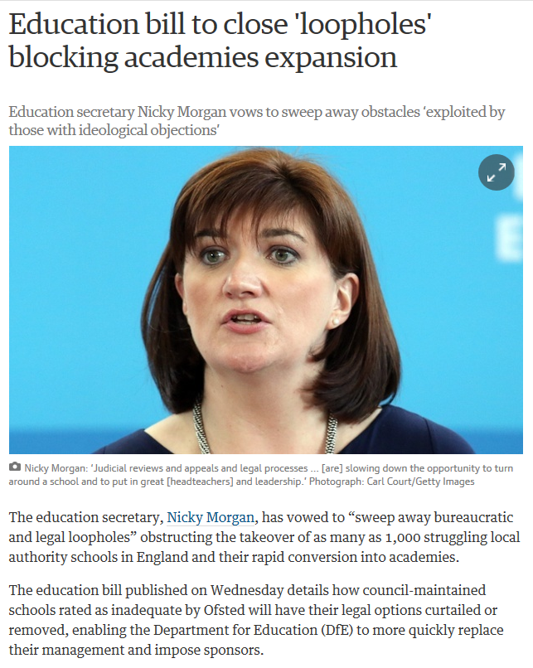
3 June 2015
Guardian, 3 June 2015 http://www.theguardian.com/education/2015/jun/03/education-bill-loopholes-academies-schools

Slide 16
The wider context beyond school
Formulation as “failing schools” deeply problematic
SES gaps are observed from age 3, long before children start school (EPPE, MCS, GUS)
Only 10%-15% of variation between pupils in England is associated with schools (e.g. Strand et al, 2015)
Within-school FSM gap is consistent regardless of school ‘quality’ (Strand, 2014d)
Schools succeeding against the odds laudable but not replicable/scaleable (see Wrigley, 2012)
Need to recognise context in evaluating performance & best practice (Burton, 2014)
If school structures are the issue, why not the charitable status of private schools?

Slide 17
References
Strand, S. (2010). Do some schools narrow the gap? Differential school effectiveness by ethnicity, gender, poverty and prior attainment. School Effectiveness and School Improvement, 21(3), 289-314. http://dx.doi.org/10.1080/09243451003732651
Strand, S. (2011). The limits of social class in explaining ethnic gaps in educational attainment. British Educational Research Journal, 37(2),197-229. http://dx.doi.org/10.1080/01411920903540664
Strand, S. (2014a). Ethnicity, gender, social class and achievement gaps at age 16: Intersectionality and ‘Getting it’ for the white working class. Research Papers in Education, 29, (2), 131-171. http://dx.doi.org/10.1080/02671522.2013.767370
Strand, S. (2014b). School effects and ethnic, gender and socio-economic gaps in educational achievement at ag e 11. Oxford Review of Education, 40, (2), 223-245. http://dx.doi.org/10.1080/03054985.2014.891980
Strand, S. (2014d). Even at best schools, kids on free school meals are performing worse than their peers. The Conversation. http://theconversation.com/even-at-best-schools-kids-on-free-school-meals-are-performing-worse-than-their-peers-32006
Strand, S., Malmberg, L. & Hall, J. (2015). English as an additional language and educational achievement in England: An analysis of the National Pupil Database. London: Educational Endowment Fund. http://educationendowmentfoundation.org.uk/uploads/pdf/EAL_and_educational_achievement2.pdf
Strand, S. (2015). Ethnicity, deprivation and educational achievement at age 16 in England: Trends over time. London: DFE.

Slide 18
END OF PRESENTATION

Slide 19
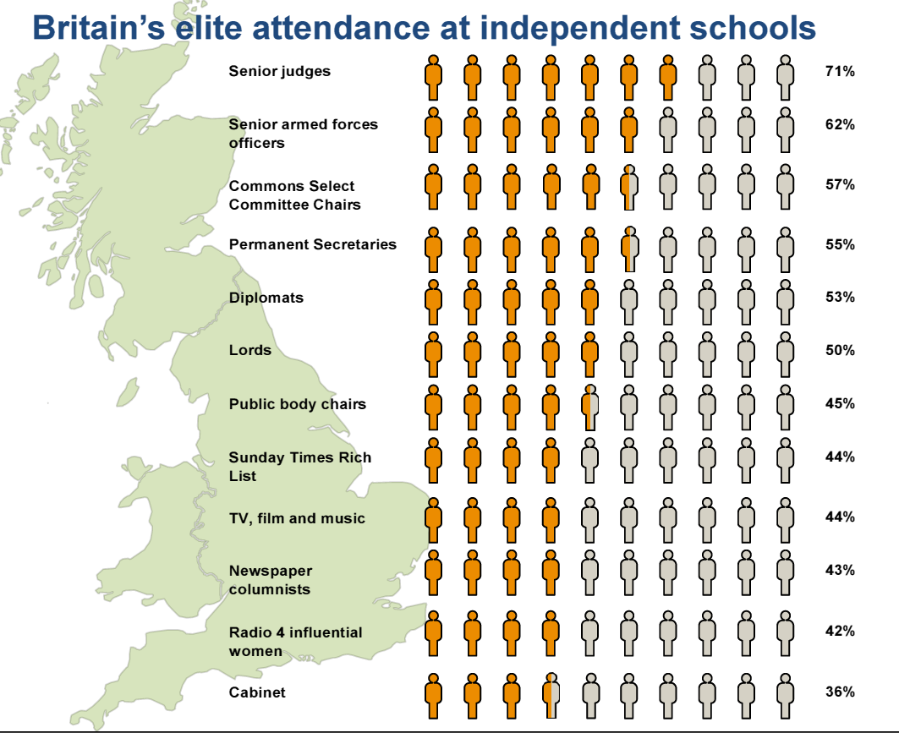
SMCPC (2014). Elitist Britain? London: Social Mobility and Child Poverty Commission.

Slide 20
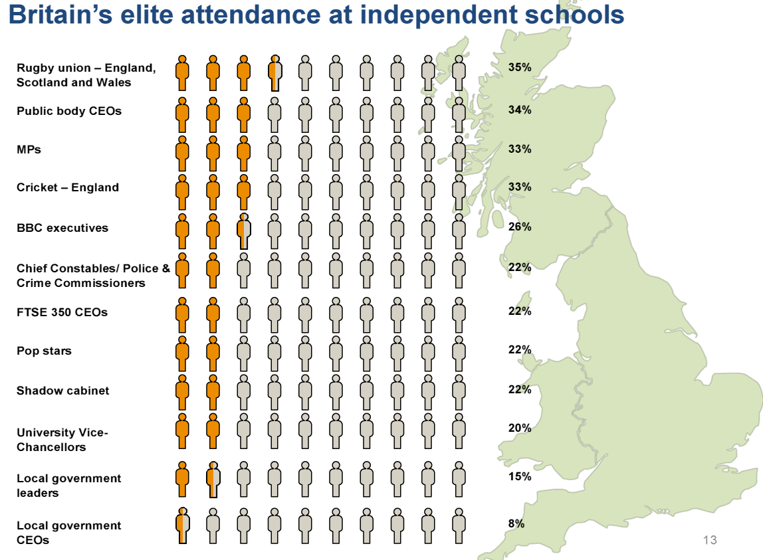
SMCPC (2014). Elitist Britain? London: Social Mobility and Child Poverty Commission.

Slide 21
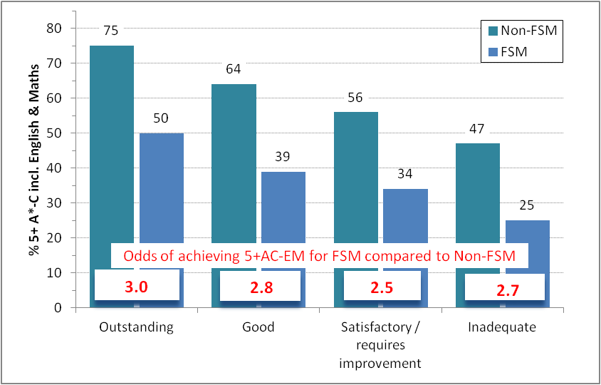
FSM gap by OFSTED rating
Source: Ofsted (2013). Unseen Children: Access and achievement 20 years on (P53).
Breakdown by school overall effectiveness judgement.

Slide 22
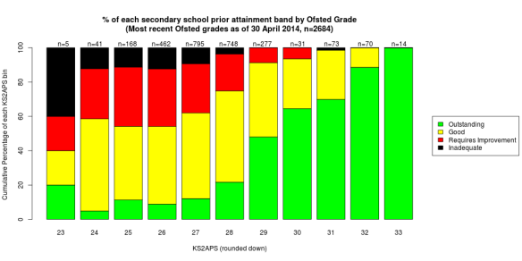
OFSTED grades strongly predicted by Intake
Note: KS2 points of the 2013 Y11 group & most recent OFSTED grade. KS2<26 (25% schools) = 9% outstanding; KS2>=29 (17% schools) 62% outstanding. Source: Trevor Burton (2014). https://jtbeducation.wordpress.com/2014/06/29/whats-the-easiest-way-to-a-secondary-ofsted-outstanding/

Slide 23
Foundation Stage (age 5): England 2013
Source: DFE SFR 47/2013

Slide 24
Key Stage 2 (age 11): England 2013
Source: DFE SFR 51/2013
Notes:
Wandsworth WBRI-FSM=65%, All=80%.

Slide 25
White British FSM lowest achieving
Source: Strand (2015)

Slide 26
The mechanism
Funding Pupil Premium Grant (PPG)
School’s decide on the intervention/s
http://educationendowmentfoundation.org.uk/toolkit/
OfSTED best practice WWC updated & PPG annual report
Accountable through performance tables / OfSTED / school website
Progress 8 to remove perverse incentives of 5EM
Publication of PPG gap, including 3-year rolling averages
Notes:
EYPP from April 2015 - £300 PPG 3/4 olds + 40% of 2 year-olds 15 hrs free nursery.

Slide 27
School success against the odds
DfE Extra Mile Project – visited 45 primary & 50 secondary schools that had raised attainment in some of the most deprived wards in England.
12 key practices identified:
High participatory/active learning in lessons
Value local people & culture, high levels of engagement
Broaden pupils horizons
Offer a more relevant curriculum
Build pupils’ language repertoire
Track pupil progress and intervene
Effective reward and sanctions schemes
Develop SEAL, etc.
See case studies:
http://webarchive.nationalarchives.gov.uk/search/?y=0&where=text&x=0&query=extra+mile+case+studies&x=0&y=0
Notes:
http://webarchive.nationalarchives.gov.uk/20130401151715/http://www.education.gov.uk/publications/eOrderingDownload/3882_The%20Extra%20Mile_web.pdf
https://www.gov.uk/government/publications/evaluation-of-the-extra-mile
http://webarchive.nationalarchives.gov.uk/20130401151715/http://www.education.gov.uk/publications/eOrderingDownload/3882_The%20Extra%20Mile_web.pdf

Slide 28
Regional trends GCSE 2002-2012
Source: Greaves et al. (2014). Lessons from London schools for attainment gaps. SMCPC, p12.

Slide 29
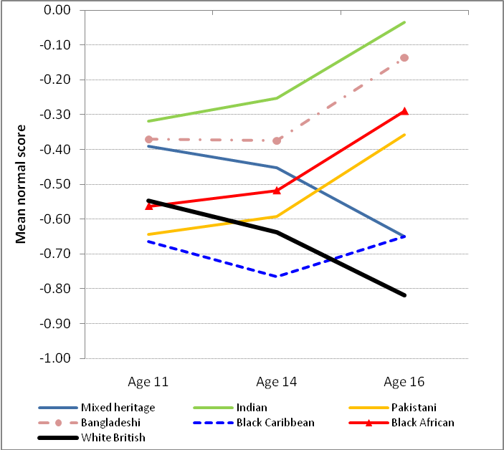
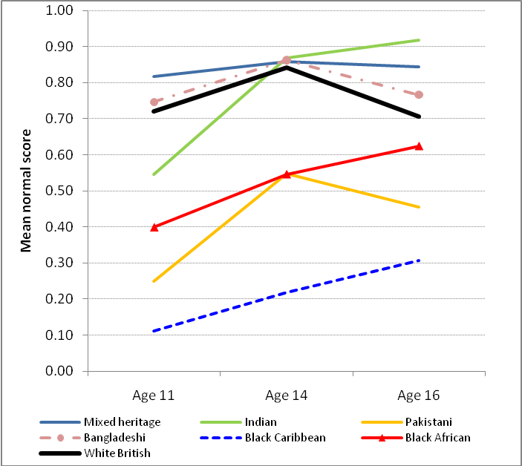
SES and progress age 11-16
Bottom SES Quintile | Top SES quintile
Low SES: White British decline, most BME improve particularly during KS4. High SES: gaps close but WBRI stay ahead.
Source: LSYPE (Strand, 2014a)

Slide 30
Implications for policy/practice
FSM gap does not result from a small no. ‘failing schools’
Floor targets, new academies/free schools overemphasised
‘Success against the odds’ exceptions & not easily replicable
Beyond the school gates
Home / parental factors, access to social & economic capital, poor health, peer groups, crime or neighbourhood deprivation
Cumulative impact of early Home Learning Environment (HLE) age 0-3 and ”Matthews’ effect”
Pupil premium positive influence by focussing schools attention on the FSM gap within their schools
Evaluate setting allocation / flexibility (e.g. Oakes, 2005)
Distribution of teachers across classrooms within schools (e.g. Clotfelter et al, 2005)
Working with parents (e.g. Parent Support Advisor pilot, 2009)
Early intervention (PPG weighting revised, new EYPP)
Notes:
PSA: £40M in 20 LAs 2006-2008, created a new professional 700+ new professionals (PSAs) created, three-quarters in primary schools.

Slide 31
Overall conclusions
Focus on low attainment of White British Working Class (WC) pupils is valid – but (i) also Black Caribbean WC, and (ii) Black Caribbean underachieve from middle/high SES homes.
Key resilience factors are often individual/family but schools can and do make a difference (though there are limits to what schools alone can achieve).
Pupil Premium Grant offers substantial redistributive funding, real chance to make a difference, need to focus on within-school resource deployment, parental involvement etc.
If government seriously wants to ‘break the cycle’ of social reproduction of inequality will need more radical action (remove the charitable status of private schools, do they help the most needy and vulnerable in society? (SMCPC, 2014, Elitist Britain).
Notes:
Do they “help the needy and the most vulnerable in society or those already the richest and the most privileged?” EVIDENCE= Average cost of boarding school 2013 £27,600 – average wage £26,500 (before tax). Bursaries often no cost to school and despite inflated claims of 33% (Daily Mail) ”only around 1% is in receipt of means tested scholarships covering 100% of fees” (SMCPC, 2014, Elitist Britain, p9) . No corporation tax, no tax on donations, 80% discount on rates.

