Slide 1
Effective use of the pupil premium to raise achievement
Lessons from research
Robbie Coleman (robbie.coleman@eefoundation.org.uk)
18th June 2015

Slide 2
Basic hypothesis
It will be easier to achieve what you want with the Pupil Premium if you have access to information about what has been tried elsewhere.

Slide 3
A starting point

Slide 4
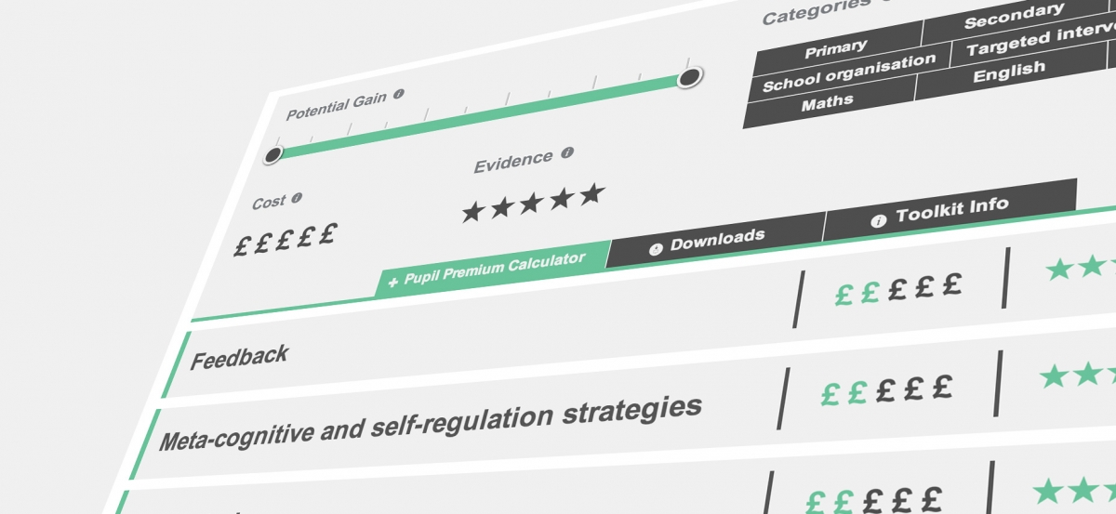
Three rules of thumb
1. Consider what you want to achieve, before turning to the evidence
2. Use the Toolkit as a starting point, then dig deeper
3. Understand the ‘active ingredients’ of implementation

Slide 5
One to one tuition

Slide 6
Building the evidence
Since 2011 we have funded 100 projects that aim to:
Build on existing evidence.
Generate significant new understanding of what works.
Be replicable and cost effective.

Slide 7
Projects by numbers
4,700 schools currently participating in projects
100 projects funded to date
600,000 pupils currently involved in EEF projects
£220m estimated spend over lifetime of the EEF
15 independent evaluation teams
£57m
funding awarded to date
12 funding rounds to date

Slide 8
Projects
Completed
Thinking, Doing, Talking Science
Mathematics Mastery
Switch-on Reading
To come
Texting parents
Lesson study
School start times

Slide 9
Get involved
Several ground-breaking EEF funded trials are looking for schools to work with, contact the organisations below as soon as possible if your school is interested.
The Good Behaviour Game – a classroom management programme: admin@mentoruk.org
Secondary schools across the country can sign up now for:
Embedding Formative Assessment, with SSAT and Dylan Wiliam: anna.ware@ssatuk.co.uk
Teensleep, with University of Oxford - Testing the impact of later start times and sleep education: christopher-james.harvey@ndcn.ox.ac.uk
Best Practice in Grouping Students - Best practice in setting and mixed ability teaching, with King‘s College: groupingstudents@kcl.ac.uk
Notes:
DIY guide is becoming interactive – October 2014.

