Slide 1
Raising the Achievement of EAL Pupils
Steve Cooke

Slide 2
Who are EAL Pupils?
R is a Syrian refugee. His father is Kurdish and his mother is Russian. He speaks Kurdish, Arabic and Russian.
L is of Bangladeshi heritage. She has arrived from Italy. She speaks Bengali and Italian.
D is from the Czech Republic. He is of Roma heritage. He speaks Czech and Tigranski.
M is an unaccompanied asylum seeker from Turkey. He is Kurdish and speaks Kurdish and Turkish.
H is from Pakistan. He attended primary school in England until Year 5 and then went to Pakistan where he did not attend school.

Slide 3
What do we know about them?
What experiences of formal education have they had?
Are they literate? If so, in what languages. At what level?
What are their life experiences?
What are their economic circumstances?
What are their family circumstances?
How do they construct their own sense of identity?
Do they want to be in England?

Slide 4
Might they be ..
More-resilient
learners
Less-resilient
learners

Slide 5
American Research
The teachers knew that there were differences between the two groups of students, but they were never observed adapting their instruction to accommodate the needs of non-resilient students. Furthermore, many teachers indicated during their interviews that teacher directed instruction was the most inappropriate instructional approach for non-resilient students, yet it was the predominant approach used in most classrooms.
CREDE Research Brief #7

Slide 6
American Research
The teachers reported that almost any instructional approach worked with resilient students, whereas they said that cooperative learning, a structured curriculum, and “hands-on” activities were the most effective strategies for non-resilient students. The teachers also reported that teacher-directed instruction was the most ineffective instructional approach for both resilient and non-resilient students.
CREDE Research Brief #7

Slide 7
The school has …
A whole school approach which is led by commitment and action by the SLT.
Systems for inducting and integrating new pupils into the school.
Appropriate assessment procedures including assessment of progress in EAL.
Robust tracking and target setting systems.
Strategies for parental engagement.

Slide 8
SLT can provide
Employment and effective deployment of specialist EAL teaching and learning expertise.
High, but realistic expectations of EAL pupils.
Explicit support for and expectation of a language across the curriculum approach to topic and subject learning.
Specific CPD which relates to EAL, and the inclusion of an EAL perspective in other CPD.
Support for collaborative / partnership teaching.
Planned time for teaching staff to liaise with each other and with specialist EAL staff.

Slide 9
Lessons which emphasise
The integration of language and content.
The explicit teaching and learning of academic language.
The effective use of visuals; concrete, symbolic and graphic which are effectively connected to the language used.
Maximising purposeful pupil – pupil dialogue and pupil –teacher dialogue.

Slide 10
And so …
Provide many opportunities for pupils to verbalise the visual and visualise the verbal.
Allow the modelling and development of academic language through micro-scaffolding (clarifying questioning, prompting, paraphrasing, reformulating, summarising etc.)
Exploit the use of talk / writing frames, substitution tables etc.

Slide 11
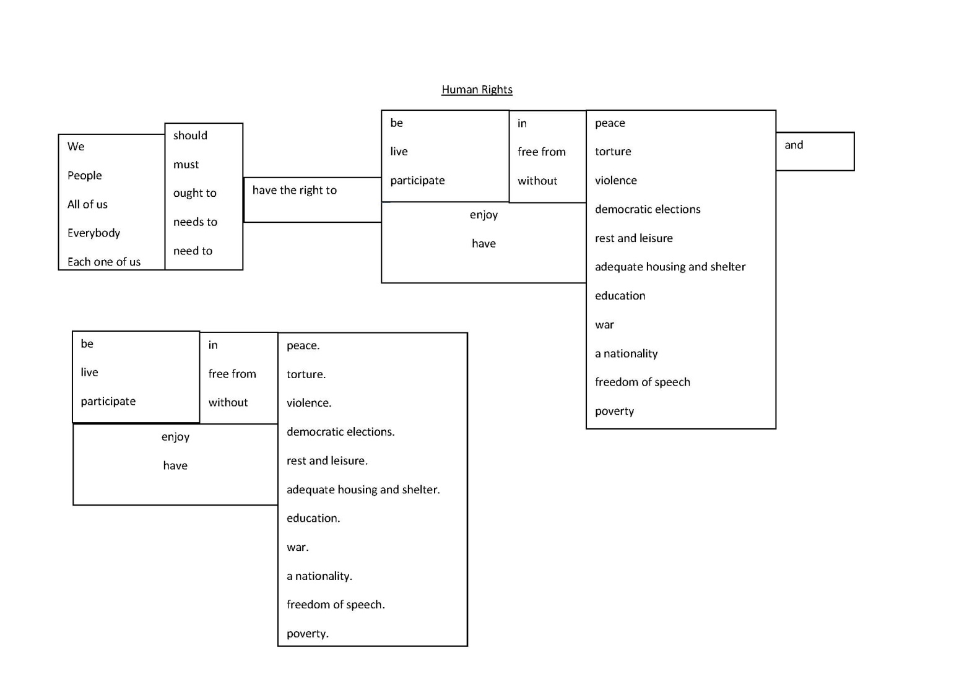
Substitution table
See Document X

Slide 12
Talk / Writing Frame
Human rights
I think that three of the human rights are particularly ……………………… .
Firstly, I think that the right to ……………………………………………………………………………………
is extremely ………………………………………………… because …………………..................................……………………………………… .
Secondly, the right to ………………………………………………………
is also enormously …………………… . This is because ……………
…………………………………………………………………………………………… .
Se Document X for full text

Slide 13
Classroom activities
Information gap activities.
Good quality collaborative learning activities which act as a catalyst for purposeful reading and talk.
Directed activities related to text (DARTs).
Extensive use and exploitation of ‘Key Visuals’.
Activities which enable pupils to build schemata of the content and structure of different text types.
Talk for writing activities.
A variety of supports at word, sentence and text level for developing writing.

Slide 14
The way forward.
Dedicated funding which targets regions and schools facing the greatest challenges.
Recognition of EAL as a specific area of expertise .
Accredited training which develops this specialist expertise.
Initial teacher training which integrates EAL perspectives rather than including it as an ‘add on’.

Slide 15
To what extent …
Does classroom organisation allow for peer interaction and for students to explore ideas and concepts together?
Are there opportunities for students to support each other’s learning and learn from each other?
Is the use of first languages encouraged and supported?

Slide 16
To what extent …
Are minority students integrated socially and functionally into the classroom?
Are students offered choices within topics about activities and ways of working?
Are ground rules and criteria for success made explicit to students?
Do assessment procedures identify and acknowledge students’ individual progress?

Slide 17
To what extent …
Is content learning integrated with language learning and development?
Is academic language being explicitly explored, taught and developed?
Is lesson content relevant, stimulating, cognitively demanding and well contextualised?
Is there a high level of comprehensible input and are there opportunities to use language purposefully?

Slide 18
To what extent …
Are students’ cultural and linguistic identities validated?
Is students’ existing knowledge, including cultural and linguistic experience acknowledged and activated?
Is English as an Additional Language teaching contextualised and relevant?

Slide 19
Reference
Padrón, Y., Waxman, H. , Brown, A. and Powers, R. (2000) Improving Classroom Instruction and Student Learning for Resilient and Non-resilient English Language Learners. Research Brief 7, Center for Research on Education, Diversity & Excellence, University of California, Santa Cruz, Ca. USA.

