Slide 1

Effective use of the Pupil Premium to close the attainment gap
James Richardson
Senior Analyst, Education Endowment Foundation
27th June 2014 james.richardson@eefoundation.org.uk www.educationendowmentfoundation.org.uk
@EducEndowFoundn

Slide 2




Who we are
The Education Endowment Foundation is an independent grant-making charity dedicated to breaking the link between family income and educational achievement.
The EEF was founded in 2011 by lead charity The Sutton Trust, in partnership with Impetus Trust (now part of Impetus–The Private Equity Foundation)...
… with a £125m grant from the Department for Education
Together, the EEF and Sutton Trust are the government-designated ‘What Works’ centre for improving education outcomes for school-aged children.

Slide 3
The problem…
1.4 million: the number of children aged 4-15 eligible for free school meals (FSM) in this country
22 months: the age at which the attainment gap between children from rich and poor backgrounds is detectable
75,000: the approximate number of pupils who do not reach Level 4 in English aged 11 every year
63%: the proportion of FSM children who did not achieve 5 good GCSEs, incl. English and Maths, last year.

Slide 4
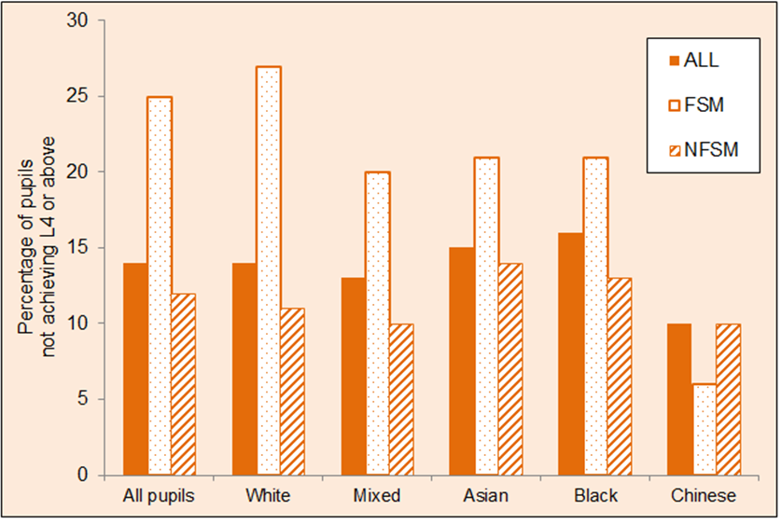
The Reading Gap at transition

Slide 5
The EEF approach
Summarise the existing evidence
Make grants
Evaluate projects
Share and promote the use of evidence

Slide 6
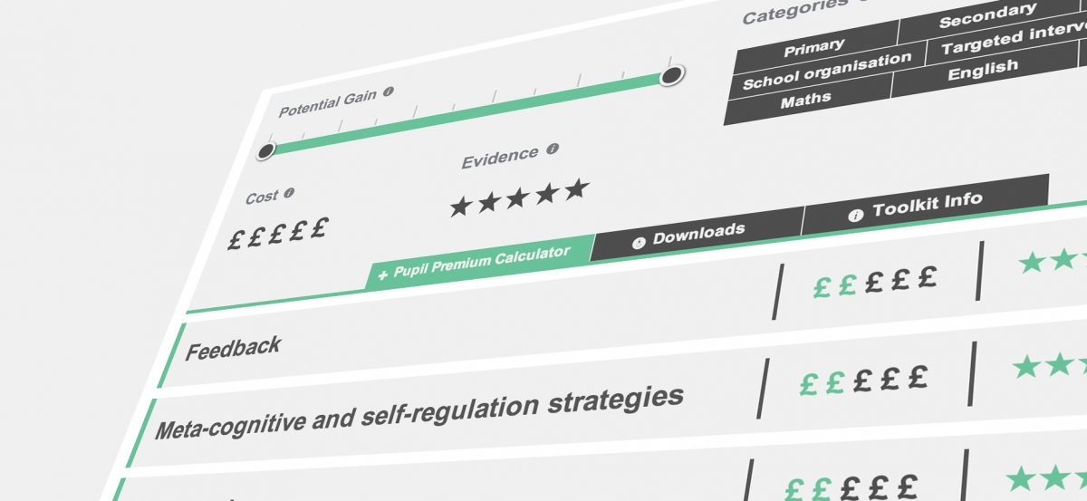
Teaching and Learning Toolkit
The Toolkit is an accessible, teacher-friendly summary of educational research. ‘Which?’ for education
Practice focused: tries to give schools the information they need to make informed decisions and narrow the gap.
Based on meta-analyses conducted by Durham University.
Notes:
Not just what works, but what works best and what works cheapest.

Slide 7
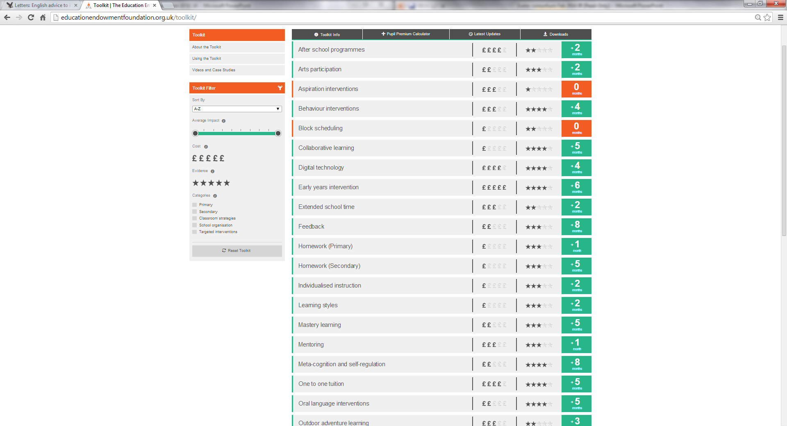
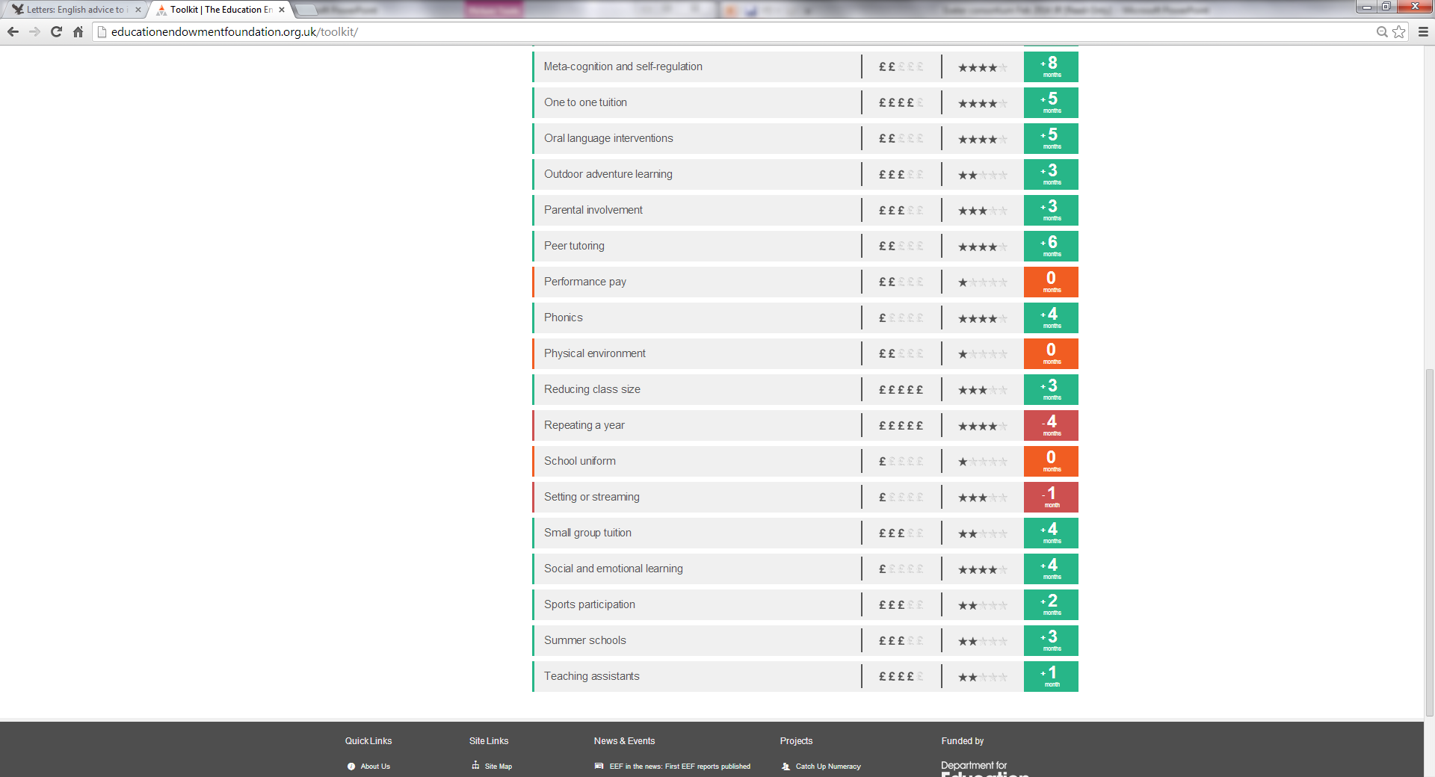
Teaching and Learning Toolkit

Slide 8
Overview of value for money
Promising
10
May be worth it
Feedback
Meta-cognitive
Independent learning
Peer tutoring
Pre-school
Homework
1-1 tutoring
Effect Size (months gain)
Summer schools
Outdoor learning
ICT
Phonics
Parental involvement
After school
Smaller classes
Individualised learning
Sports
Requires careful consideration
Learning styles
Teaching assistants
Arts
0
Ability grouping
Performance pay
£0
£1000
Cost per pupil

Slide 9
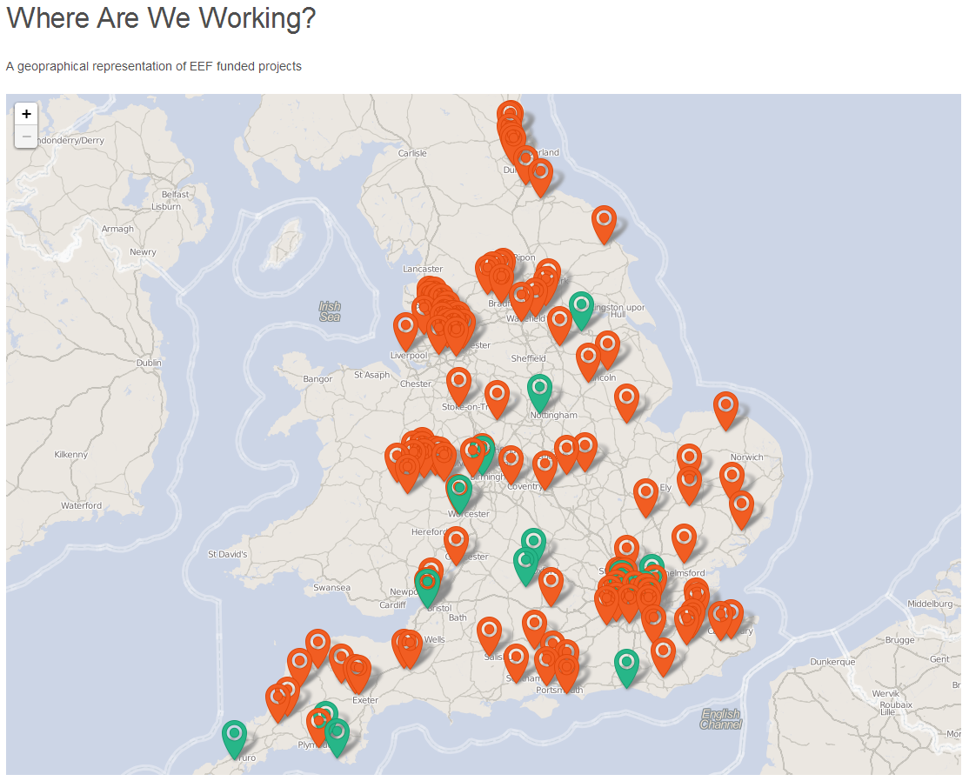
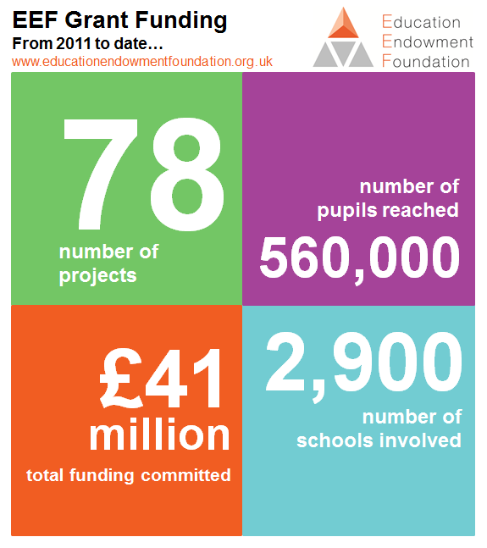
EEF-funded projects: snapshot

Slide 10
Focusing on transition
In 2012, the EEF funded 24 transition studies with a £10m dedicated grant from the DfE:
We asked schools to bring the best of their literacy transition work for evaluation and testing
Funded programmes included commercial products, school-grown solutions, in and out of school activities
1 in 10 secondary schools
17,000 pupils involved

Slide 11
Switch On Reading
One to one programme delivered by teaching assistants over a 10 week period
Delivered to Year 7 students who did not achieve Level 4 at KS2
Group | Number of pupils | Effect size* | Estimated months’ progress
All pupils | 308 | +0.24 | +3
Lower attainers | 156 | +0.39 | +5
FSM-eligible | 98 | +0.36 | +4
SEN reported | 225 | +0.31 | +4

Slide 12


Reading comprehension approaches appear to be more effective than phonics or oral language approaches for older, low attaining readers.
The best interventions evaluated so far demonstrate +4 months of progress with an attainment gap that is 16 months wide.
Children who have not succeeded using phonics previously may benefit from approaches which place a greater emphasis on meaning and context.
Lessons from transition studies
One to one and small group tuition is widely used.
What is being taught, by whom and with what resources?
Diagnostic assessment is critical.
Comprehension,
word recognition,
vocabulary knowledge require different interventions
Summer schools can improve reading ability but their effectiveness will be limited by the quality of teaching which takes place.

Slide 13

“The three approaches that showed the most benefit for a relatively low investment are what the report calls the ‘proven classroom approaches’ of providing effective feedback on pupils’ performance, encouraging pupils to think about their own learning strategies, and getting pupils to learn from each other.”
Effective classroom strategies for closing the gap in educational achievement for children and young people from poor backgrounds, including white working class boys
Notes:
Has anyone read this? Doubt it. Like many things, gets done and put on a shelf. Needs translating and actively disseminating.

Slide 14
The quality of teaching matters most – e.g. ‘phonics’ not enough, pedagogy is crucial.
Changing the curriculum or the mode of delivery (ICT) does not produce large gains
Lessons from C4EO Review
Developing evidence-based teaching methods makes the biggest difference. e.g. co-operative learning, thinking and learning skills, formative assessment
Applying new strategies is difficult. It requires extensive professional development

Slide 15


Emerging synthesis of evidence
Improving classroom teaching in specific techniques is the most promising strategy
The professional development required is intensive, structured and specific. Its impact should be continually evaluated.
Specific evidence-based interventions can have merit but must be implemented effectively
Small group and 1:1 tuition can have an impact when it involves well-trained staff in specific techniques and interventions.
www.educationendowmentfoundation.org.uk

