Slide 1
Educational Underachievement of White Working Class Children
National Conference
Institute of Education, University of London
27th June 2014

Slide 2
School strategies to raise the achievement of White Working Class pupils
Headteachers Panel:
Mark Adams, Headteacher, St Nicholas Priory CE VA Junior School, Norfolk LA
Paul Robinson, Headteacher, Woodmansterne Primary School, Lambeth LA
Angela Ward, Headteacher, Perry Hall School, Bromley LA
David Boyle, Principal, Dunraven School, Lambeth LA
Kenny Frederick, former Headteacher, George Green’s School, Tower Hamlets LA
Chair: Jayne Mitchell, Headteacher of St Andrews CE Primary School and Chair of Lambeth Headteachers Council

Slide 3
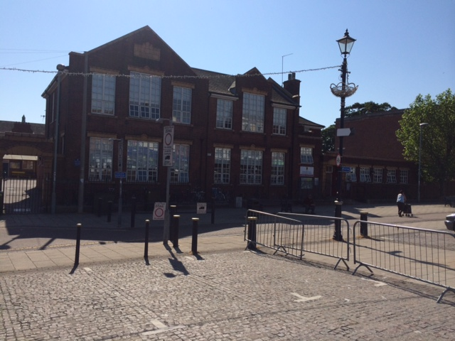

Slide 4
Educational Underachievement of White Working Class Children
School strategies to raise the achievement of White Working Class pupils
Mark Adams
St Nicholas Priory CE VA Junior School
Great Yarmouth
Norfolk

Slide 5
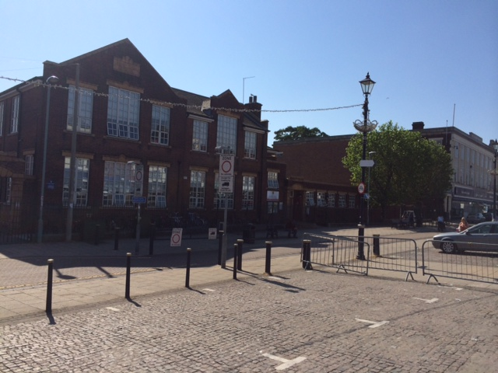

Slide 6
Brief introduction about the school:
384 children
Junior school from 2008, previously middle school, will become a primary school from 2015
Town centre location, no grass, the ancient town wall runs through the school site
Statistically the school takes pupils from one of the most deprived wards in the county and indeed the country
56% FSM
£240k pupil premium 14/15
28% EAL, 11 languages, a majority have arrived in the country in the last 5 years
Ofsted
2011 special measures
2012 requires improvement
2014 good

Slide 7
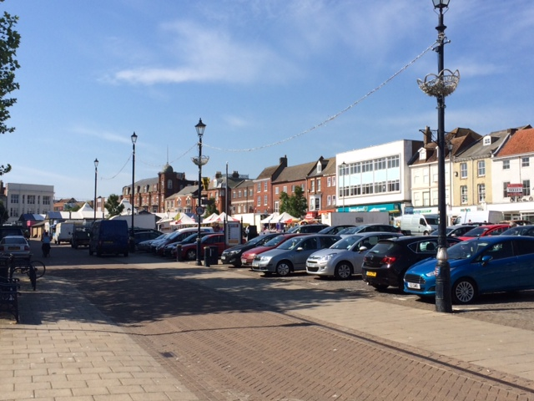

Slide 8
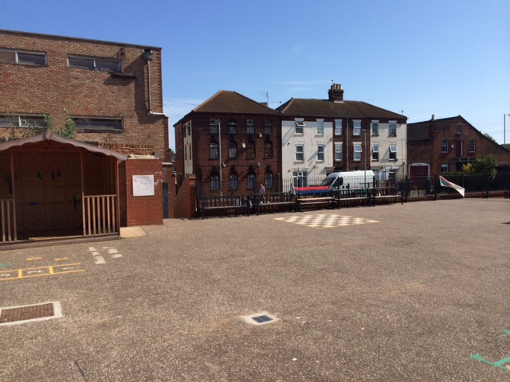

Slide 9
Barriers to learning:
Aspirations
Expectations
Experiences
Provision
Attitudes

Slide 10
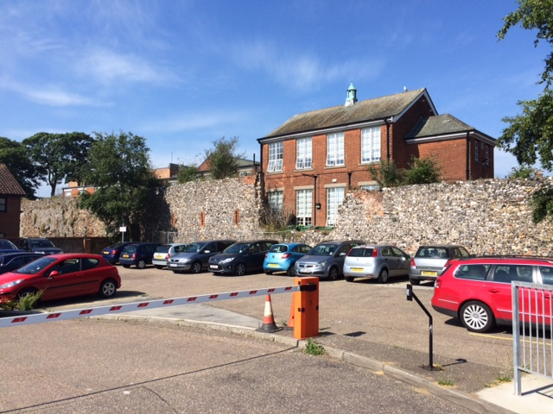

Slide 11
Strategies to overcome these barriers
Creative use of pupil premium including for social welfare
Developing relationships with parents
Rigorous monitoring of individual pupils through pupil progress meetings
Changing the culture
Shaping aspirations – What could I become?

Slide 12
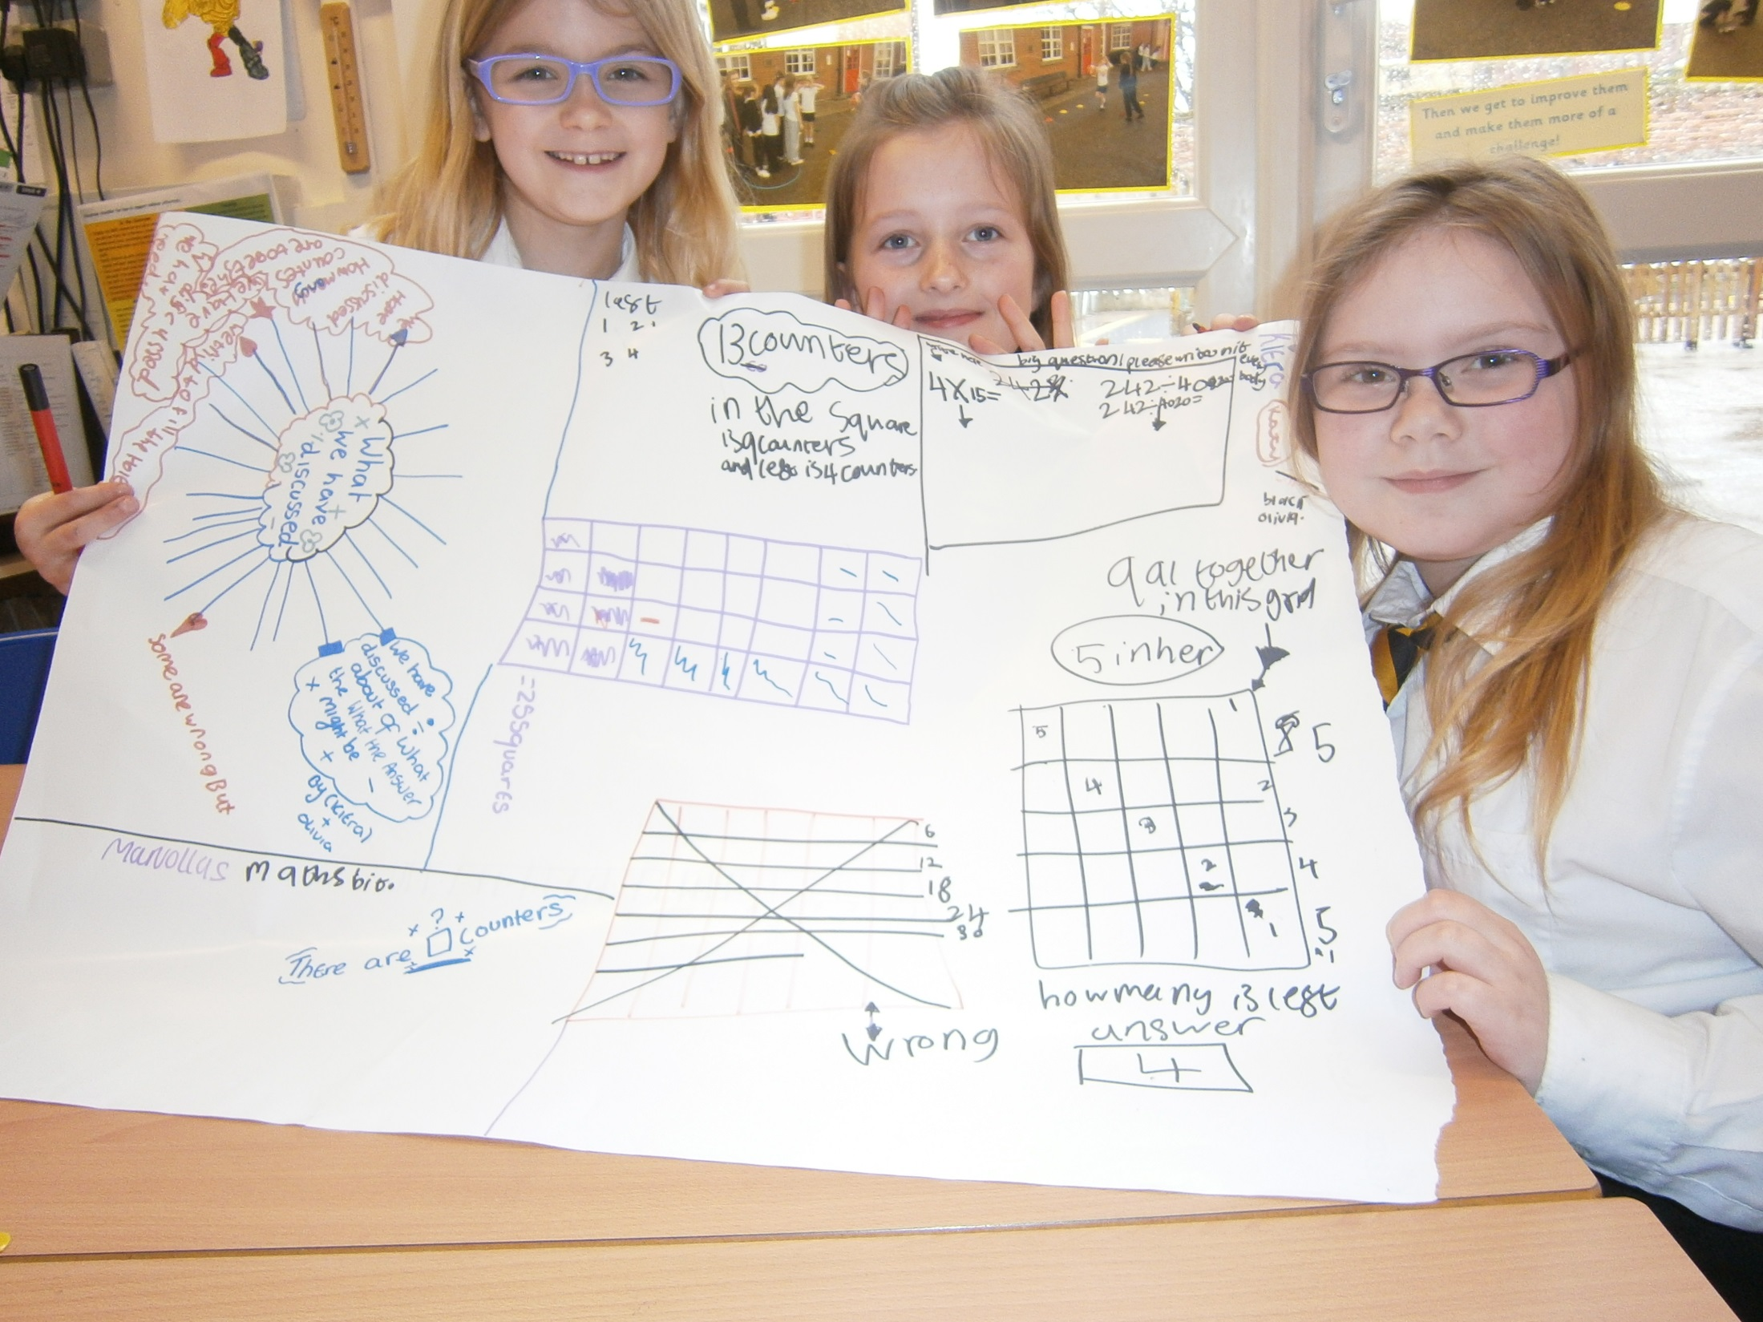

Slide 13
Creative use of pupil premium
Free breakfast
Dinner for £1 (free from Sept)
Free topic trip every term
Topic related visitor to each class each term
Tablet computer for home and school use for every year 4 & 5 pupil
80 Kindles to support reading across the school
Books for the library, classrooms and to give as gifts to families for attendance at Reading Café and completing home learning projects
NCFC Double Club
Extra- curricular clubs (33 clubs involving 570 pupil places)

Slide 14
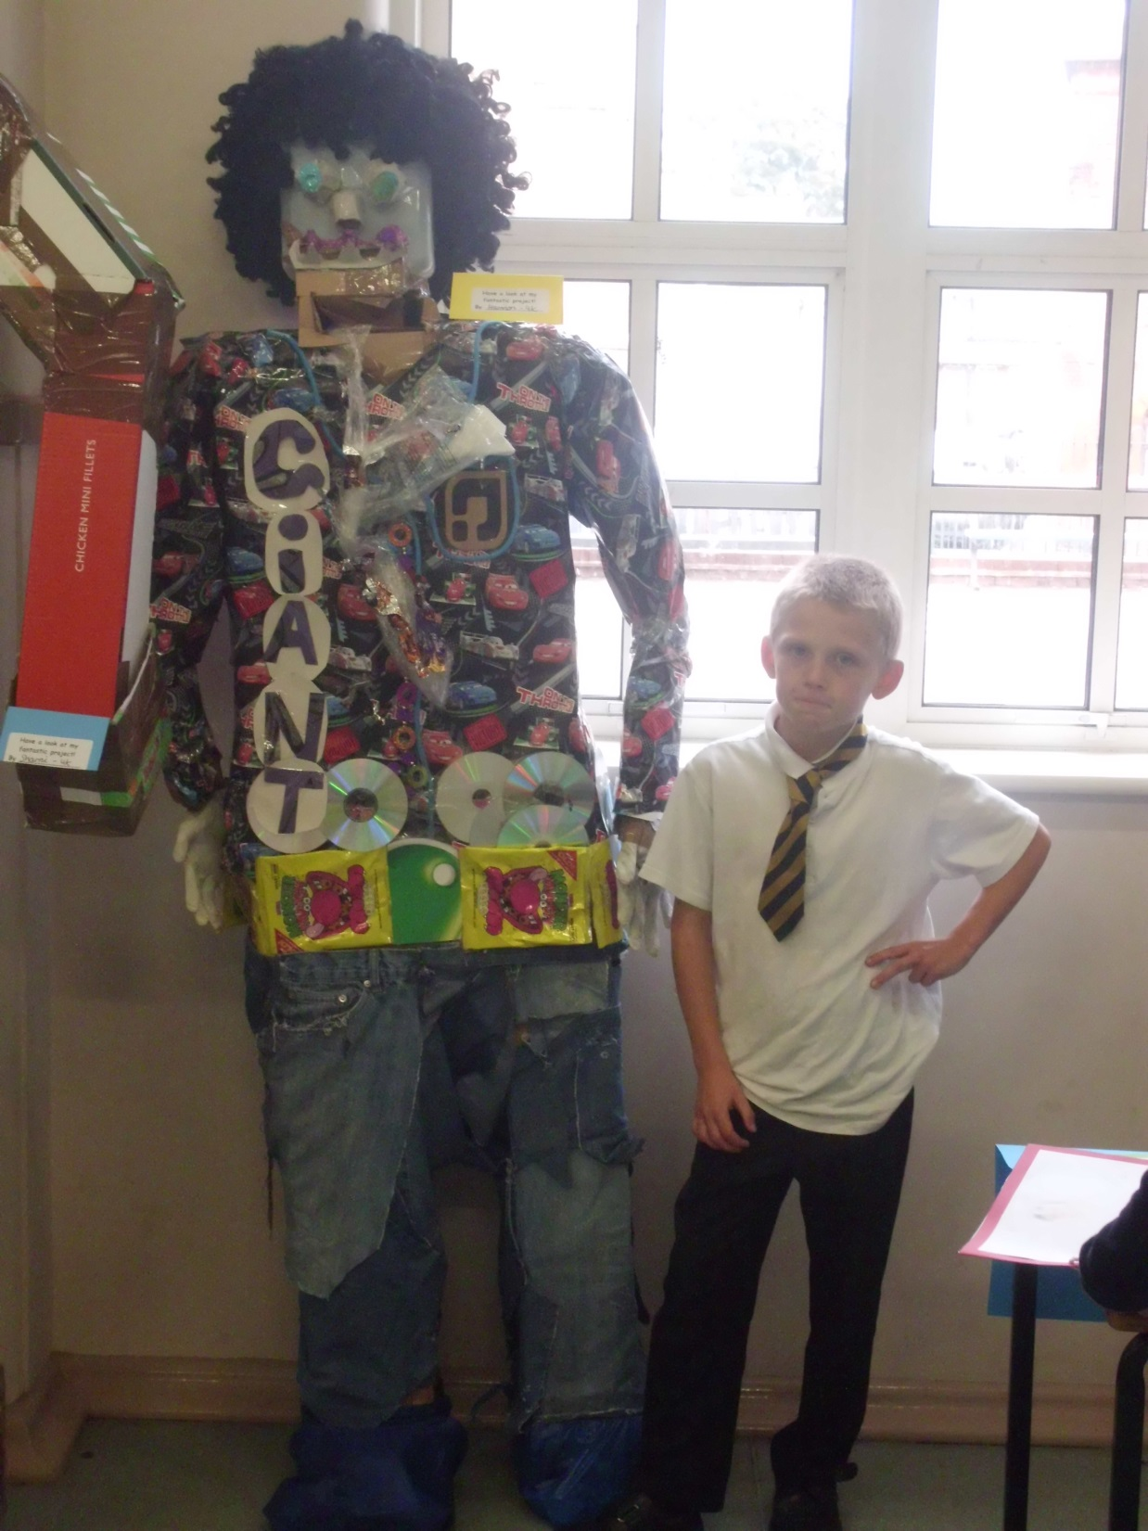

Slide 15
Developing relationships with parents and improving engagement
Home learning projects
Drop-in every morning
Maths Café and maths evenings
Reading Café
Parents Evenings
Not fining them!

Slide 16
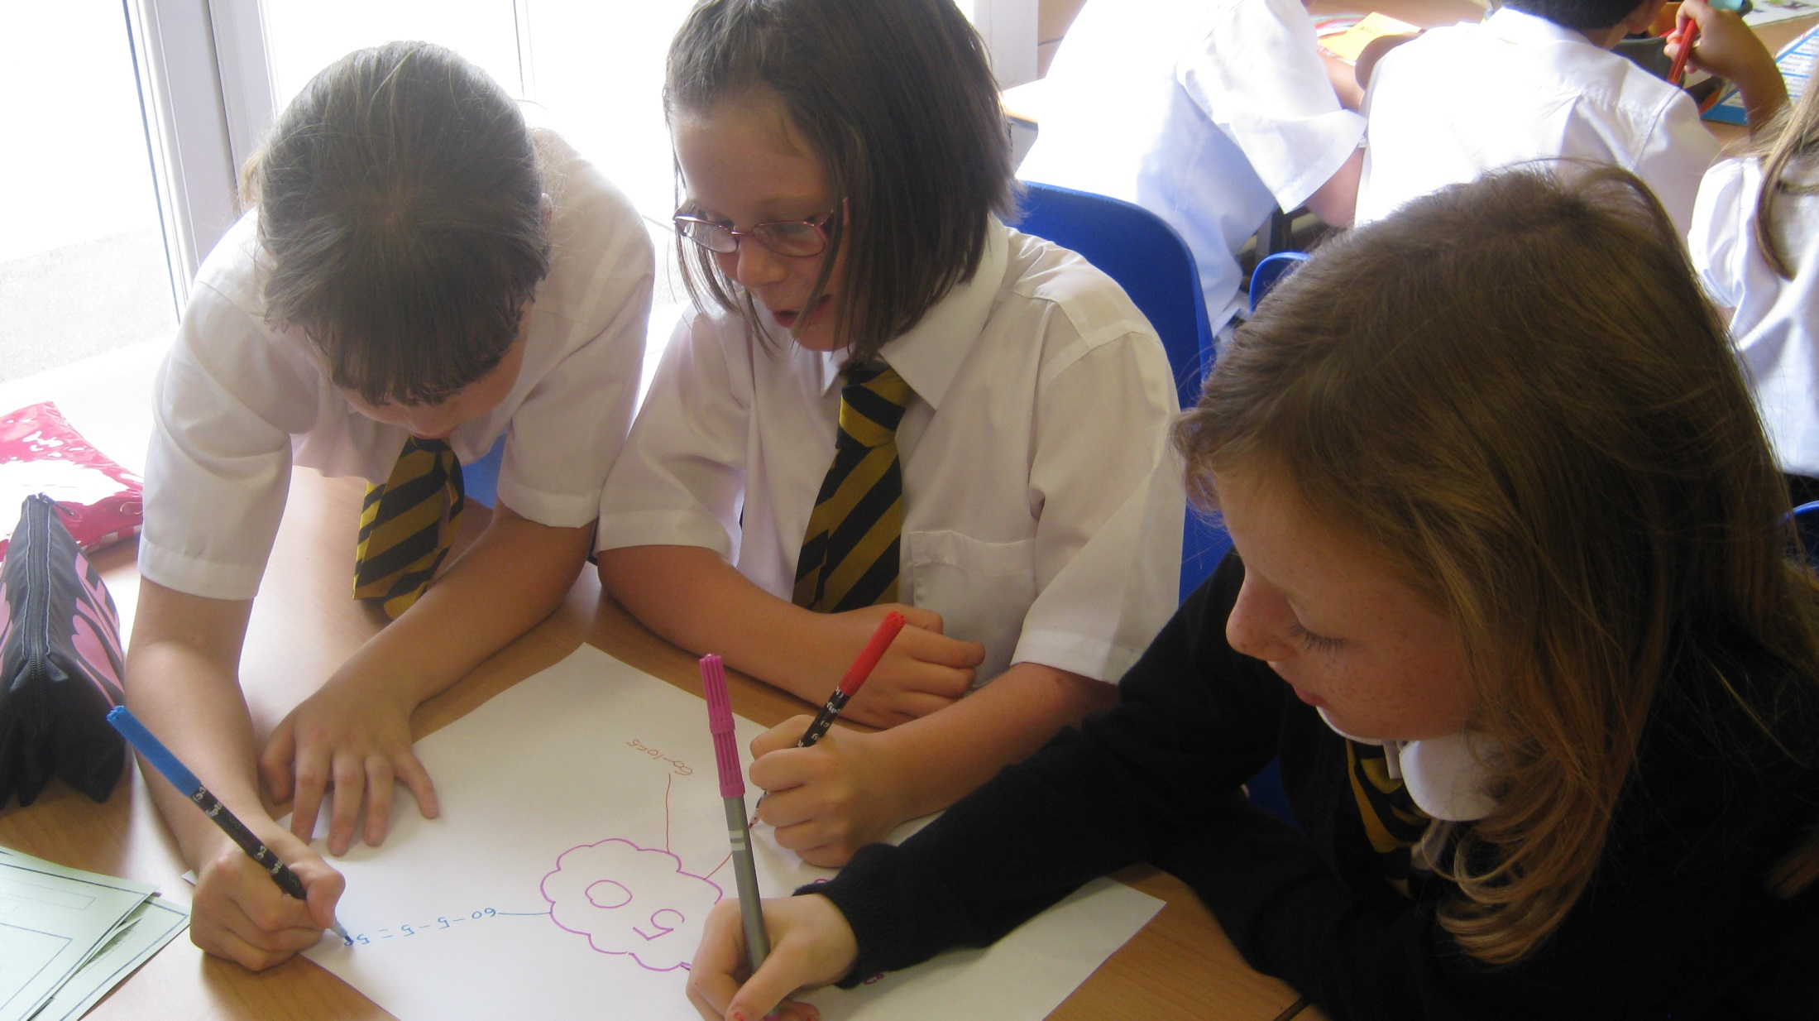

Slide 17
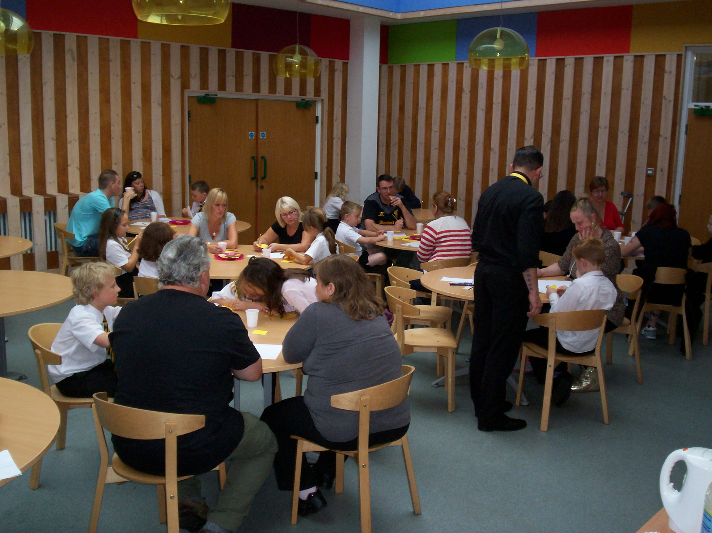

Slide 18
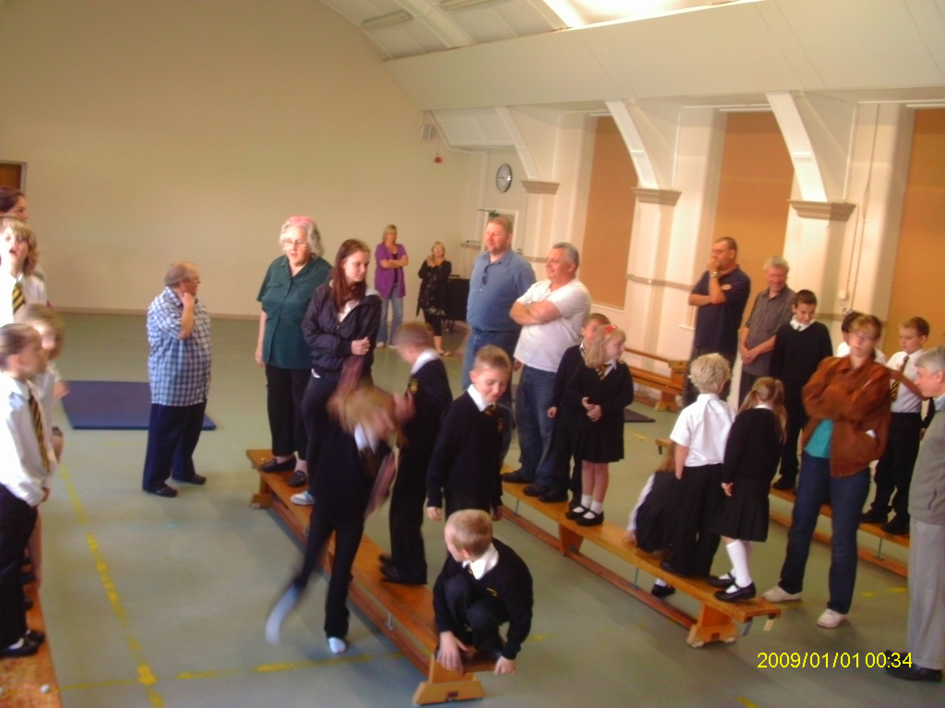

Slide 19
Teach, evaluate & intervene
Use of data
Pupil progress meetings
Specialist TAs and teachers
RWI
Accelerated Reader
High quality teachers providing targeted intervention

Slide 20
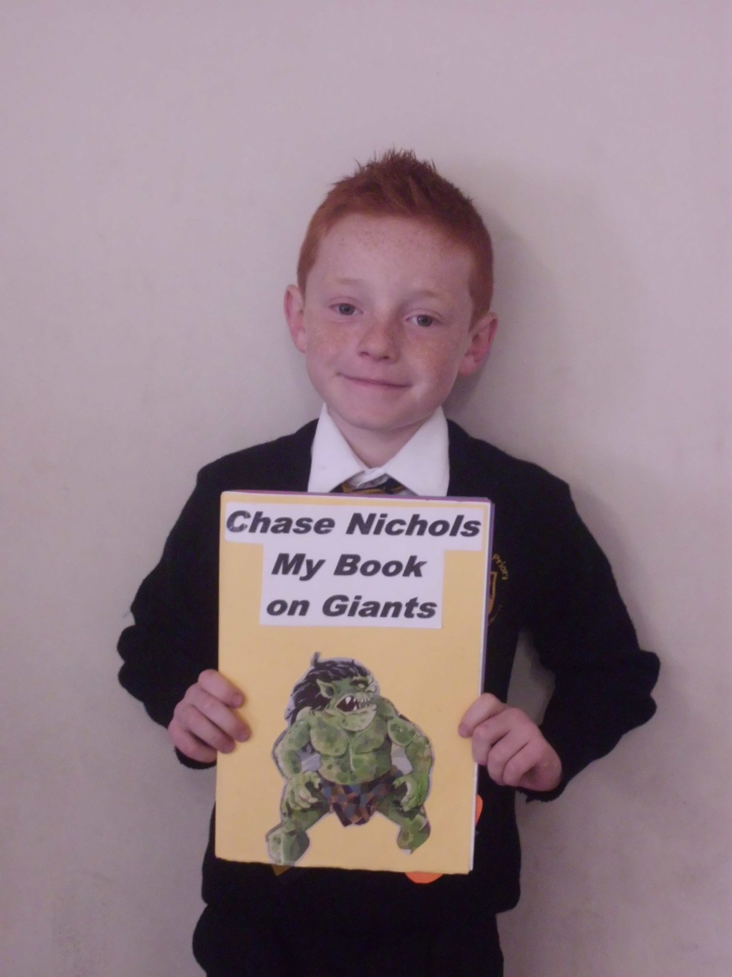

Slide 21
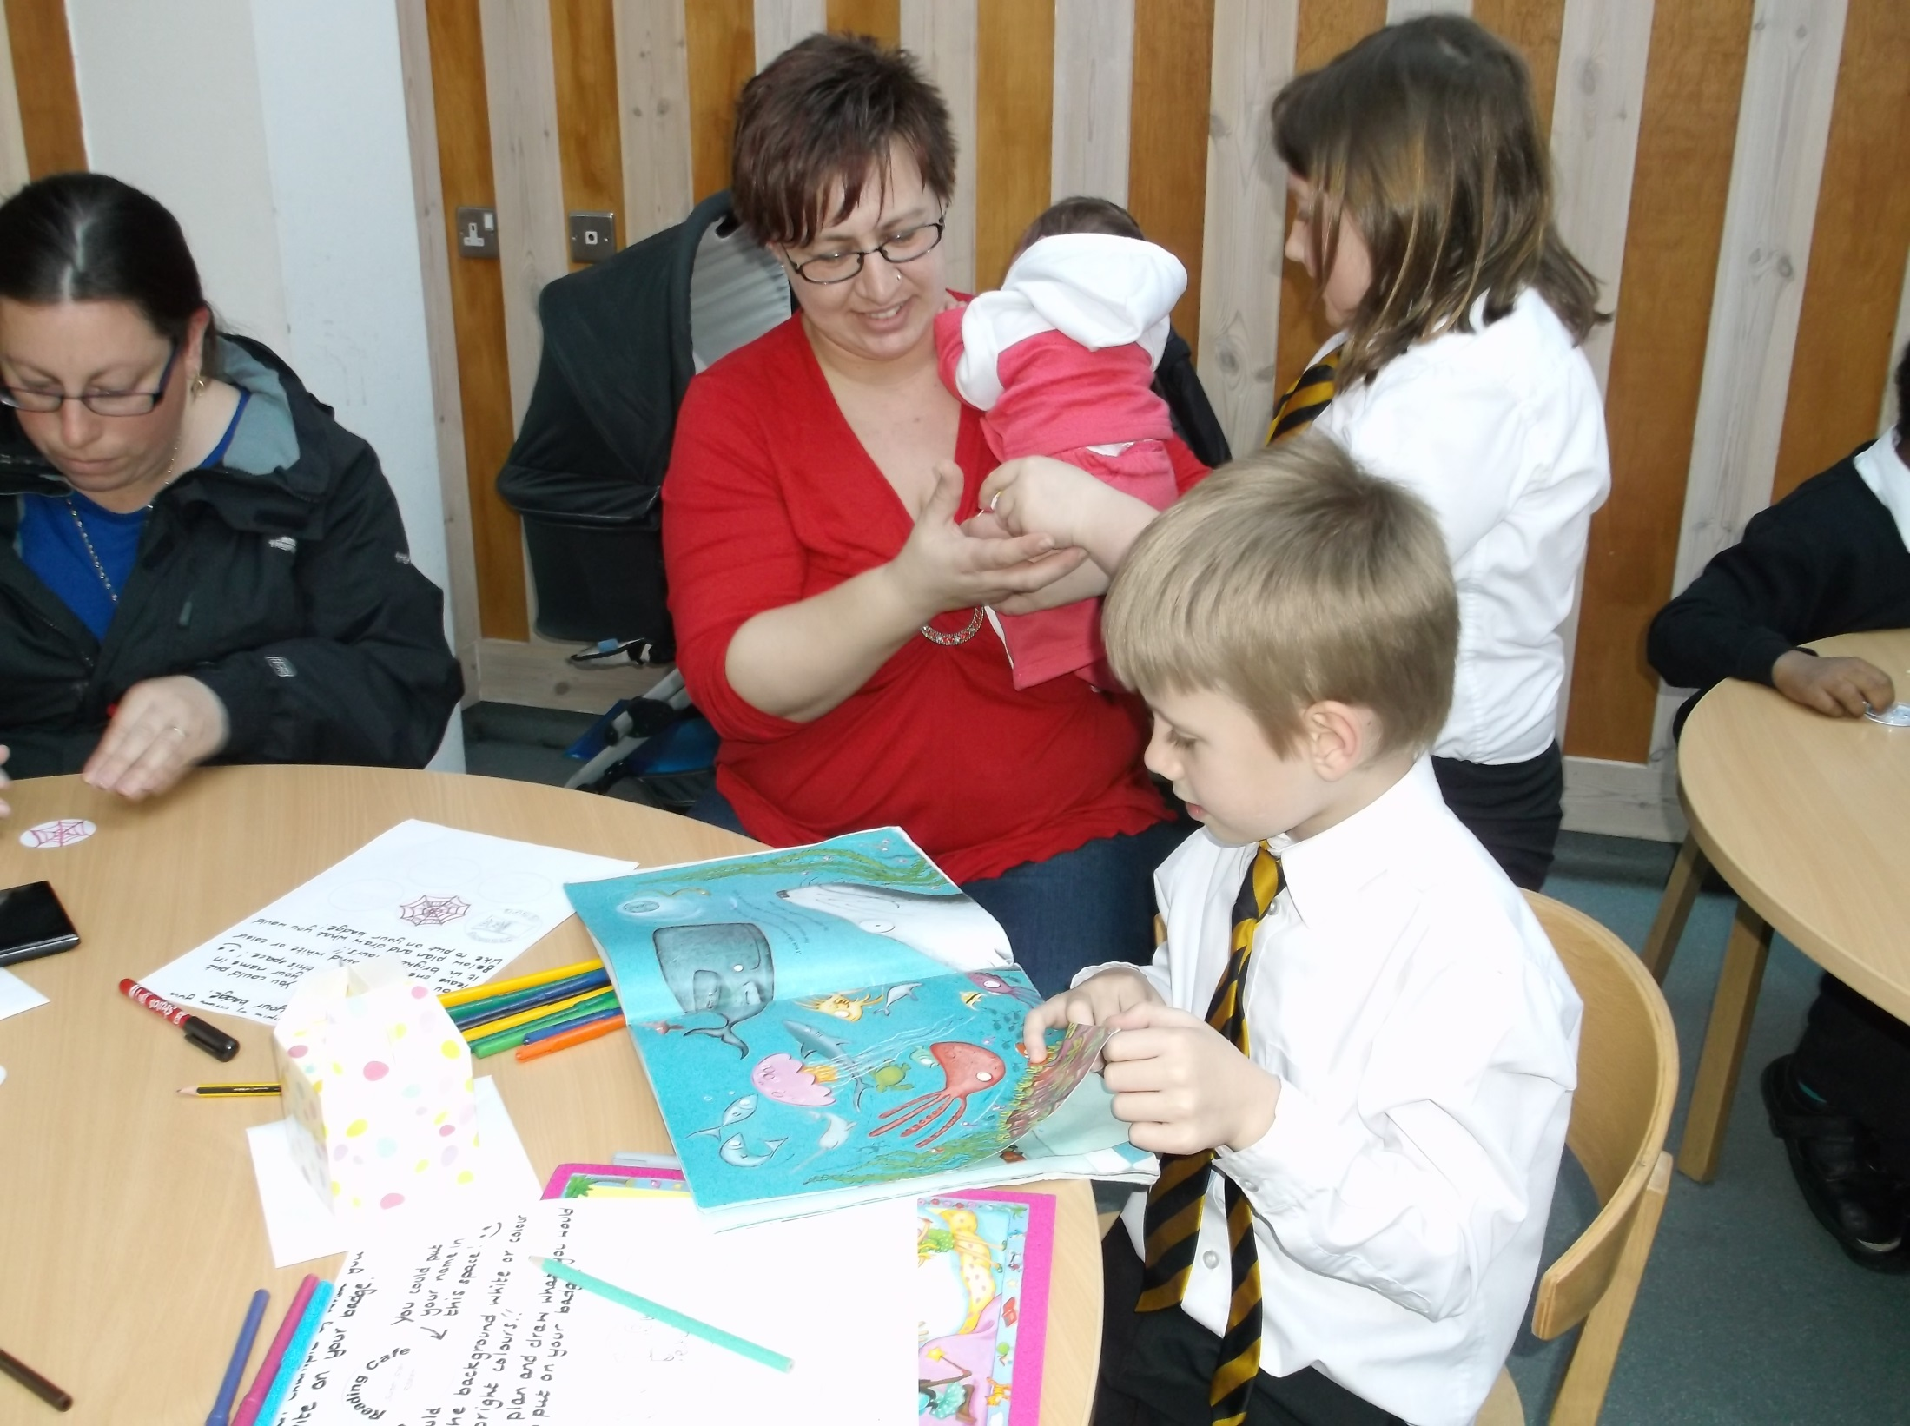

Slide 22
Changing the culture
Learning contracts
Learning ambassadors
½ term projects
Looking outside Norfolk and not making excuses
Lambeth
Wroxham Primary, Hertfordshire
Hartsholme Primary Academy, Lincoln

Slide 23
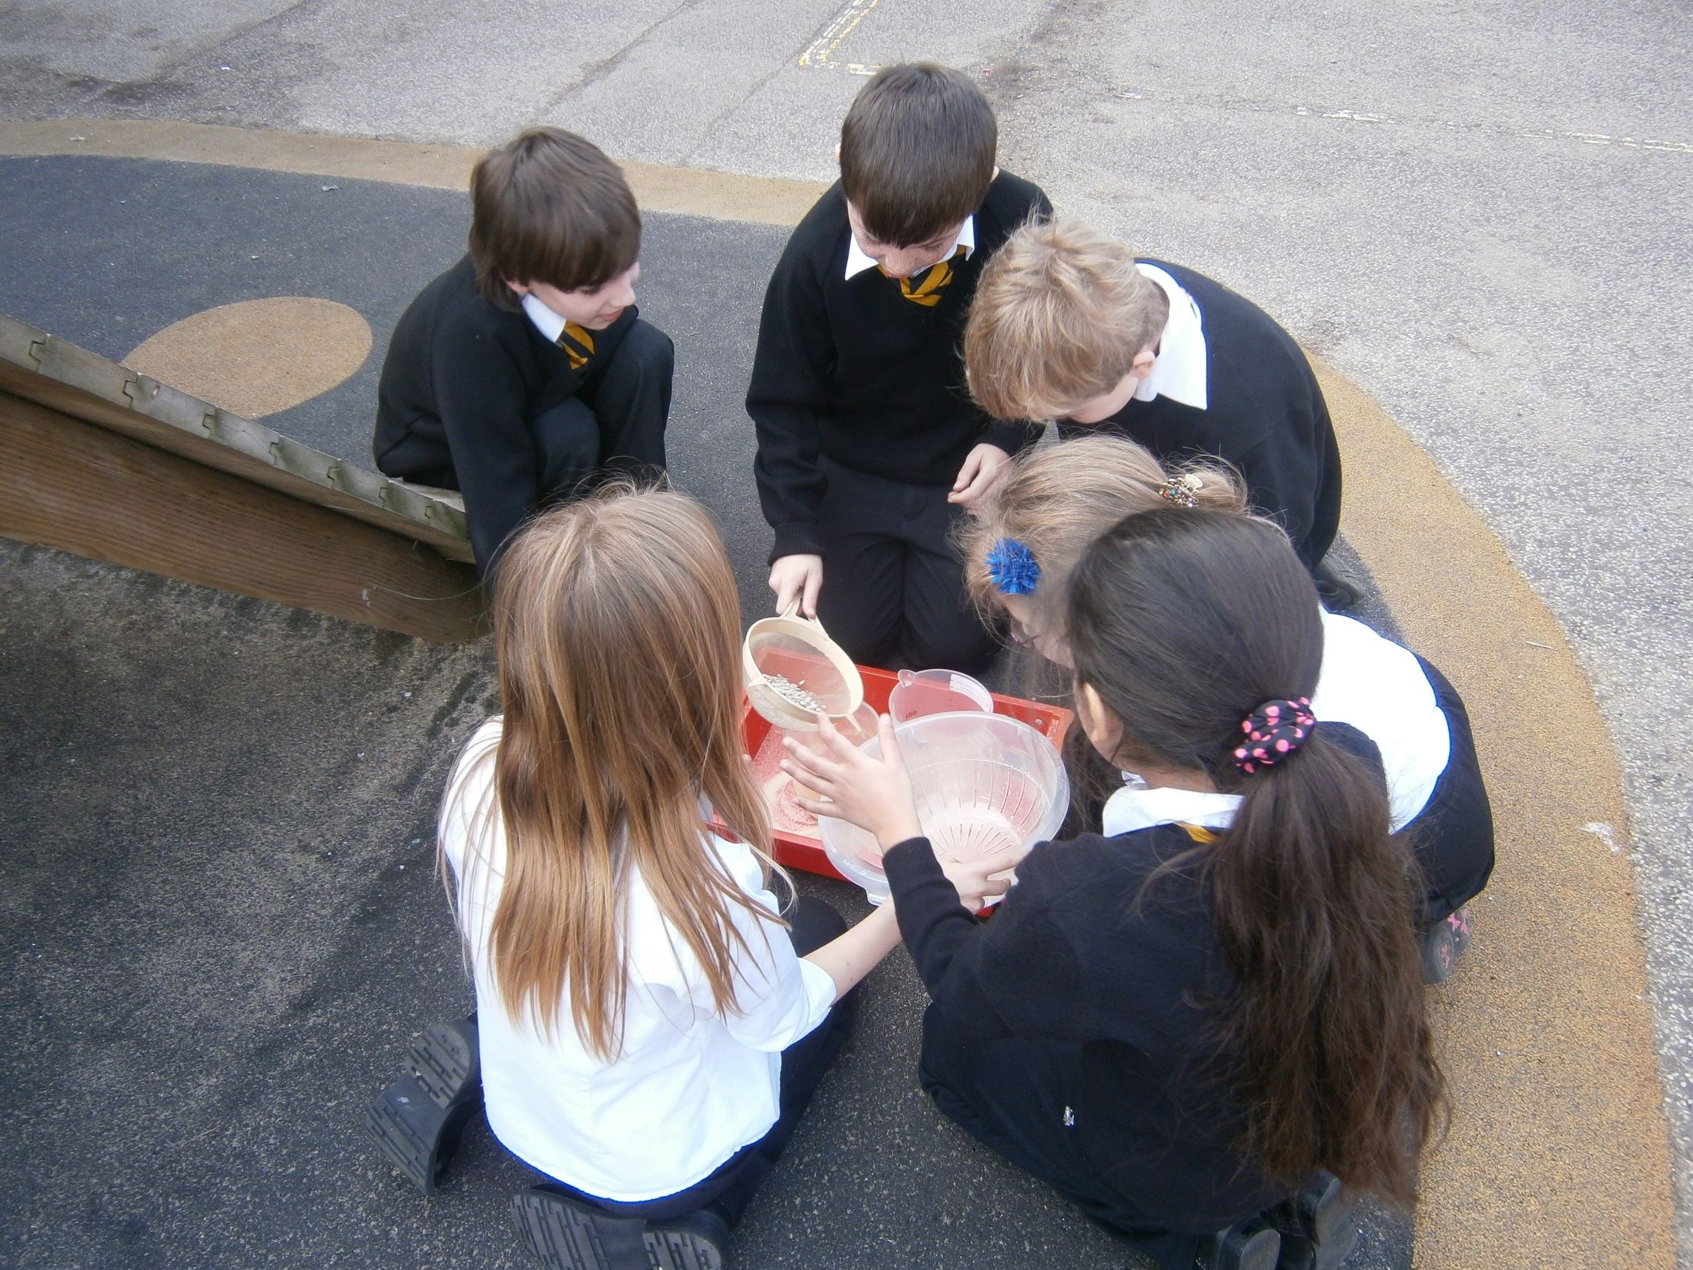

Slide 24
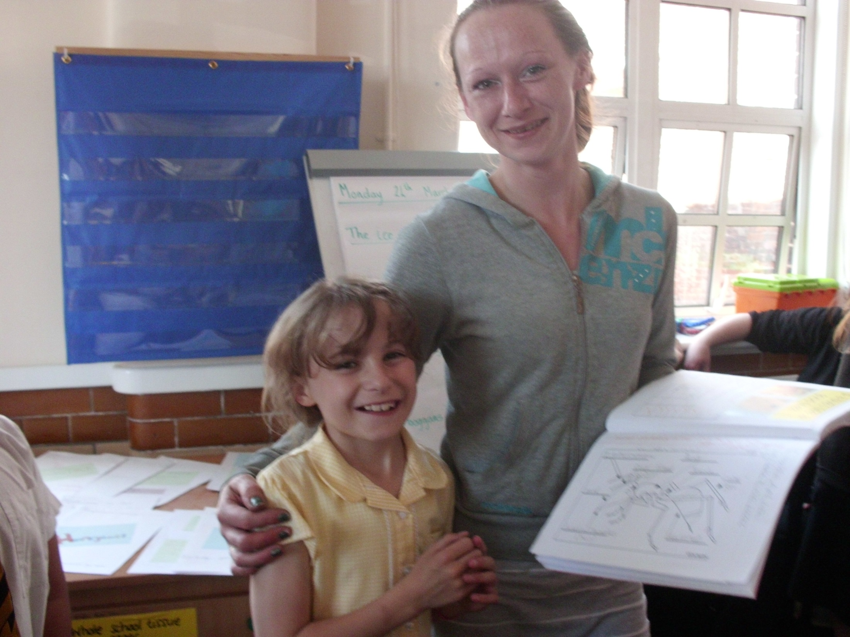

Slide 25
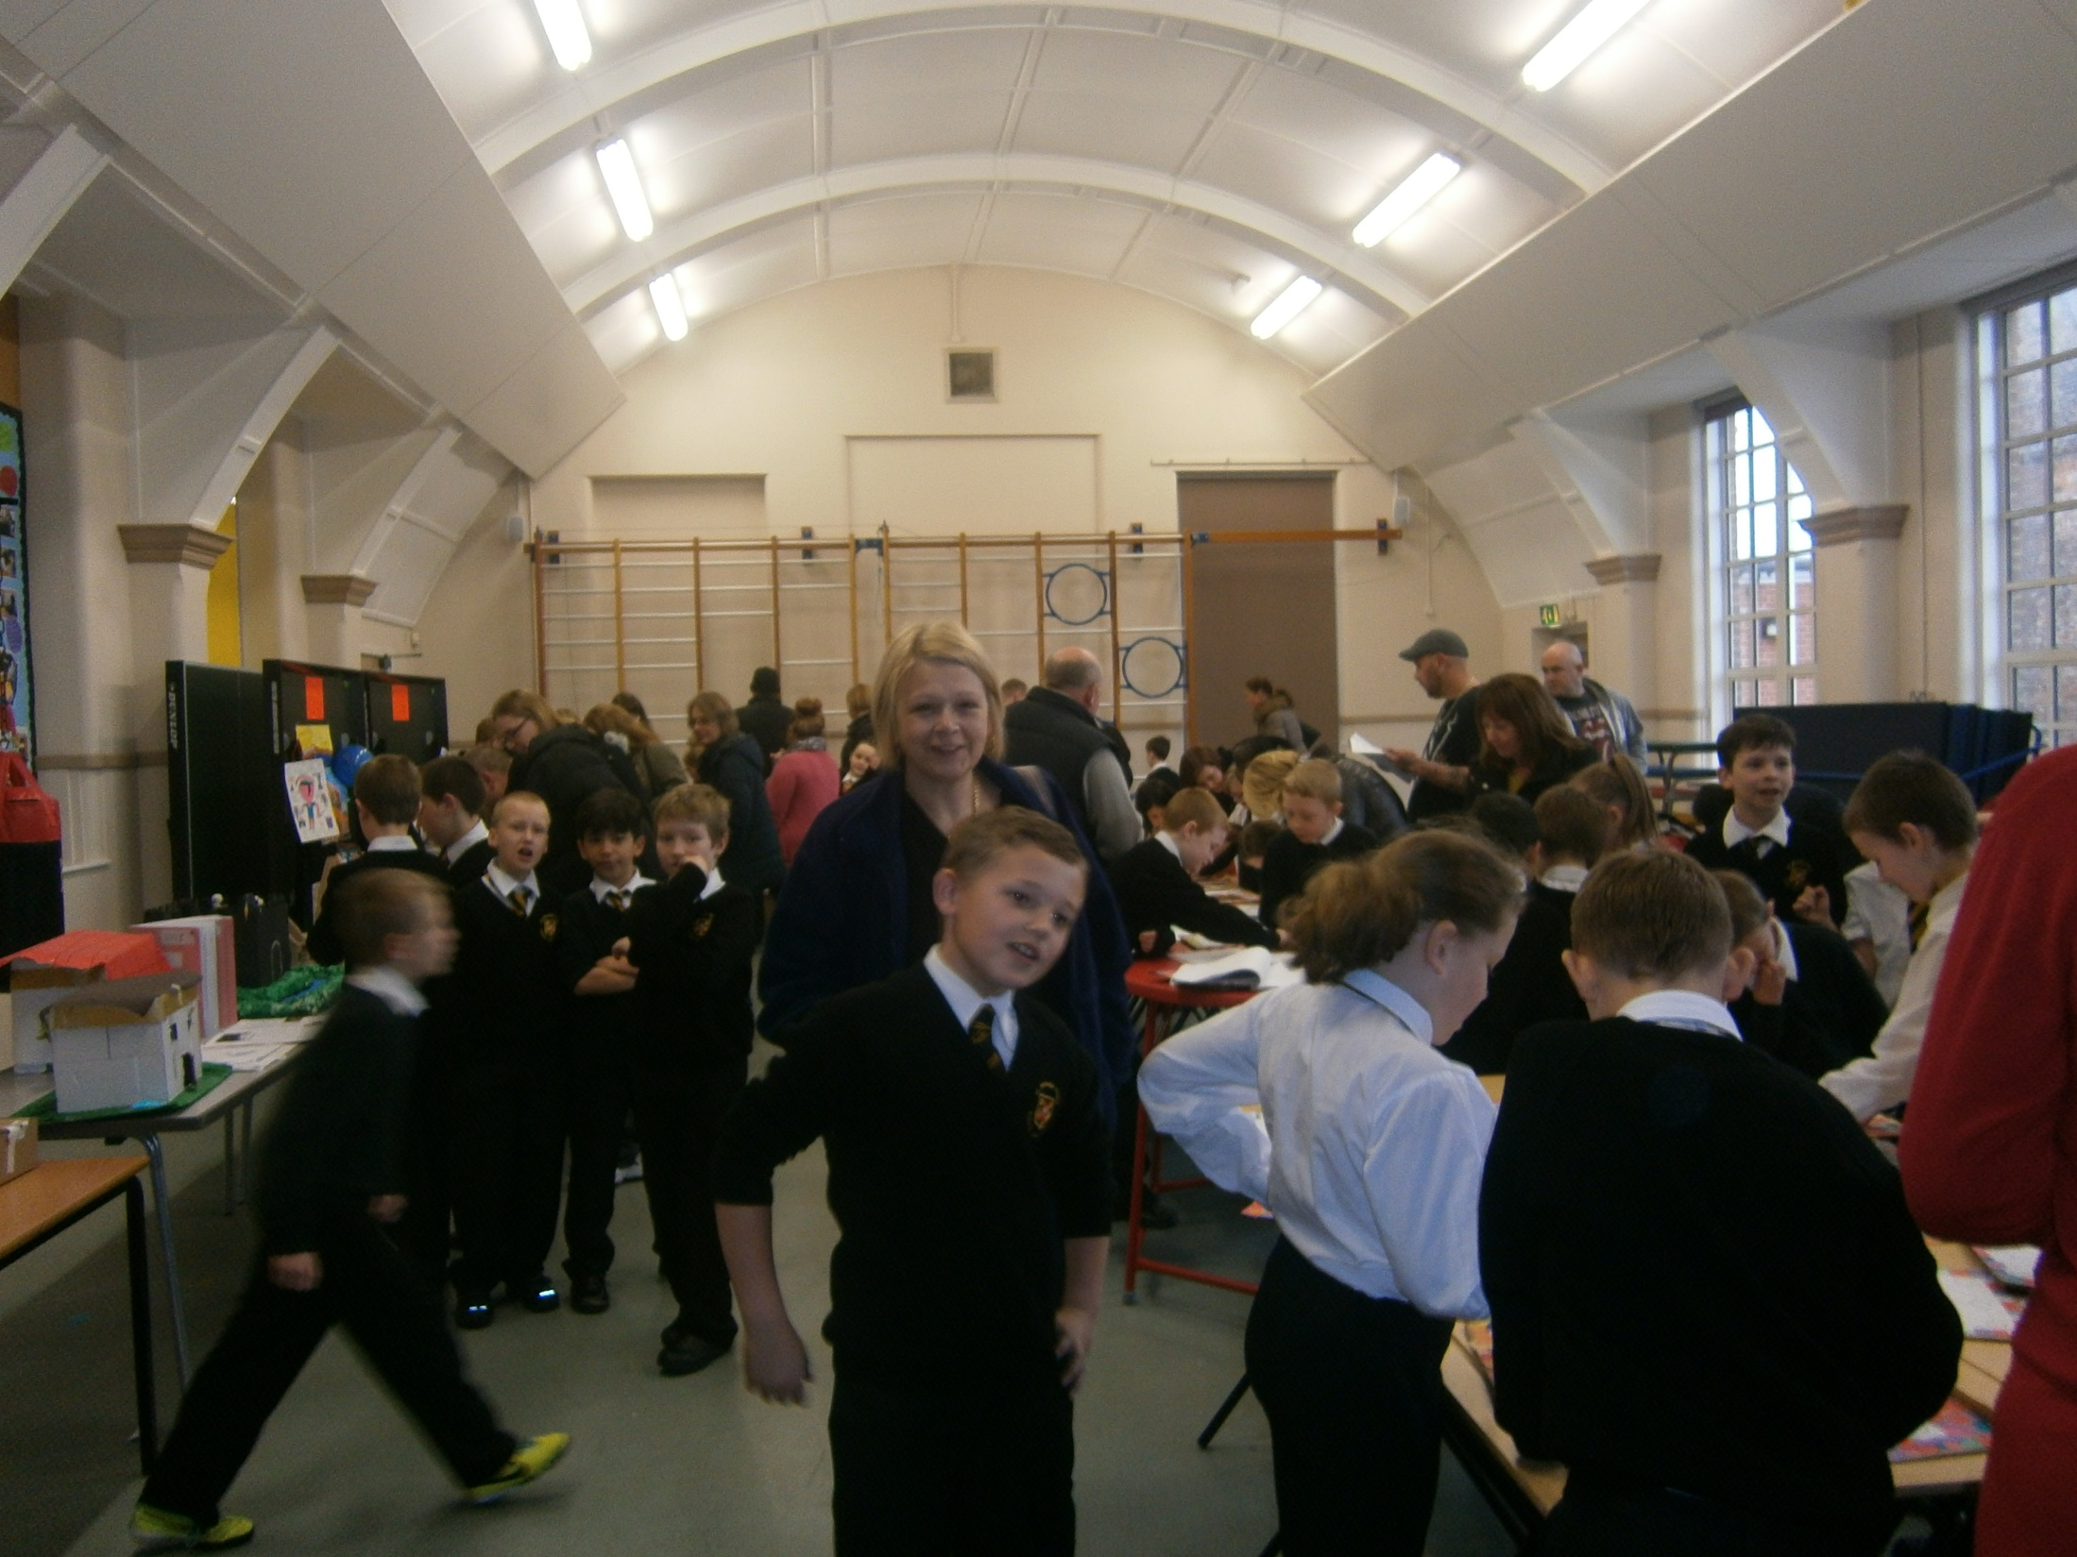

Slide 26
Shaping aspirations – What could I become?
1:1 interviews
University- UEA
Experiences
London visit
Master Classes
Celebration Evening

Slide 27
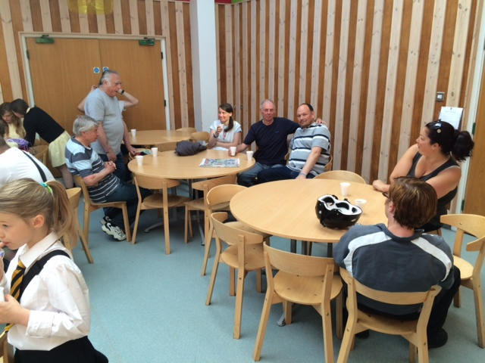

Slide 28
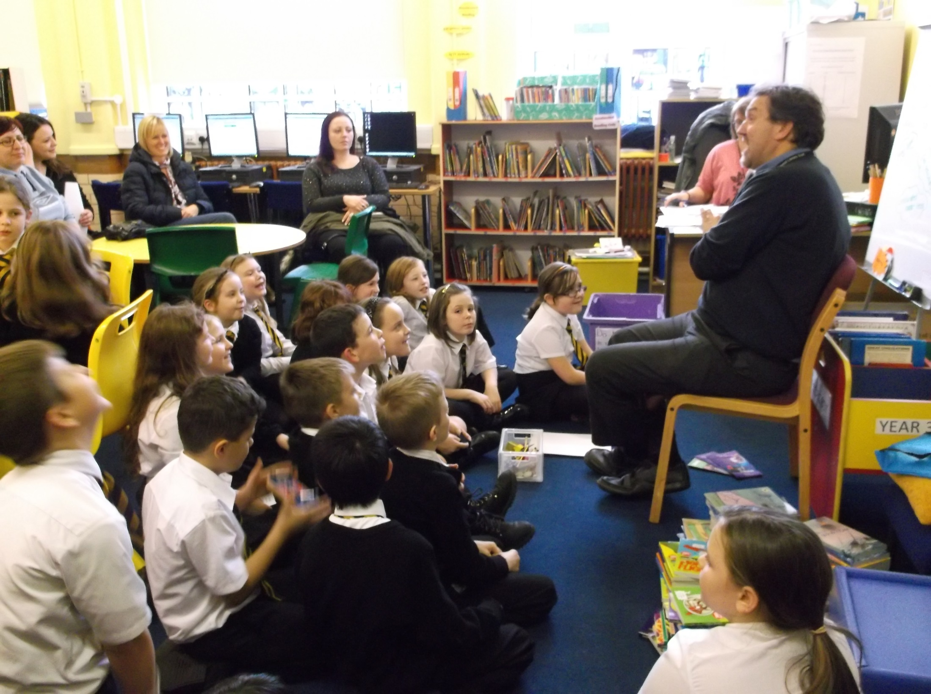

Slide 29
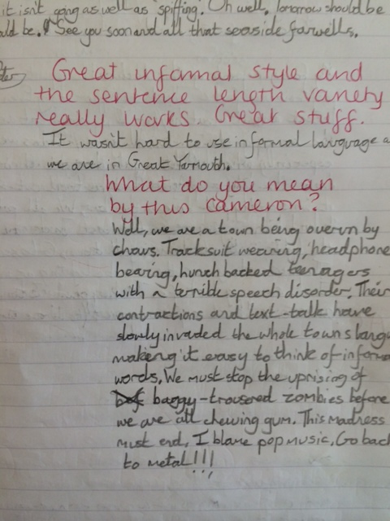

Slide 31
To Miss Ollington,
I am sorry for nothing. In the future I will do as I am told first and then disobey the rules. One thing to get us straight, you like science I don’t I hate it. Don’t give me science just give me a wordsearch that’ll keep me busy. So now you will know that I don’t do things like that I don’t like it. If I get things like that I get in a funny mood like I did today. I am sorry for distracting the class and not leaving the classroom.
From Tanna

Slide 32
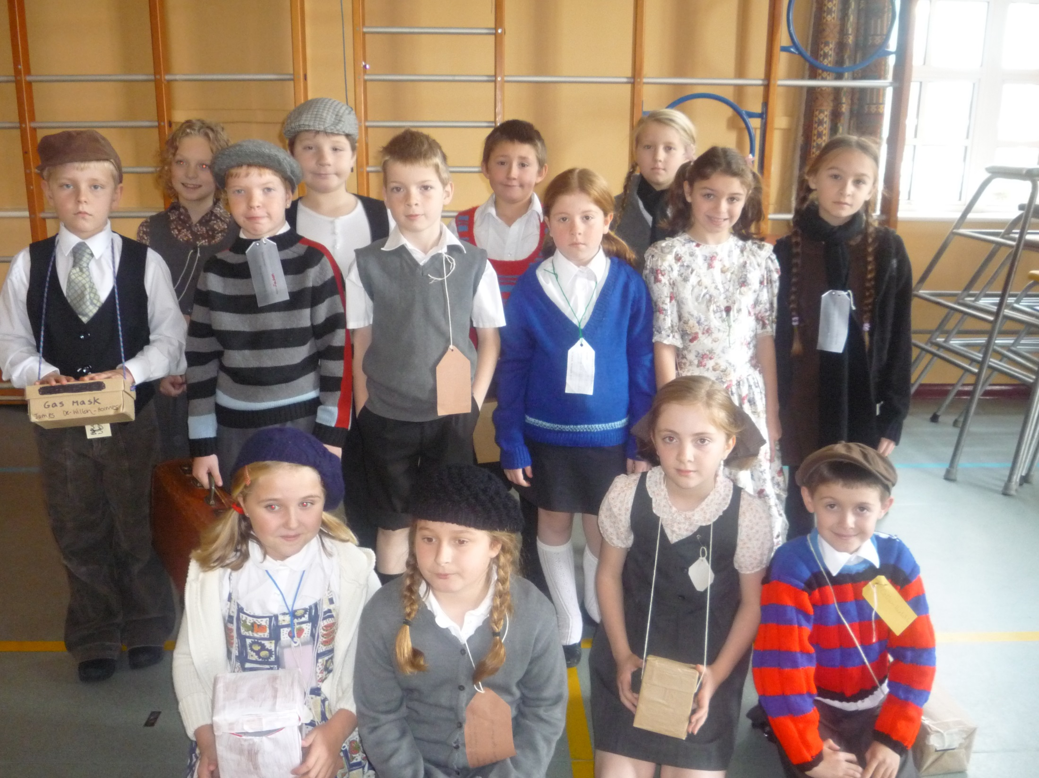

Slide 33
School strategies to raise the achievement of White Working Class pupils
Angela Ward
Headteacher
Perry Hall School, Bromley LA

Slide 34
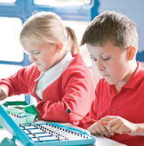
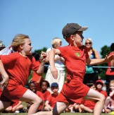
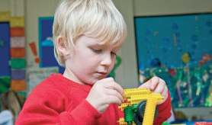
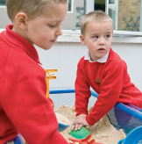
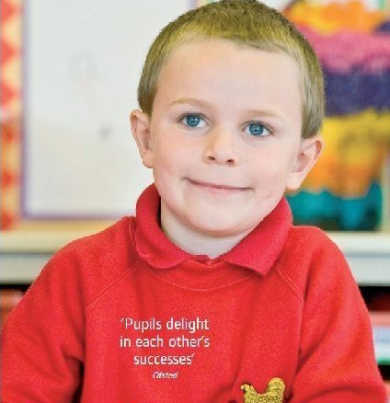
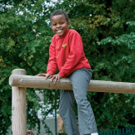
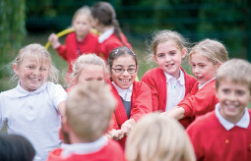

Slide 35
Ethos
Children feel safe & secure
Good relationships
Calm environment
Warm & welcoming
High expectations

Slide 36
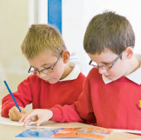
Engagement
Parents
PTA social heart of the school organising events for children to enjoy
Staff
From experienced to newly qualified always willing to go the extra mile
Children
Good behaviour, enjoy school, want to please their teachers, work hard
Community
Community Week the school reaches out to give something back to its community

Slide 37
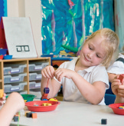
Enhancement
Identification & support
Reactive & flexible interventions
Entry level challenge into learning
Pockets of poverty awareness
Learning Mentor to support social & emotional needs
Opportunities for every child to shine
Enjoyment in learning

Slide 38
Enrichment
P4C
Power of Reading
Forest School
Visits & School Journey
School Council & pupil leadership
Competitive sporting events
Curriculum Showcases

Slide 39
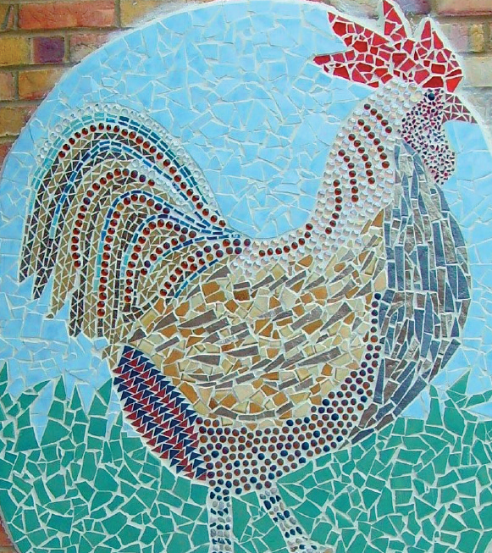
Exceeding Expectations
2013 KS2 Results Expected Progress
Reading 96%
Writing 96%
Maths 93%
FSM/CLA achieving more than expected progress
Reading 50%
Writing 42%
Maths 33%

Slide 40
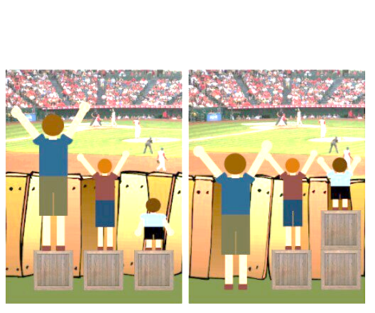
Equality
Treat children unequally to give them the best chances!

Slide 41
School strategies to raise the achievement of White Working Class pupils
Paul Robinson
Headteacher
Woodmansterne Primary School, Lambeth LA

Slide 42
School strategies to raise the achievement of White Working Class pupils
David Boyle
Principal
Dunraven School, Lambeth LA

Slide 43
Tackling underachievement – towards ‘Excellence for all’
Context
Keys issues
Impact
David Boyle
27 June ‘14

Slide 44
The power of transformation

Slide 45
Context
4-19, roll 1300 – 1800 (post 16 230)
National average on entry Y7
53% PP
70% BME
29% EAL
29% SEN, high needs SLCN Base (15 – 33)
National Support School
Academy Convertor

Slide 46
No one does it alone

Slide 47
Relationships
Safe and secure
Pastoral system
Inclusion
Transition
Everyone is known by someone

Slide 48
You’ve got to be prepared 1

Slide 49
Intervention - systems
Inclusion – ‘The Base’, SET, SLCN & early signs
Y9 mentoring and Dux programme
Going for Gold programme, KS4 (and KS3)
Post-16 – 321, impact reports

Slide 50
You’ve got to be prepared 2

Slide 51
Intervention - external
External agencies – Motiv8 (pre-NEET), YESS
Life skills programme
Careers advice and work experience
Platinum group visits/extras (Oxbridge, etc)
Insistent, consistent, persistent

Slide 52
We’re not who you think we are

Slide 53
Notes:
Branding – heritage and data model

Slide 54
It’s all about team work

Slide 55
Presenting Impact
GCSE 2013
5 X A*-C – 98%
5 X A*-C including English and Maths - 77%
A*/A – 27%
English Baccalaureate – 47%
All groups green in RAISEonline

Slide 56
NEET
2011 – 0%
2012 – 0%
2013 – 0%

Slide 57
Students on Free School Meals

Slide 58
Students – White Working Class

Slide 59
Post 16
24% Russell Group
39% ‘Top 25’
0% NEET
Top 2% Value added (3 years running)

Slide 60
Excellence for all – lift off

