Slide 1
The Education Select Committee Inquiry into the educational achievement of white working class children: a summary National Conference on the educational achievement of White Working Class children, London Institute of Education 27 June 2014 Professor Steve Strand University of Oxford, Department of Education steve.strand@education.ox.ac.uk 01865 611071

Slide 2
Summary of presentation
Overview of the Select Committee Inquiry into the educational achievement of white working class (WWC) children
Clarifying terms and measures
The extent of the WWC gap
Drivers of the WWC gap
Addressing the issue: Schools and the Pupil Premium
Coda - The limits of school effectiveness?

Slide 3
Select Committee report
Instigated following OfSTED ‘Unseen Children: Access & achievement 20 years on’ (June 2013)
40+ written submissions, seven evidence panels with 28 witnesses incl. schools minister David Laws, visit to Peterborough LA & schools
All written evidence and transcripts / videos of sessions plus final report available from: http://www.publications.parliament.uk/pa/cm201415/cmselect/cmeduc/142/142.pdf

Slide 4
The core issue: FSM gap age 16
Source: NPD 2013 (own analysis)

Slide 5
1. Is WWC the correct term?
‘White British’ is the focus group
Roma / Irish Traveller groups extremely low achievement, but also very small numbers (0.1%) and complex needs
White Other-FSM overall higher achieving than White British-FSM but extremely varied, reflecting recency of arrival in UK & language fluency (Strand, in preparation)
Debate around “working class” term
Phenomena robust across other indices as such as NS-SEC, parental education qualifications, IDACI etc.
FSM employed for pragmatic reasons (available to schools & verifiable) so focus is more on poverty, but Ever 6 widens coverage (15% -> 25%).

Slide 6
SES and attainment age 16
Note: SES from Principal Components Analysis of: Household Social class (NS-SEC), parents educational qualifications, home ownership, FSM and neighbourhood deprivation (IDACI).
Source: LSYPE (Strand, 2014)

Slide 7
2/3. Drivers of the WWC Gap
Committee recognised wide range of factors important at individual, home/family, school and neighbourhood levels
LSYPE indicates the wide range of such factors, but WWC gap at age 16 could largely be accounted for by four variables collected at age 14:
Students’ academic self concept (ASC);
Frequency of completing homework;
Students’ educational aspirations;
Parents’ educational aspirations for the young person.
= Indicators of Engagement/Disengagement

Slide 8
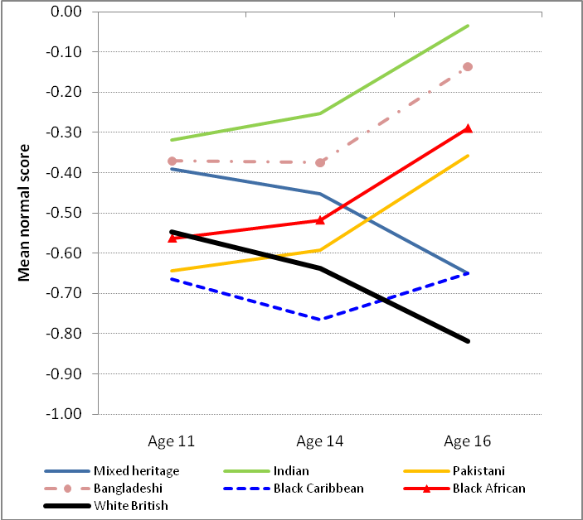
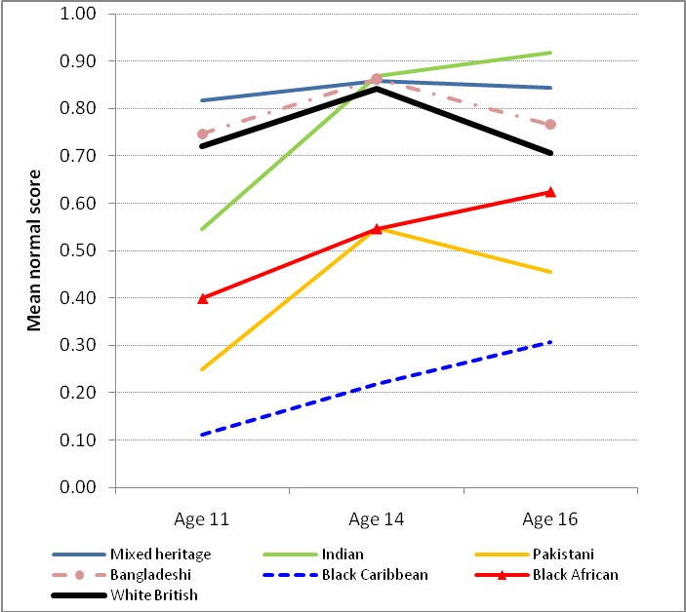
SES and progress age 11-16
Low SES (Bottom 20%) | High SES (Top 20%)
Low SES: White British decline, most BME improve particularly during KS4. High SES: gaps narrow but WBRI stay high.
Source: LSYPE (Strand, 2014)

Slide 9
Key Stage 2 (age 11): England 2013
Source: DFE SFR 51/2013

Slide 10
Foundation Stage (age 5): England 2013
Source: DFE SFR 47/2013

Slide 11
4. Addressing the problem
Report focus on transformational capacity of schools
OfSTED (2013): Only 66% of schools in bottom IDACI quintile rated good/outstanding compared to 86% in top quintile – room for improvement in school quality
London Effect:
Big improvement relative to other regions 2007-12
Students on FSM much more successful than elsewhere (5AC-EM 52% vs. 37%)
Biggest gaps now more frequently in towns & coastal areas (OfSTED 2013, p59)
EEF evidence: “In 2012, there were 428 secondary schools, nearly 1:7, where pupils eligible for FSM performed above the national average for all pupils in terms of Best 8 points scores” (Written evidence 0034).

Slide 12
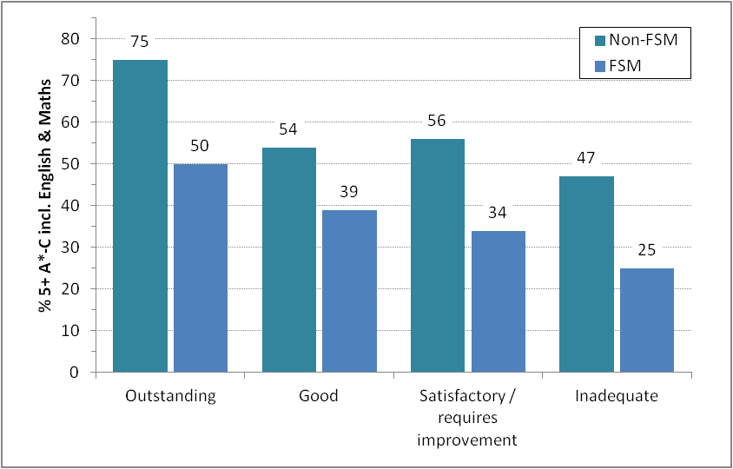
FSM by school OFSTED rating
Source: Ofsted (2013). Unseen Children: Access and achievement 20 years on (P53).
Breakdown by school overall effectiveness judgement.

Slide 13
The mechanism
Funding Pupil Premium Grant (PPG)
School’s decide on the intervention/s
http://educationendowmentfoundation.org.uk/toolkit/
OfSTED best practice WWC updated & PPG annual report
Accountable through performance tables / OfSTED / school website
Progress 8 to remove perverse incentives of 5+ A*-C EM
Publication of PPG gap, including 3-year averages

Slide 14
The limits of School Effectiveness?
Risk that FSM gap is equated with ‘failing’ schools, or simply a ‘technical’ issue for schools to solve
London Effect: if restrict analysis to White British only much smaller FSM differential (5AC-EM 40% v. 34%)
EEF evidence: 1:7 is only 15% of schools, includes 164 grammar schools, two-thirds very low concentration FSM (<10%) (see Wrigley, 2012)
Within-school gaps: FSM gap does not appear to vary significantly between outstanding and inadequate secondary schools (Ofsted, 2013) or by school CVA scores (e.g. Strand, 2010, 2014)

Slide 15
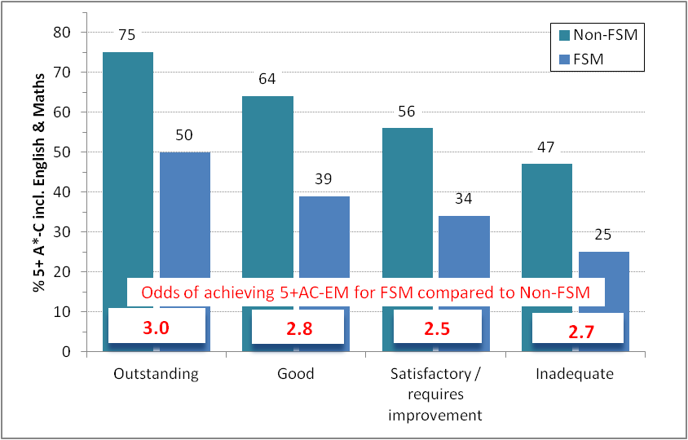
FSM by school OFSTED rating
Source: Ofsted (2013). Unseen Children: Access and achievement 20 years on (P53).
Breakdown by school overall effectiveness judgement.

Slide 16
Implications for policy/practice
FSM gap does not result from a small no. ‘failing schools’
Floor targets, new academies/free schools overemphasised
‘Success against the odds’ exceptions & not easily replicable
Beyond the school gates
Home / parental factors, access to social & economic capital, health, peer groups, crime or neighbourhood deprivation, cumulative impact of early Home Learning Environment (HLE) age 0-3 and ”Matthews’ effect”
Pupil premium positive influence by focussing schools’ attention on the FSM gap within their schools
Evaluate setting allocation / flexibility (e.g. Oakes, 2005)
Distribution of teachers across classrooms within schools (e.g. Clotfelter et al, 2005)
Working with parents (e.g. Parent Support Advisor pilot, 2009)
Early intervention (PPG weighting revised)
Notes:
PSA: £40M in 20 LAs 2006-2008, created a new professional 700+ new professionals (PSAs) created, three-quarters in primary schools.

Slide 17
Overall conclusions
Focus on low attainment of White British WC pupils is valid – but (i) also Black Caribbean WC, and (ii) Black Caribbean underachieve from middle/high SES homes.
Key resilience factors are sometimes individual/family, but schools can and do make a difference (though there are limits to what schools alone can achieve).
Pupil Premium offers substantial redistributive funding, real chance to make a difference, need to focus on within-school resource deployment, parental involvement etc.
Further research needed to focus on root causes of social class gap in early years (age 0-5), family & neighbourhood factors, role of curriculum and school composition.

Slide 18
References
Evans, G. (2006). Educational failure and white working class children in Britain. Basingstoke: Palgrave Macmillan.
Lindsay, G., Davis, H., Strand, S., Cullen, M.A,, Band, S., Cullen, S., Davis, L., Hasluck, C., Evans, R. & Stewart-Brown, S. (2009). Parent Support Adviser Pilot Evaluation: Final Report. London: DCSF. https://www.education.gov.uk/publications/eOrderingDownload/DCSF-RR151.pdf .
Strand, S. (2010). Do some schools narrow the gap? Differential school effectiveness by ethnicity, gender, poverty and prior attainment. School Effectiveness and School Improvement, 21(3), 289-314. http://dx.doi.org/10.1080/09243451003732651
Strand, S. (2011). The limits of social class in explaining ethnic gaps in educational attainment. British Educational Research Journal, 37(2),197-229. http://dx.doi.org/10.1080/01411920903540664
Strand, S. (2012). The White British-Black Caribbean achievement gap: Tests, tiers and teacher expectations. British Educational Research Journal, 38(1),75-101. http://dx.doi.org/10.1080/01411926.2010.526702
Strand, S. (2014a). Ethnicity, gender, social class and achievement gaps at age 16: Intersectionality and ‘Getting it’ for the white working class. Research Papers in Education, 29, (2), 131-171. http://dx.doi.org/10.1080/02671522.2013.767370
Strand, S. (2014b). School effects and ethnic, gender and socio-economic gaps in educational achievement at age 11. Oxford Review of Education, 40, (2), 223-245. http://dx.doi.org/10.1080/03054985.2014.891980
Strand, S. & Winston, J. (2008). Educational aspirations in inner city schools. Educational Studies, 34(4), 249-267. http://dx.doi.org/10.1080/03055690802034021

