Slide 1
Dr Chris Brown
London Centre for Leadership in Learning
University College London
Using data and research to support school improvement

Slide 2
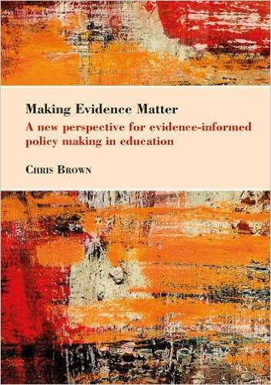
About me

Slide 3
Current areas of focus
Why do educational leaders decide to embark on various forms of school improvement. What decisions are open to them and how do they select from these? What role does research play?
If school leaders decide that they want to lead research informed schools, what factors facilitate evidence use or research engagement? Likewise for policy makers.
How can educational practitioners most effectively engage with research?

Slide 4
Evidence informed practice

Slide 5
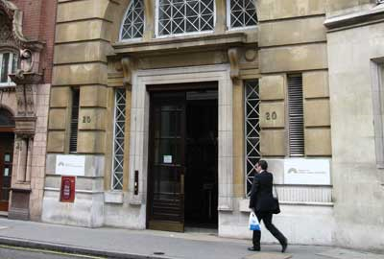
Evidence informed practice
The Department for Education, define EIP as: “a combination of practitioner expertise and knowledge of the best external research, and evaluation based evidence” (www.education.gov.uk, 2014).

Slide 6
Benefits to evidence use
Supovitz (2015): a common characteristic of high performing school systems is that they facilitate the collaborative examination of research and data evidence in order to identify both likely problem areas (in relation to teaching and learning) and potential solutions to these problems.
Mincu (2013) and Cordingley (2013) report correlational evidence - where research and data are used as part of high quality initial teacher education and ongoing professional development, they make a positive difference in terms of teacher, school and system performance

Slide 7
Benefits to evidence use
‘research-engaged’ schools that take a strategic and concerted approach in this area show a shift from an instrumental ‘top tips’ model of improvement to a learning culture
here staff work together to understand what appears to work, when and why (Handscomb and MacBeath, 2003; Godfrey, 2014; Greany, 2015).

Slide 8
The self improving school system
The development, seeking out, use and sharing of effective pedagogic practice is something now viewed as vital to school improvement and as a necessary response to the structural changes facing many school systems worldwide.
In England, recent (2010-2015) Conservative/Liberal Democrat Coalition and newly elected Conservative governments have pursued a ‘self-improving school-led school system’.
In this system, schools are positioned as autonomous and accountable, with increased diversity and choice for parents through ‘free schools’ (akin to US Charter Schools), and with a radical reduction in central and local oversight (Greany, 2015: 16; Godfrey, 2014a).

Slide 9
The self improving school system
Greany (2014), suggests that there exist four core criteria for self-improvement.
teachers and schools being responsible for their own improvement;
teachers and schools learning from each other and from research so that effective practice spreads;
the best schools and leaders extending their reach across other schools so that all schools improve; and
government support and intervention is continuously minimised.

Slide 10
Evidence use as part of SISS
Given the current emphasis on self-improvement, it is not surprising that evidence, research and data use has also become an intentional feature of recent government education policy.
Teaching schools are expected to :
build on existing research as they contribute to alliance and wider priorities,
base new initiatives on existing evidence and measure the impact of these initiatives,
ensure that staff use existing evidence, and
provide necessary time and support for staff to participate in R&D activities.

Slide 11
Research Learning Communities

Slide 12
Effective ways to engage with research and evidence
In 2014 Education Endowment Foundation put out a call for research projects to explore how to encourage the take up of research and evidence by teachers…

Slide 13
Developing a practical understanding
National College R&D themes project
Louise Stoll’s extensive work on Professional Learning Communities
ESRC and Challenge Partners funded work on Middle Leaders as Catalysts for Change
8 x London Schools Excellence Fund Studies
Work with Teaching School Alliances up and down the country
Research centred lesson study work for Camden schools and early years centres

Slide 14
Cycles of enquiry

Slide 15
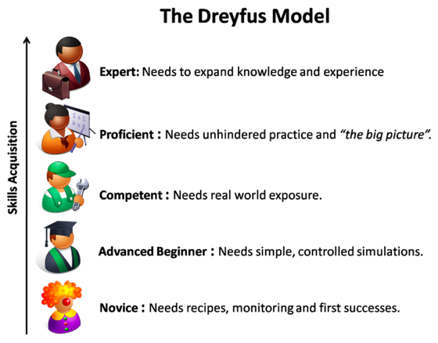
Expertise

Slide 16
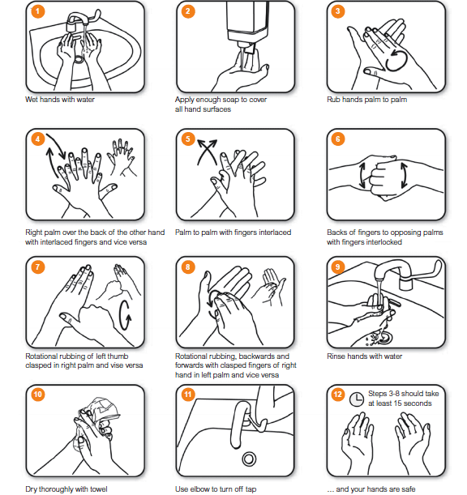
Expertise

Slide 17
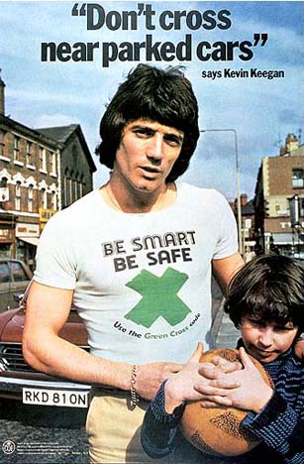
Expertise

Slide 18
Professional Learning Communities
They have a shared vision and sense of purpose
Members of the PLC consistently take collective responsibility for student learning
Participants collaborate in ways that go beyond mere superficial exchanges of help, support, or assistance
Group, as well as individual, learning is promoted
Participants engage in reflective professional inquiry
Diverse perspectives
A culture of trust and enquiry
Stoll et al. (2006)
Notes:
They have a shared vision and sense of purpose, centred on improving outcomes for children (Hord, 2004; Andrews and Lewis, 2007). In addition, they also possess a shared value base, which provides a framework for decision making that is both collective and ethical (Louis et al., 1995).
Members of the PLC consistently take collective responsibility for student learning (King & Newmann, 2001; Kruse et al., 1995; Leithwood & Louis, 1998). This helps to sustain commitment, eases isolation and also serves to exert peer pressure and accountability on those who do not do their fair share, and (Newmann & Wehlage, 1995; Cole and Weinbaum, 2010).
Participants collaborate in ways that go beyond mere superficial exchanges of help, support, or assistance (Louis et al., 1995). For example, they might engage in joint review and feedback (Hord, 2004). Collaboration helps to strengthen attachment to and the achievement of shared purpose (Newmann & Wehlage, 1995). Similarly, collaboration increases participants’ feelings of interdependence and collective responsibility: a goal of better teaching practices would be considered unachievable without collaboration, linking together activity and the achievement of shared purpose.
Group, as well as individual, learning is promoted. All teachers are learners with their colleagues (Louis et al., 1995). Collective learning is also evident when the school learning community interacts, engages in serious dialogue and deliberates about information and data, interpreting it communally and distributing it among colleagues.
Participants engage in reflective professional inquiry. This includes: ‘reflective dialogue’ (Louis et al., 1995), conversations about serious educational issues or problems involving the application of new knowledge in a sustained manner; ‘deprivatization of practice’ (Louis et al., 1995), frequent examining of teachers’ practice, through mutual observation and case analysis, joint planning and curriculum development (Newmann & Wehlage, 1995); seeking new knowledge (Hord, 2004); tacit knowledge constantly converted into shared knowledge through interaction (Fullan, 2001); and applying new ideas and information to problem solving and solutions addressing pupils’ needs.

Slide 19
Professional Learning Communities
When done well, professional learning in collaborative communities can lead to improvements in both teachers’ practice and student outcomes (Stoll et al, 2006; Veschio et al, 2008; Harris and Jones, 2012).

Slide 20
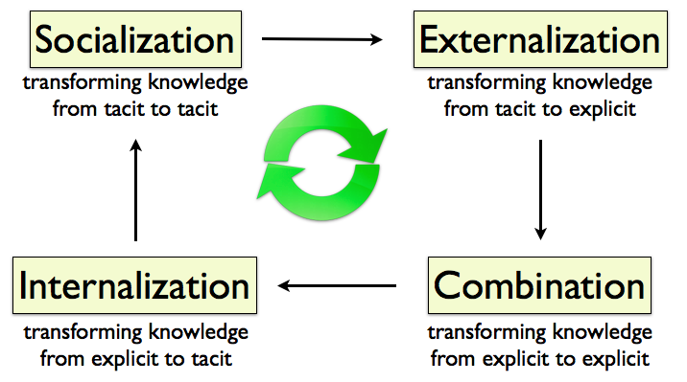
Learning conversations
Making them a way of life
Talking about your knowledge on a given issue
Looking at research on a given issue and then how this can be used to produce approaches to teaching and learning
Trialling and embedding these within your school

Slide 21
Networked Learning Communities
Networked Learning Communities (NLCs) have emerged as a means by which teachers, headteachers and others, who are located in individual schools, can move outside their day-to-day contexts to engage with a broader scope of ideas and possibilities as part of a cross-school or multi-school PLC
(e.g. Earl and Katz, 2006; Harris and Jones, 2012).

Slide 22
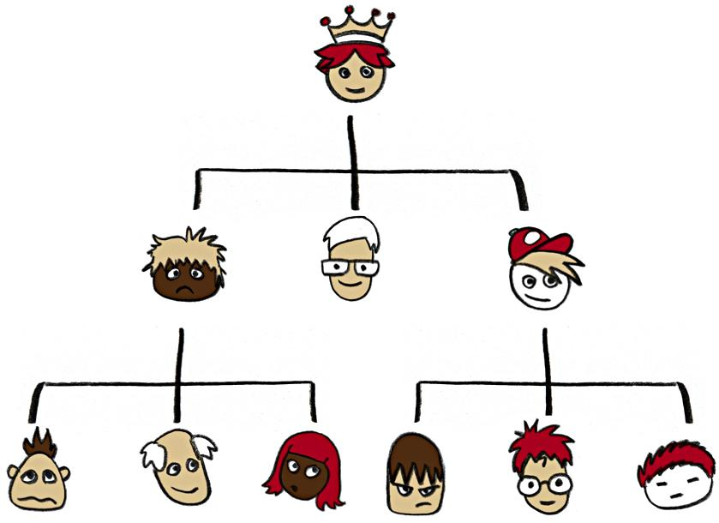
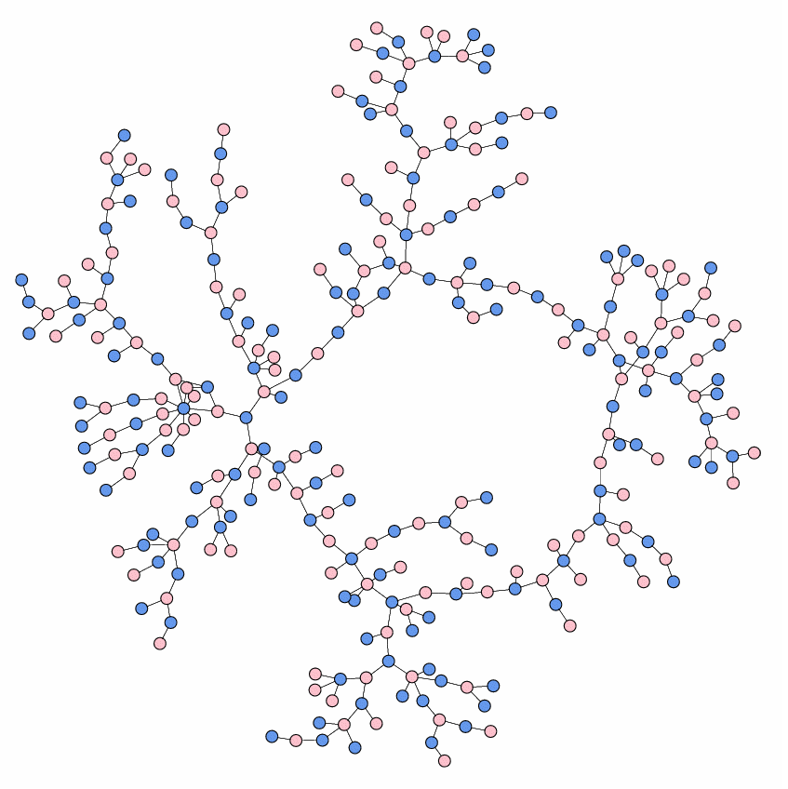
It is leadership as influence that led us to the idea of opinion formers

Slide 23
What is an RLC?
Research Learning Communities are networked learning communities that focus on engaging with and in research in order to tackle issues of teaching and learning
RLCs operate in cycles of enquiry
RLCs facilitate capacity building, inter school support and intra school development

Slide 24
The EEF project
Recruited 110 primary schools across England and set up ten Research Learning Communities (RLCs) with some 55 primary schools.
Membership of RLC includes at least one opinion-leader and one Senior Leader from each school.
The 10 RLCs meet four times a year for a whole-day workshop, supported by LCLL research-facilitators.

Slide 25
Outline of activity
Workshop 1: Understand
Int. sess. 1:
Share
Workshop 2: Develop
Int. sess. 2:
Trial
Workshop 3:
Refine
Int. sess. 3: Embed
Workshop 4: Take stock
Int. sess. 4: Share impact

Slide 26
The project (2)
Workshops focus on specific issues agreed on in advance (i.e. to look at issues of importance identified by schools) and introduce research evidence that investigates ‘what works’ in relation to these issues.
Within the RLC workshop, facilitators use evidence-informed approaches/exercises to enable participants to engage interactively with both research and their own and colleagues’ tacit practice-based knowledge.
Following workshops participants go back to their schools and share and build on what happened in the workshops

Slide 27
The project (3)
During year two we are trying to ensure RLC members begin to source their own evidence and begin to run the workshops so as to ensure a sustainable approach.
By the end of the project each school will have two experienced evidence champions, experience of engaging in an evidence use enquiry cycle and so the capacity to build evidence use within their schools and also across others in their alliance
We will also provide a toolkit to schools to help with this.

Slide 28
What is the project telling us?

Slide 29
It is leadership as influence that led us to the idea of opinion formers

Slide 30
The need to identify opinion formers also presented the opportunity to engage is some in-depth analysis as to what drives research use.
How frequently do you interact with this person?
Thinking about the last 12 months, have you turned to any of the colleagues listed below as reliable sources of expertise in terms of teaching and learning?
How do you rate the quality of this interaction?

Slide 31
Centrality
Network scholars often use the notion of ‘centrality’ as an index of relational activity.
Individuals that are of higher degree centrality are those with greater number of in/out ties in general (i.e. those that both receive and share information with more other actors:.
Correspondingly, the higher the degree centrality within a network, the more likely information (including research and evidence informed practice) will be moved efficiently and so flow to/from and reach individuals (Moolenaar and Sleegers, 2010).

Slide 32
The efficiency of a network in circulating knowledge and materials and in using these solving will be related to:
Strength of ties = frequency and quality of relationship
high quality, high frequency ties are important to the delivery of coordinated reform efforts, and support the transfer of tacit, non-routine, and complex knowledge,
high quality, high frequency ties allow for joint problem solving and the implementation of school level solutions
(Reagans and McEvily, 2003)
Notes:
Specifically, whether an existing network will be efficient in circulating knowledge and materials and in using these to engage in effective problem solving will be tied to the strength of its ties that relate to the ‘frequency’ and ‘quality’ of the relationships one has with others in terms of seeking or being sought for expertise. For instance, [reference removed for peer review] argues that high quality, high frequency ties are important to the delivery of coordinated reform efforts, since such ties may support the transfer of tacit, non-routine, and complex knowledge, allow for joint problem solving and the implementation of school level solutions (also see: Uzzi, 1997; Hansen, 1999; and Reagans and McEvily, 2003). Network scholars often use the notion of ‘centrality’ as an index of relational activity. Actors (individuals) that are of higher degree centrality are those with greater number of in/out ties in general (i.e. those that both receive and share information with more other actors: Borgatti et al., 2013). Correspondingly, the higher the degree centrality within a network, the more likely information (including research and evidence informed practice) will be moved efficiently and so flow to/from and reach individuals ([reference removed for peer review]; Moolenaar and Sleegers, 2010).

Slide 33
‘transformational’ and ‘learning centered’ aspects of leadership should be focused on organisational learning

Slide 34
Trust
Where social relations are steeped in high levels of trust, they are likely to improve outcomes for pupils (Mintrop and Trujillo, 2007).
In part, this is because the strength of ties amongst teachers determines whether an individual can access resources and correspondingly whether they are able to maximize their pedagogic effectiveness, and it is trust that improves the strength of these ties.

Slide 35
Trust
High levels of trust are associated with a variety of reciprocal efforts, including where collaboration, learning, complex information sharing and problem solving, shared decision making, and coordinated action are required (Tschannen-Moran, 2004).

Slide 36
Method and sample
A social network survey was administered to all teaching staff within schools, including school leaders, classroom teachers, instructional support staff, etc.
The survey gathered data to measure Organisational Learning, trust, and research/evidence use (‘RE Use’) climate from 828 teachers of 43 schools.
In addition social network data and analysis was gathered to quantify teachers’ professional relationships in relation to expertise seeking behaviors.
A total of 828 teachers from 43 schools participated in the survey, resulting in an average response rate of 75%.

Slide 37
Research Questions
Research question 1: to what extent do teachers’ perceptions of the presence of organizational learning factors within their school affect their perceptions of the school’s research/evidence use climate?
Research question 2: to what extent are perceptions of the research use climate positively related to the frequency and quality of the expertise seeking interactions reported by teachers?
Research question 3: what impact do perceptions that they are working in a high trust environment have on teachers’ perceptions of the research/evidence use climate within their school?

Slide 38
Descriptive statistics and correlation matrix of the study variables
Notes:
In general, teachers perceive the climates of their school as being driven by the use of research evidence, trusting, and learning oriented (mean ranging from 4.4 and 4.7). In terms of professional relationship, teachers are connected with an average of 56% of other colleagues for expertise around teaching and learning (mean = 55.9, SD = 31.5) on a weekly basis. In addition, of all the connections individual teachers have around teaching and learning, 45% of the ties are regarded as either useful or very useful (mean = 44.8, SD = 29.1). The correlations indicate that Trust and OL are both statistically significantly and positively correlated with RE Use Climate (r = .31 and .15, p < .01, respectively). This suggests that teachers who perceive their school climates as being trusting and learning oriented are thus more likely to also perceive a collective norm around the use of research evidence in practice across the school. Moreover, there is a statistically significant and positive, although weak, relationship between both TLE degree centralities and RE Use Climate (r = .13 and .18, p < .01), suggesting that teachers who are connected with more other colleagues around teaching and learning expertise (as determined by their response to the question “to whom do you turn as reliable sources of expertise in terms of teaching and learning”) and who have more useful connections around teaching and learning are more likely to perceive their school climate as being shaped by the use of research evidence.

Slide 39
Relationships between RE Climate and OL, Trust, and TLE Degree Centralities
Notes:
Table 4 provides the final models of our multilevel analysis. The first model, added significantly to the demographic-based model (χ²change(2) = 76.18, p < .01), examines the relationship between teachers’ perceptions of Trust and OL and their perceptions of School’s RE Use Climate, controlling for school’s staff size, teachers’ gender and years of working in their current position.
The first model show that a statistically significant amount of variance in individual teachers’ RE Use Climate is attributed to the school level (intraclass correlation coefficient for RE Use Climate, ICC = .27), indicating that 27% of the variability in teachers’ RE Use Climate perception occur between schools even controlling for demographical variables. Confirming hypothesis 1 and 3, our findings indicate that teachers’ perceived climates of Trust and OL are statistically significantly and positively related to their perceived school’s RE Use Climate. That is, teachers who report their school to have high levels of trust and are learning oriented also tended to report that their school engaged in activities that are supportive of research/evidence informed practice.
In the second and third models, we add degree of weekly interaction and degree of useful interaction, respectively, to examine the relationship between degree centralities and perceived RE Use Climate. Model 2a and 2b each added significantly to the first model (χ²change (1) = 5.88, p < .05, χ²change (1) = 9.54, p<.01, respectively), and shows a statistically significant amount of variance in individual teachers’ RE Use Climate that is attributed to the school level (ICC = .24 and .23, respectively), with the remaining large portion of variability attributed to the teacher level (76% and 77%, respectively). The findings, confirming hypothesis 2, indicate that in addition to the significant predictors of Climate of Trust and OL, both types of degree centralities are significantly and positively related to the perceived School’s RE Use Climate. In other words, teachers who have more weekly interactions with other colleagues for teaching and learning as well as a greater number of useful connections for teaching and learning tend to report higher levels of school-wide instructional activities that are research-based. For all models, no statistically significant difference is found in gender and years of experience.
What also emerges from the analysis, however, is that of all the variables for RE Use Climate, perceptions of trust is by far and away the biggest driver of perceived research use: with a range of β sizes ranging from 0.28 to 0.25. The Trust variable has approximately three times more significant weight on the RE Use Climate perceptions than OL (β around 0.08). It can also be seen that while the frequency and the quality of interactions are important, it is the regularity of interactions that has more impact on perceptions of research use, as compared to the usefulness of interaction. This highlights the importance of school leaders attending to both the formal and informal aspects of evidence-informed practice/evidence informed school improvement EIP/EISI. Although OL does positively impact the degree to which teachers perceive the use of RE Use climate within their school, it is the level of trust, that is more strongly associated with how staff in engage in OL and how they respond and interact with each other informally. Trust appears to be main driver around teachers’ perceptions that they operate within an environment both employing and encouraging the employment of research and evidence.

Slide 40
Network sociograms
Notes:
In addition, we provide two network sociograms from two sample schools as an illustrative example of the study findings (see Table 5). We focus on the relationship between the outcome variable (RE Use Climate) and TLE degree centralities. The two sociograms indicate that the school with a higher RE Use climate (School A) also tends to exhibit professional connections regarding exchanging expertise in teaching and learning that are relatively more dense and of greater average degree of than the school with a lower RE Use climate (School B) (density = 0.23 vs. density = 0.13; while degree centrality = 10.28 vs. degree centrality = 5.87). Individual teachers at the school with a lower RE Use climate are either connected with fewer or no colleagues in terms of exchanging teaching and learning expertise, as compared with those at school with a higher RE Use climate. This finding between teachers’ frequency of professional interaction and their perception of school’s RE use climate corroborates the statistical analysis displayed in Table 4. In other words, teachers who perceive their school’s climate as being more oriented to the use of research/evidence in practice tend to frequently exchange expertise regarding teaching and learning with more colleagues than teachers who perceive a lower level of RE Use Climate. Such pattern of relationships between outcome variable and the other study variables (Trust, OL, and usefulness of interaction) also are reflected in other sociograms we prepared for the study.

Slide 41
Significance
The importance of learning and trust in facilitating the types of relations needed to provide teachers with access to the research/evidence centered social capital that resides within a school.
The work expands our notions of what is necessary to support the use of research/evidence in schools by placing more relational elements of the improvement equation front and center

Slide 42
Significance
Our data confirms suggestions that organizational learning is positively associated with research/evidence use.
High levels of trust may also facilitate teachers acting upon the OL messages they receive from school leaders
Notes:
In part this is because some OL items (such as question 6: ‘in this school time is made available for education/training activities for school staff’) may be foundational to the capacity (ability) to engage in research, while others correspond to the structures required to effectively share information around an organization (e.g. question 7: ‘this school has forums for sharing information among staff’).

Slide 43
Questions?

Slide 44
Moving forward

Slide 45
Further areas to consider
Ensuring we base our approach on the needs of the school rather than ‘hot topics’
Coaching
Domains of evidence use

Slide 46
Combine the strengths of data use and EIP
DBDM | EIP
+ Starts with vision and goals of a school, focusing on a context specific problem | - Is it definitively based on a real need in the field
- Data: inform educators about problems in their school, but what causes this problem? | + Educators can draw upon a variety of effective approaches to school improvement
+ Schools develop a context specific solution | - One size does not fit all
- Data: pinpoint possible causes of a problem, but educators may not know the best available course for school improvement | + Picking a promising solution, based on an existing evidence base.

Slide 47
Eight-stage
cycle inquiry
Brown et al (2016b)

Slide 48
Coaching
Do educational leaders always know what creating a research engaged school entails?
Leadership coaching has been shown to be effective in helping school leaders enhance their skills and develop new habits, as well apply theoretical learning to workplace practice. RCTs examining the effectiveness of leadership coaching (e.g. Goff et al., 2015) show that coaching can serve to positively improve leadership practice in relation to both the transformative and pedagogic-type aspects of leadership

Slide 49
Coaching
Providing schools with initial audit of their baseline level of EIP and a diagnostic of potential improvements
Offering a workshop to all school leader participants which explores: what it required for a school to be research engaged; case studies of the kinds of activities needed to deliver research engagement; and an overview of effective leadership in relation to EIP.
Allocating participating school leaders two coaches (a general coach and a specialist coach) who will work with them over a twelve month period, meeting both by face to face and/or telephone. The role of the generalist coach is to help school leaders: i) establish an EIP vision for their school that moves them towards specific EIP goals; and ii) focus/plan how these goals might be achieved. The specialist coach augments this general support by providing hands-on expertise

Slide 50
Domains of decision making and research use (Neeleman, 2016)
Pedagogical approaches | Educational programmes | Methods for teaching, learning & assessment | Educational pathways
Quality assurance | Organisation of education | Organizational structures | Mission, vision, identity, culture, and image
Student care and support | Stakeholder relationships | Financial resources | Facilities and accommodation
Professional autonomy and culture | Teaching and school related assignments | Staffing policy: assessment & payment | Recruitment & employment

Slide 51
The impacts of leadership on student achievement
Robinson et al., 2009 conducted a comprehensive literature review on the impacts of leadership on student achievement
Establishing goals and expectations (effect size = 0.42)
Strategic resourcing (effect size = 0.31)
Planning, coordinating and evaluating teaching and the curriculum (effect size = 0.42)
Ensuring an orderly and supportive environment (effect size = 0.27)
Promoting and participating in teacher learning and development (effect size = 0.84)
Notes:
Establishing goals and expectations (effect size = 0.42) includes the setting communication and monitoring of learning goals, standards and expectations and the involvement of staff and others in the process so that there is clarity and concensus
Strategic resourcing (effect size = 0.31) the alignment of resource selection and alignment to priority teaching goals
Planning, coordinating and evaluating teaching and the curriculum (effect size = 0.42) direct involvement in teaching through regular classroom visits and the provision of feedback to teachers. Direct oversight of curriculum through schoolwide coordination across classes and grades and alignment to school goals
Ensuring an orderly and supportive environment (effect size = 0.27) protecting time for teaching and learning by reducing external pressures and interruptions and establishing an orderly and supportive environment both inside and outside of classrooms
Promoting and participating in teacher learning and development (effect size = 0.84) Leadership that not only promotes but directly participates with teachers in formal and informal professional learning
From Earl and Dack (2013)

Slide 52
Domains of decision making and research use (Neeleman, 2016)
Pedagogical approaches | Educational programmes | Methods for teaching, learning & assessment | Educational pathways
Quality assurance | Organisation of education | Organizational structures | Mission, vision, identity, culture, and image
Student care and support | Stakeholder relationships | Financial resources | Facilities and accommodation
Professional autonomy and culture | Teaching and school related assignments | Staffing policy: assessment & payment | Recruitment & employment

Slide 53
Questions?

