Slide 1
The Wyvern Federation

Slide 2
Ashmole Primary School

Slide 3
Aurora House
(Centre for Children with Autism)

Slide 4
Herbert Morrison
Primary School

Slide 5
Vauxhall Primary School

Slide 6
Wyvil Primary School

Slide 7
Wyvil Centre for Children with Speech & Language Impairment

Slide 8
The Ben Hollioake Centre
Ben Hollioake Learning Centre

Slide 9
Lambeth Teaching School Alliance

Slide 10
The Oval Learning Cluster

Slide 12
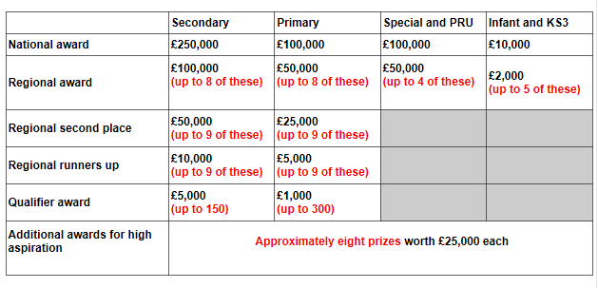
KS2 Pupil Premium Award 2015 and 2016

Slide 16
Soft Federation / Collaboration
Fixed term
Separate Governing Bodies
Separate Budgets
Separate Admissions Arrangements
School specific contracts for permanent members of staff
Jointly agreed termination arrangements
Jointly shared costs/commissioned services

Slide 17
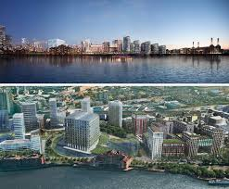
Kennington Regeneration
Zone

Slide 18
Ashmole Primary School
Section 8 monitoring visit
February 2015

