Slide 1
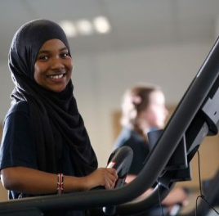
Introducing Whitefield School….
Whitefield School
Live, Learn, Aspire, Achieve
Notes:
Film clip produced by my Media Studies staff and students at the school
I can take no credit for the production of this, just for choice of the old fashioned music, a song which I actually happen to like!

Slide 2
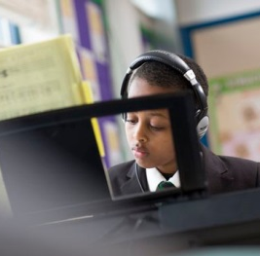
Whitefield School
The improvement journey at Whitefield School
Liz Rymer, Headteacher
June 2016
Live, Learn, Aspire, Achieve
Live, Learn, Aspire, Achieve
Notes:
Delighted to be here today, delivering a brief starter activity to a class of students…..
Hope you will all behave and be attentive!

Slide 3
Whitefield School
Class of 2015
KS2 APS 24
47% FSM
10 /136 HA (L5+)
41% LA
19% of these LA students got 5+ A* to C inc English and maths (versus only 6.7% national) , 4th in UK and top in London
70%+ achieved A* to C in English
Live, Learn, Aspire, Achieve
Notes:
First, I want to start by returning to a few of the statistics you saw, briefly, in the film clip
Last year’s data on my 2015 year 11 students
Successfully achieved some credible results, especially with our low ability students. And in a school with 41% low ability student, we have to be good at this!
But also in a school with 88% EAL students, we achieved 72% A* to C in English
Got us some positive publicity, (Schools Week alternative league tables) which is the only reason I am standing here today

Slide 4
Whitefield School
So why am I here?
Live, Learn, Aspire, Achieve
Notes:
Lots of school improvement strategies we have used, many of which we have heard or will hear about today
Just picked out a few I am particularly keen on, and have led us, I believe, to be named as a school where low ability students are not being left behind….
I am very proud of this

Slide 5
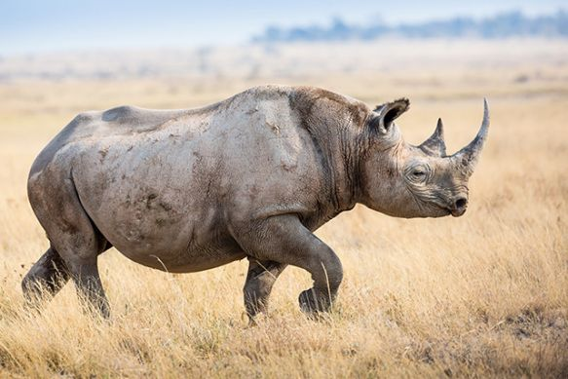
Whitefield School
Live, Learn, Aspire, Achieve
Notes:
Not a panda…..

Slide 6
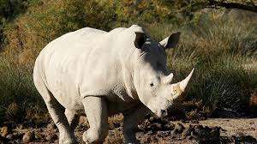
‘WE DON’T WANT ANY RHINOS’
Whitefield School
R = Really
H = Hear
I = In
N = Name
O = Only
Live, Learn, Aspire, Achieve
Notes:
This was our headline from Schools Week, January 2015
Heard a consultant called David Moorer speak back in about 1990 – 1 in 4 students in secondary school don’t speak to a member of staff during an average school day, really stuck in my mind
Together with books such as Toxic Childhood, by Sue Palmer, makes me want to talk to as many of my students as I can as often as I can
Rhinos, lost students, grey students - whatever you call them, I don’t want them in my school
So these are some of the things we do to prevent this….

Slide 7
Knowing students as individuals
Whitefield School
Forensic analysis of data by all
RAP meetings where progress of all is discussed
Structured Line Management meetings
Pen Portraits on every class so staff must know their students
Trips and events
Talk to the students at every opportunity
Corridor etiquette, single file queuing…
Live, Learn, Aspire, Achieve
Notes:
Have to know every student in every subject
Use RAP model, where the data of every student in every subject is analysed at a variety of levels – class teacher through pen portraits, ML through their M&E roles, SLT through LM meetings with fixed agendas that focus on progress, to regular discussions with me and my very strong Governing Body
But also want to engage with students as individuals – offer lots of trips, many of which my students would never experience for themselves – 350 annually to the pantomime to experience live theatre
Teaching students about holding doors open for each other and single file queuing in the canteen encourages staff to talk to more students on duty

Slide 8
Whitefield School
Fit for purpose curriculum
Two year KS3, three year KS4
Vertical GCSEs @ KS4 (Yrs 9, 10 and 11)
One year GCSEs
Linear A levels
Three year sixth form
Rich extra-curricular programme
Structured form time programme
Doing what is best for our students
Live, Learn, Aspire, Achieve
Notes:
Must ensure that what we are offering and the way we are offering it suits our students. We have to get them to want to come to school, or we can’t help them
Currently about to start our third year with a vertical curriculum, in fact changing our timetable on Monday
Struggling to carry on with this model with the new GCSE specifications, but we will carry on somehow with this.
It suits our students, especially in a school with such high mobility figures

Slide 9
Whitefield School
‘Wrap around’ support
Two form tutors per form class
AM and PM registration
Non teaching Pastoral Support Officer and teaching Director of Progress per year group
Mentoring schemes
Alternative Education Programmes
CEIAG Quality Mark, Healthy Schools
96%+ attendance, top 5% in UK
Live, Learn, Aspire, Achieve
Notes:
But we can’t get away from the fact that many of our students come from troubled backgrounds, many refugees, many troubled families, many In Year Fair (unfair) Access students
We have to get these students into school, and we have to support them, through thick and thin, when they do arrive
And arrive they do (96%+ attendance)
Support them in every way we can….

Slide 10
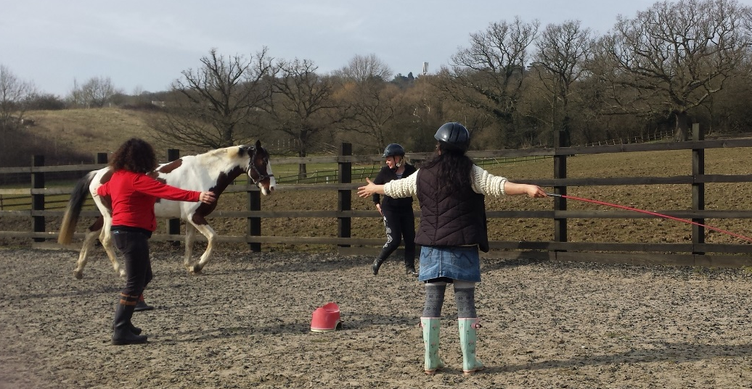
Whitefield School
Live, Learn, Aspire, Achieve
Notes:
I will try anything, recently won some funding to pay for horse therapy, (which pleases me as a horse owner)
And gets a year 9 student into school regularly for the first time for two years!
Already booked for next year

Slide 11
Effective partnerships with parents
Whitefield School
Unique KS2 Primary Liaison and Transition
Welcome Evenings
Shows, concerts, exhibitions
Guidance leaflets for parents
Use of translators
Parent workshops
PTA
Emails not post
MCAS
90%+ turn out @ Parents Evenings
Live, Learn, Aspire, Achieve
Notes:
Links with parents starts at KS2, way before they come to Whitefield
Work closely with partner primary schools, all 52 of them!
Encourage parents and families to come in at every opportunity – Welcome Evenings, workshops, PTA, shows and concerts, exhibitions
Send right things home in an accessible format, target those who don’t come in, expectation that parents do come in

Slide 12
Whitefield School
Lots of other strategies I could
have talked about…..
B4L
AfL
Interventions
QFT
Coaching
M&E
Unifrog
CPL
L&M
Live, Learn, Aspire, Achieve
Notes:
Lots of strategies that I could have talked about, but time is short

Slide 13
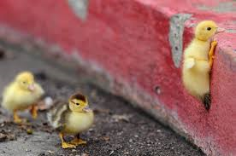
Whitefield School
Sometimes, things are tough…..
Live, Learn, Aspire, Achieve
Notes:
Finish with my final animal image – things are tough at times, especially for some of the students at Whitefield School

Slide 14
Whitefield School
Culture of no limits
Aim to be ‘the best that we can be’
Live, Learn, Aspire, Achieve
Notes:
But we always strive to be the best that we can be…..

Slide 15
Come and see for yourselves…
Whitefield School
Liz Rymer, Headteacher
ery@whitefield.barnet.sch.uk
Live, Learn, Aspire, Achieve
Notes:
So I welcome visits to the school.
Thank you for listening

Slide 16
Headteachers’ Panel Session 1
What Works in School Improvement?

