Slide 1
Making use of assessment data to drive school improvement
J. West
Lambeth Conference
June 22 2016

Slide 2
Why did we even HAVE levels?
The magic idea of MEASURING in a way that everybody understood!
Who are the stakeholders involved in this ‘improvement’ process?
Students
Families
Us – the school institution
Them – external verification processes

Slide 3
What data do students need to understand to make improvement?
Formative assessment – grades and levels can impede students’ ability to engage with targets.
Progress over attainment
Staff expertise

Slide 4
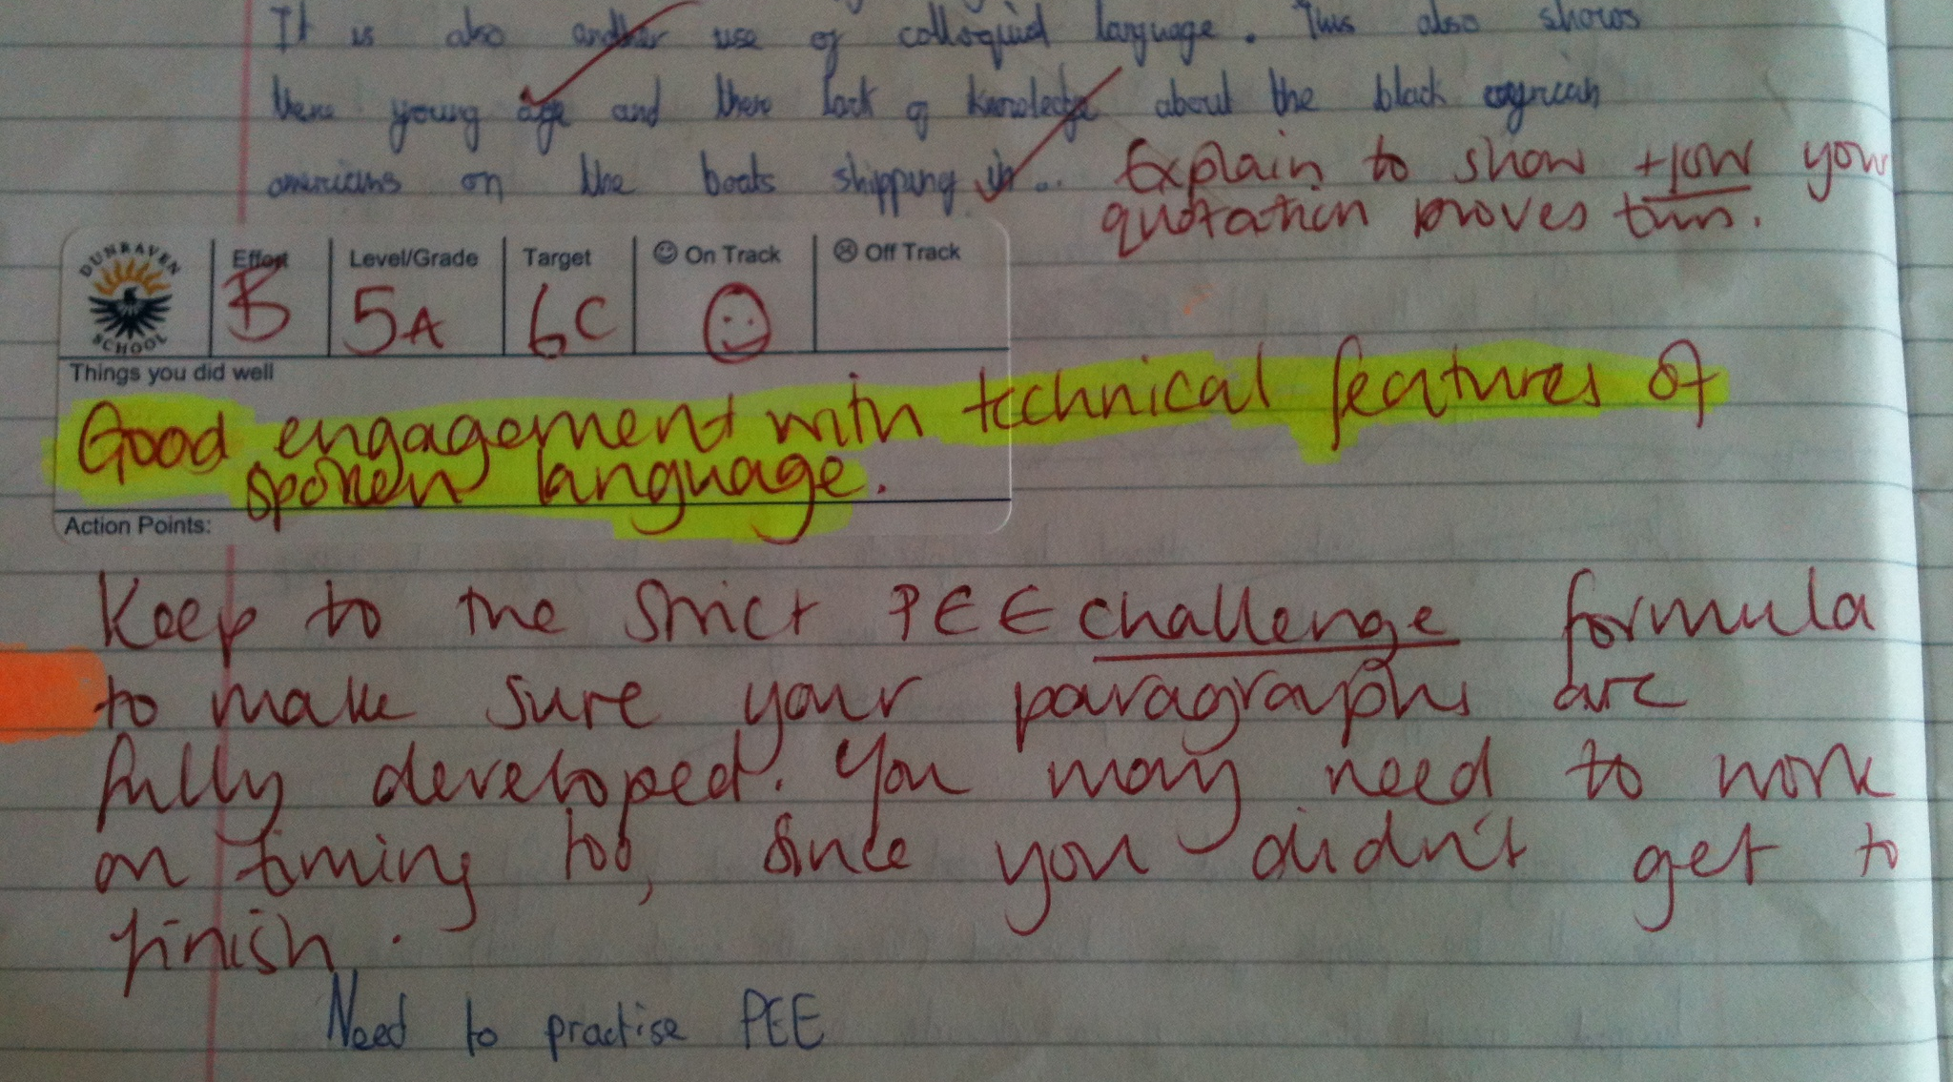
The only ‘data’ that students therefore engage with shows their rates of progression

Slide 5
Task level (FT) | Process level (FP) | Self-regulation level (FR) | Self level (FS)
Feedback about a task or a product – directions to acquire more, different or correct information.
Feedback about the learning process that requires understanding.
Feedback to students is focused at the self-regulation level, including greater skill in self-evaluation or confidence to engage further on task.
Feedback that is personal in the sense that it is directed to the ‘self’. Often this is unrelated to performance on the task.
Which is the most/least effective?

Slide 6
Task level (FT) | Process level (FP) | Self-regulation level (FR) | Self level (FS)
Most common
Relates to correctness, neatness, behaviour
90% of question in classrooms are aimed at task level (correctness)
Too much FT is negative
More effective than FT for enhancing deeper learning
Relates to cognitive processes
Strategies for error detection (green penning) and subsequent action
Most important and effective
Encourages self-assessment and regulation to improve future learning
Less effective learners depend on external factors for feedback
Least effective
“Good girl” is a personal evaluation
Links with TTA’s Growth Mindset and types of praise

Slide 7
What do families need to understand to support improvement?
That YOU know what you’re doing!! Managing transition
What your system is based on, how reporting will work, and how they can expect that to map to next steps/outcomes.
That your system enables them to see concerns and achievements so they are empowered to intervene.
The framework should help families manage expectation, but they’re working with data relating to rates of student progress

Slide 8
The Dunraven Strategy
Year 7 Maths - HT1
 | Some | Expected | Above
1.1 | Students should able to……. | Students should able to……. | Students should able to…….
1.2 | Students should able to……. | Students should able to……. | Students should able to…….
2.1 | Students should able to……. | Students should able to……. | Students should able to…….
2.2 | Students should able to……. | Students should able to……. | Students should able to…….
3 | Students should able to……. | Students should able to……. | Students should able to…….
Benefits – no sense of ‘labelling’, promotes growth mindset based on effort and perseverance
Challenges – need to be clear this is based on prior attainment and manage expectations for KS4 attainment.

Slide 9
What do we need to understand to drive school improvement?
To what is your tracking anchored? What is your benchmark? Banding, baseline testing, Teacher Assessment – your own or from feeder institutions? Can you get forensic with what you’re producing?
The mechanics of your data – staff? Data sets entered? Software?
Do your subject leaders know how to use and manipulate what you’re now producing? Are they literate enough to be empowered?
Leadership – does your data help you anticipate and understand what’s going to be on your RAISE report?
Schools need much more knowledge of this data – enough to know whether the rates of progress are acceptable, and to defend/act in response.

Slide 10
What to ‘they’ need to understand to validate school improvement?
Your data – starting points, in-year progress, mapping to nationally comparable benchmarks (GCSE, 1-9, Standardised testing).
Your timetable for transition of assessment mapping – what’s the journey for your cohort mapping and targeting?
In house QA processes – new work to old, school-to-school comparison (intelligent partnerships), drawing down from next phase for benchmarking.
‘They’ need to receive all of your data (with analysis), and a one-page summary of all the context and decisions you’ve made

Slide 11
Questions, comments, queries, next steps…

Slide 12
Summary for feeding back to students
There are four major levels of feedback.
The type of feedback and way it is given can be differentially effective.
Feedback on the process (strategies to correct errors) is preferable to feedback on the task (right or wrong)
Least effective feedback will focus on the self; doesn’t relate to the task performance.
Most effective will encourage self- regulation (efficacy and assessment) where pupils seek and deal with feedback information to improve future learning.

Slide 13
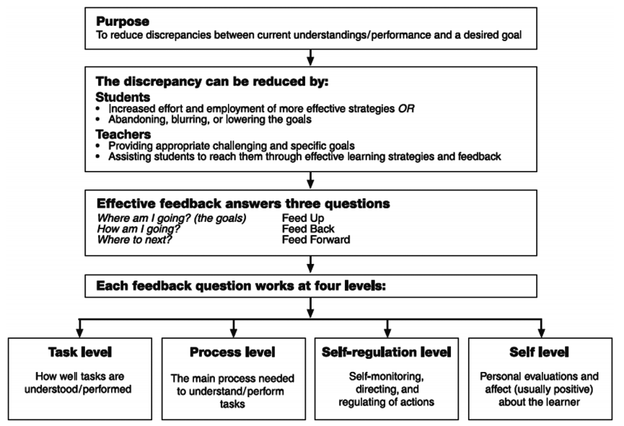

Slide 14
Sample assessment Model 1 - Linear Approach

Slide 15
Sample assessment Model 2 - Minimum level for ALL approach
 | Year 7 | Year 8 | Year 9
1 | Beginning (Y7)
2 | Developing (Y7)
3 | Secure (Y7) | Beginning (Y8)
4 | Extending (Y7) | Developing (Y8)
5 | Excelling (Y7) | Secure (Y8) | Beginning (Y9)
6 |  | Extending (Y8) | Developing (Y9)
7 |  | Excelling (Y8) | Secure (Y9)
8 |  |  | Extending (Y9)
9 |  |  | Excelling (Y9)

