Slide 1
Kevan Collins 22nd June 2016 info@eefoundation.org.uk www.educationendowmentfoundation.org.uk

Slide 2
What next…
Taken as read:
Structures and systems matter but are not an end in themselves
Evidence about what we do is more accessible and readily available and we have a professional obligation to make use of what to know to inform our work
Nothing matters more than recruiting, nurturing and developing our teachers
Budgets will tighten - we need to appreciate the value of what we spend and become savvy about education returns
We are at the foothills of a technological revolution that has the potential to transform education

Slide 3
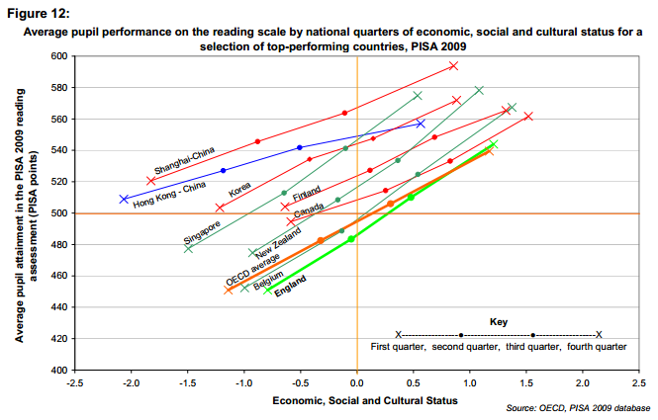
International context
“In England the impact of pupils’ socio-economic background is significantly higher than the OECD average. ... England’s slope is steeper than the OECD average, with weakest performance in the bottom half of the ESCS range despite pupils not being as disadvantaged.”
Source: ‘PISA 2009: How does the social attainment gap in England compare with countries internationally?’ (DfE, 2012)

Slide 4
Outstanding business…
The progress made by our most disadvantage children
Our professional responsibility to teach beyond narrow attainment outcomes
Getting serious about supporting and developing the ‘life-cycle’ of a teacher’s career
Investing in quality to reap the benefits of the early years offer
Acknowledging our collective and systemic failure to address the post 16 offer

Slide 5
Signs of promise
The pupil premium has encouraged us to face and address the issue of education disadvantage
New partnerships are building genuine science to support our work beyond academic outcomes
Emerging school led structures are creating new opportunities for collaboration and shared learning
Growing appetite to support rigorous research and evaluation to determine what works and inform disciplined innovation

Slide 6
The questions we will be asked…
Are more teachers engaged in collaborative learning and enquiry?
Have the gaps between children from different backgrounds closed?
Has the level of variation between schools narrowed?
Are children more engaged and motivated to learn and work hard?
Is there more competition to join the teaching profession?

Slide 7
How to get involved
Apply for funding
Our new general funding round opens this month.
Visit: http://educationendowmentfoundation.org.uk/apply-for-funding/
Volunteer to take part
We are always looking for schools to volunteer to take part in EEF-funded projects.
Visit: http://educationendowmentfoundation.org.uk/projects/how-can-i-get-involved/
Do it yourself
Our DIY Evaluation Guide, developed with Durham University, is a resource intended to help teachers and schools understand whether a particular intervention is effective within your own school context.
Visit: http://educationendowmentfoundation.org.uk/evaluation/diy-evaluation-guide/
Notes:
We think the EEF is part of the picture – we’re not the solution, but we aim to work with others to get there.

