Slide 1
What makes great teaching? Lessons from research and practice
What Works in School Improvement Good Practice
Wednesday 22nd June 2016
Institute of Education, UCL,
Professor Steve Higgins,
School of Education, Durham University
s.e.higgins@durham.ac.uk
@profstig

Slide 2
Headlines
Great teaching is hard to define
What should we look for? What can we see?
Excellent (and poor) teachers/teaching are hard to identify
Signal is hidden by noise, biases & confounds
There are many ways to be effective
Feedback can promote teacher learning, if
We are clear what we want teachers to learn
We are clear how we assess that learning
We give the right kinds of feedback in the right ways

Slide 3
1. Pedagogy

Slide 4
Dimensions of great teaching
(Pedagogical) content knowledge
Quality of instruction
Classroom management / behaviour / control
Classroom climate / relationships / expectations
Beliefs (theory) about subject, learning & teaching
Wider professional elements: collegiality, PD, stakeholder relationships
Notes:
Coe, R., Aloisi, C., Higgins, S. and Elliot Major, L. (2014) ‘What makes great teaching? Review of the underpinning research’. Sutton Trust, October 2014 http://www.suttontrust.com/researcharchive/great-teaching/

Slide 5
1. We do this already (don’t we?)
Reviewing previous learning
Setting high expectations
Using higher-order questions
Giving feedback to learners
Having deep subject knowledge
Understanding student misconceptions
Managing time and resources
Building relationships of trust and challenge
Dealing with disruption – maintaining lesson ‘flow’

Slide 6
2. Do we always do this?
Challenge pupils to say why an activity is taking place in the lesson
Ask lots of questions and check responses of all pupils
Use different types of questions with an appropriate level of challenge
i.e. process and product; open/closed; higher/lower order
Give time for pupils to respond
Space-out teaching and/or practice on a given topic, with gaps in between for forgetting
Have pupils take tests or generate answers, even before they have been taught the material
Engage pupils in regular review to embed

Slide 7
3. We don’t do this (hopefully)
Use praise lavishly
Allow learners to discover key ideas for themselves
Group learners by ability
Encourage re-reading and highlighting to memorise key ideas
Address issues of confidence and low aspirations before you try to teach content
Present information to learners in their preferred learning style
Ensure learners are always active, rather than listening passively, if you want them to remember

Slide 8
Just a check-list of techniques?
No! Great teaching involves
selecting, integrating, orchestrating, adapting, monitoring, responding, etc. …
… and depends on
context, history, personalities, relationships, etc.
But without advanced skills, a teacher’s choices are more limited
Developing expertise takes dedicated, extended practice, with feedback

Slide 9
2. Identifying great practice

Slide 10
Methods of identifying effectiveness
Classroom observations by peers, school leaders or external evaluators
‘Value-added’ models (assessing gains in student achievement)
Pupil ratings and feedback
Headteacher judgement
Teacher self-report and refection
Analysis of classroom artefacts and teacher portfolios

Slide 11
Sustained professional learning is most likely to result when:
Focus kept clearly on improving learning outcomes
Feedback related to clear, specific and challenging goals for the recipient
Attention on the learning rather than the person or comparisons with others
Teachers encouraged to be continual independent learners
Feedback mediated by mentor in environment of trust and support
Environment of professional learning and support is promoted by the school’s leadership
Notes:
Coe, R., Aloisi, C., Higgins, S. and Elliot Major, L. (2014) ‘What makes great teaching? Review of the underpinning research’. Sutton Trust, October 2014 http://www.suttontrust.com/researcharchive/great-teaching/

Slide 12
Beware these traps
Over-confidence about knowledge of what is effective
Focusing on teaching rather than learning
Thinking that we are doing it already
Over-confidence in assessments (even if formative) of teaching quality
Thinking we know “what works” rather than have evidence about “what’s worked”

Slide 13
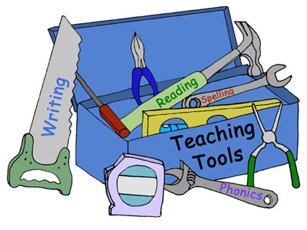
3. Tools to develop great teaching

Slide 14
Two points of leverage
Developing specific skills, techniques and expertise
Takes dedicated, extended practice, with feedback
Developing teachers’ beliefs and ‘theories’ about how and when to use specific skills
All teachers have existing theories: some may be better than others
Building new theory means starting from (and challenging) existing ones

Slide 15
Pupil survey (from Tripod)
Students’ behaviour in this class is under control.
I hate the way that students behave in this class.
Students’ behaviour in this class makes the teacher angry.
Students’ behaviour in this class is a problem.
My classmates behave the way my teacher wants them to.
Students in this class treat the teacher with respect.
Our class stays busy and doesn't waste time.
Notes:
See http://www.metproject.org/resources.php

Slide 16
Measuring quality of instruction
Requires ‘high inference’ judgements
May be no alternative to extensive training (e.g. CLASS, Danielson, FFT)
Worth trying:
Specify skills and context (e.g. reading diagnostics, questioning to check understanding)
Peer review of short video clips from teaching
Ratings using ACJ (Adaptive Comparative Judgement)

Slide 17
Tools/strategies must …
Challenge ‘we think we do that already’ mindset
Keep the focus on pupils’ learning
Build in impact evaluation: does using it actually improve outcomes?
Cannot work without background of good assessment of student outcomes: valid and reliable

Slide 18
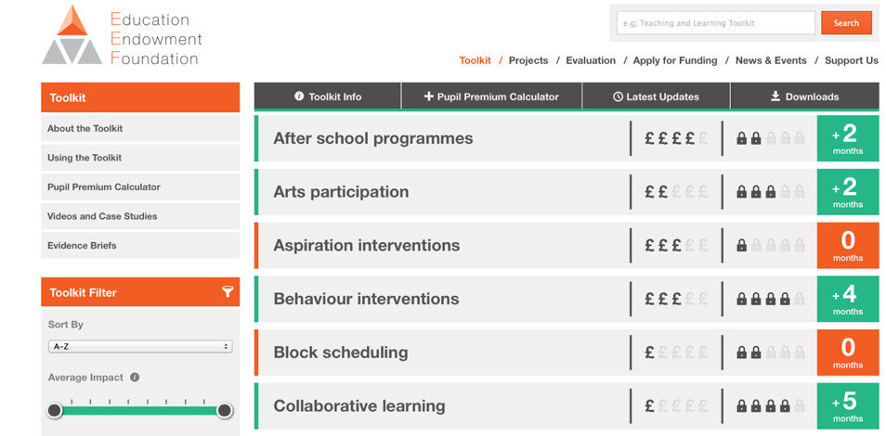
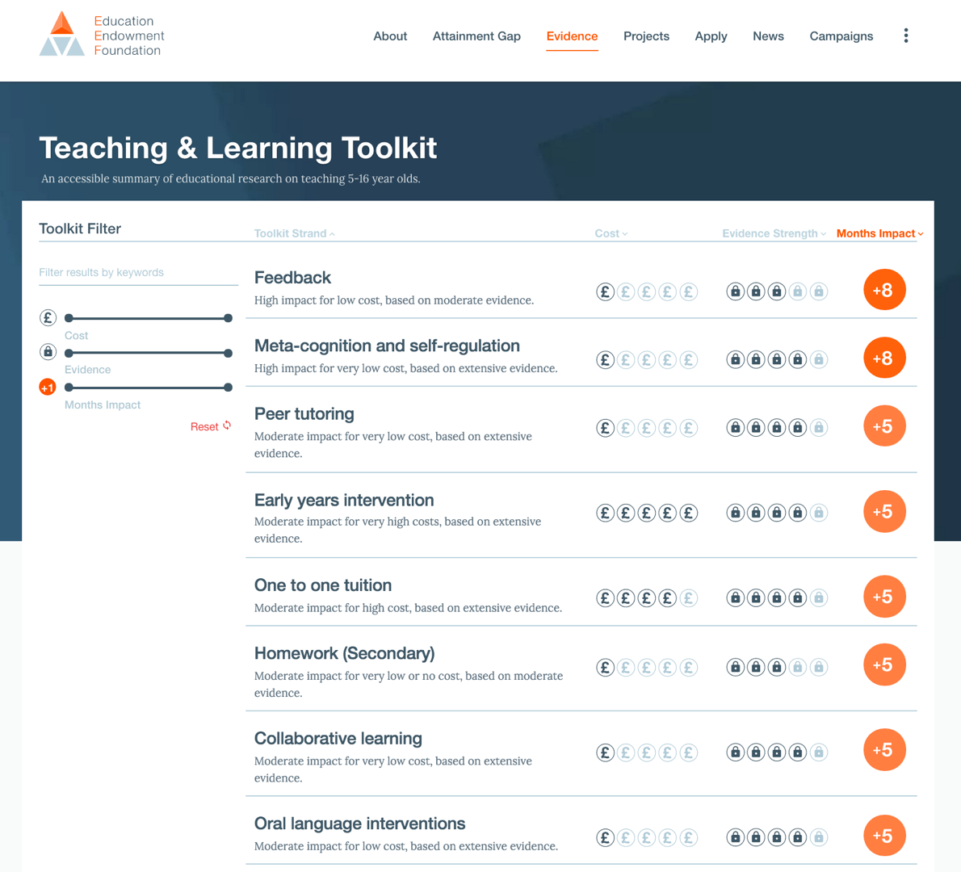
Sutton Trust/EEF Teaching & Learning Toolkit
http://educationendowmentfoundation.org.uk/toolkit
Best ‘buys’ on average from research
Key messages for Pupil Premium spending
Currently used by about 60% of schools

Slide 19
‘Best bets’ for development
www.educationendowmentfoundation.org.uk/toolkit
1.0
Promising
Feedback
Could be worth it
Meta-cognition
Effect Size (potential gain)
Peer tutoring
EY intervention
Homework (Secondary)
1-1 tutoring
Reading comprehension strategies
Small group
Phonics
Digital technology
Parental involvement
Smaller classes
Individualised learning
Extending school time
Teaching assistants
Needs careful thought
0
Performance pay
£0
Ability grouping
£1000
Cost per pupil

Slide 20
3. Promoting and developing great practice

Slide 21
Practical ideas …
Guide to help teachers to focus on what really matters
Research-based elements of effectiveness: what’s worked and why
Tools to help teachers to see progress against immediate goal
E.g. tool for tracking student time on task, quality of questioning, high expectations, diagnosing need
Assessments to keep longer-term goals in view (and evaluate against them)

Slide 22
An assessment continuum
Diagnostic
Formative
Summative
Time of teaching sequence
What needs to be taught?
How do we close the gap?
How successful was the learning and/or the teaching?
Prospective
For the teacher
Subject specific
Concurrent
For the learner
Outcome specific
Retrospective
Multiple audiences

Slide 23
What diagnostic tools do you use?
Running records in reading?
Diagnostic assessment of spelling errors?
Careless mistake or error indicating misunderstanding in maths?
Use of ‘concept cartoons’ in science?
Diagnosis focuses on efficiency of teaching as well as its effectiveness

Slide 24
“After 30 years of doing such work, I have concluded that classroom teaching…is perhaps the most complex, most challenging, and most demanding, subtle, nuanced, and frightening activity that our species has ever invented…The only time a physician could possibly encounter a situation of comparable complexity would be in the emergency room of a hospital during or after a natural disaster.”
Lee Shulman: The Wisdom of Practice

Slide 25
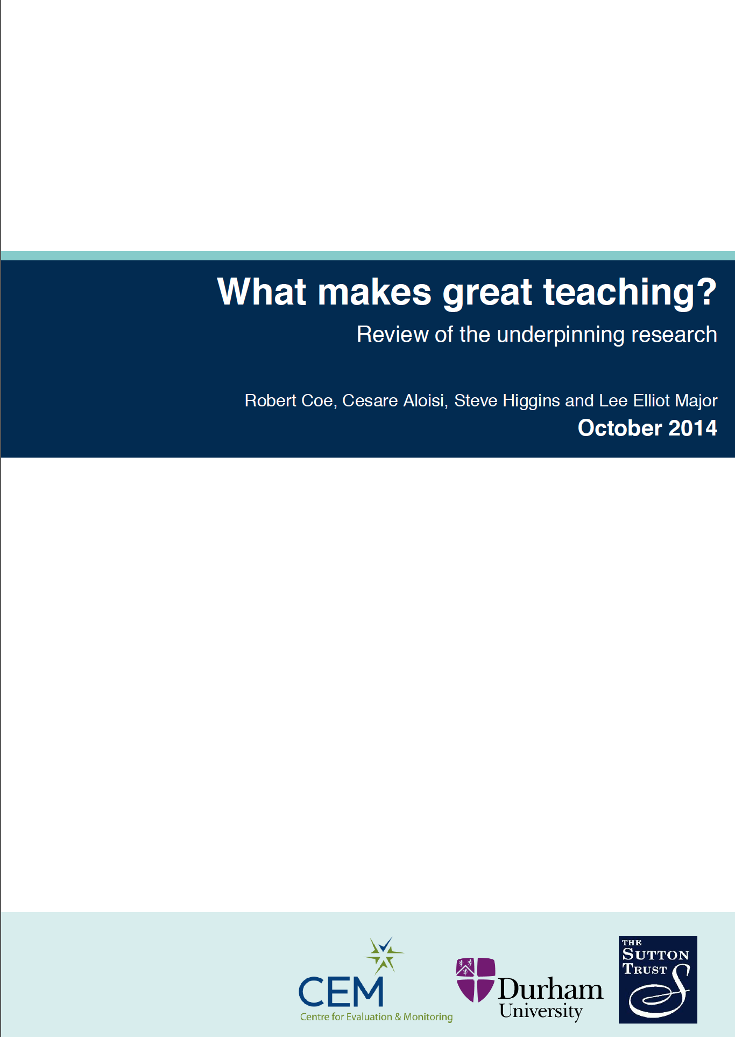
Further reading:

