Slide 1
Orlene Badu St Matthias Church of England Primary School

Slide 2
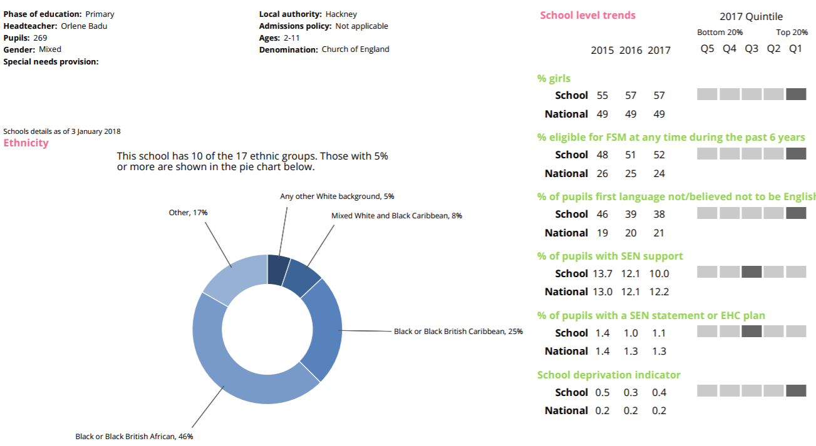
Our School
School statistics
Community- temporary housing, new to the country- pupil mobility
Notes:
Pupil mobility continues to be an issue
I wish there was a box on here for number of families with No Recourse to Public Funds to reflect a very vulnerable group that we support

Slide 3
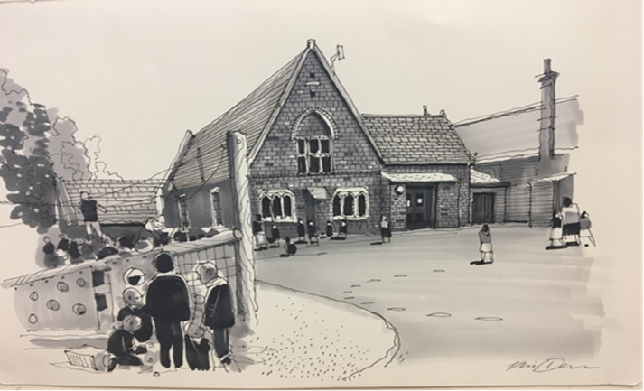
Hackney context
Approx 53,000 working aged people are affected by a common mental health condition
Young Black Men Project- Hackney
44% of households rent from a social landlord
Running county lines/ knife crime/ gang affiliation
36% of people live in poverty

Slide 4
The child is at the heart of everything we do
Notes:
My key question to every request- how will that help the child?

Slide 5
Know your community
Deep, valuable work with vulnerable groups that has an impact cannot happen without knowing your community
This is a prerequisite to ensuring strong outcomes that will support children throughout their lives and ensures that Exclusions and poor attendance are kept low
A commitment to understanding your community is a powerful tool and is incredibly empowering for the children and the school
Myself, Pastoral Manager, SENCo and Assistant head are on the school gates EVERY morning- this is where we get most of our INTEL
Notes:
Understanding our community is a powerful tool for a school in understanding, meeting the needs of and securing rapid and sustained progress for the children

Slide 6
Some of the things we know:
As a school we are aware that Black Caribbean children do not need to be changed- they are not the problem.
The system is what needs changing and at St Matthias we have looked extensively at that system and reflected on strategies we can implement to ensure high outcomes.
Notes:
Now I would like to share some of the key strategies we have used to engage our Black carribean children and their families

Slide 7
Pastoral Manager- Her role is KEY
Highly effective Pastoral Manager who cares deeply about the children
Due to a robust induction which included clear and detailed information about our community she was able to build solid relationships very quickly with children and their families
She understands the parents, their interactions and behaviours and that of their children
This relationship has supported her work in: empowering the children with how to increase their self esteem and confidence, enabling children to overcome external pressures that can be negatively impacting on their ability to retain learning, she deals with a range of behaviour issues and has regular, rigorous and open conversations about the impact of poor attendance, also monitoring it closely
Notes:
At first we were concerned that not having a male would not benefit some of the vulnerable boys we work with but she soon taught us that the relationships you build are the most important factor!

Slide 8
Data- ‘No excuses’
SLT’s language is vital: expectation that every child must make at least good to outstanding progress
Teachers have to use Data to inform their planning and differentiation- by owning it they are empowered to challenge and extend
The barriers to learning are not an excuse for poor outcomes; we must find solutions to these barriers to ensure children make progress
Every teacher held to account for the progress children make over the year
During our Data and progress meetings across the year one of our key areas of focus on our action planning: Black Caribbean children.
Notes:
By tracking black caribbean children across the year it has decreased variation and an opportunity regularly to ensure they continue to build on progress every year

Slide 9
Drive for Quality First Teaching
Rigorous drive for Outstanding and Good teachers that will ensure all children in their class will achieve and make significant progress
Every child has to make progress and meets or (preferably) exceeds expectations with high quality teaching day in and day out
The monitoring schedule in our school is rigorous, planned for and informs everything that we do to ensure improvements in teaching and learning
We work in a high- performing Federation of schools which allow us to share good practice and pedagogy, observe a range of teaching in a range of schools and deepen understanding of teaching and learning to benefit their own practice and outcomes for children in their care

Slide 10
Diversity in the workforce
33% of teachers are BME
79% of support staff are BME
25% of our SLT are BME
The children need very clear role models within all levels of the organisation to aspire to and have the support of
We have begun an exercise analysing our recruitment process to identify if there any changes that can be introduced to increase the amount of applications we get from a diverse range of teachers and senior leaders
www.behaviourialinsights.co.uk

Slide 11
Cultural Competency CPD
Unconcious bias
Institutional racism
Racial identity
Stages of racial identity and awareness (black and white)
Post- Traumatic Slave Syndrome
Providing a Culturally Inclusive education
Honest reflection on long- standing challenges black people face in the UK and strategies to support them in overcoming these barriers as well as changes to our systems
This training had a deep and lasting impact on all staff members and ultimately the children- lead to higher expectations and openness to challenges
Dr Laura Fontaine
www.freemindclinic.org.uk

Slide 12
Culturally and Locally- influenced Curriculum
We collected the views of children, parents/ carers and staff when restructuring our Curriculum to ensure we were meeting the needs of our cohort with regards to their learning and expectations
We have included topics within our curriculum that range from learning about their immediate locality to the traditions and experiences of their own and other cultures in line with National Curriculum expectations
This has led to an increased participation and engagement of children which ultimately increases their outcomes and progress
We have a range of multi- cultural events and assemblies over the year to engage all sections of our community

Slide 13
Parenting Course- under construction
We are currently writing our own parenting course for Black Caribbean and Black African families that has a firm basis in the knowledge of their communities
As a school we are continually trying to find ways to reflect on our community and identify strategies to improve their access to education, employment and further support.
We have had input from an Educational Psychologist, Consultant Psychologist and an Aspace- play therapist

Slide 14
Transition arrangements- CRUCIAL
Working within a borough committed to improving outcomes
Hackney has created a thorough reporting system that all schools must complete for the most vulnerable children about any concerns we may have and positive strategies to support them through transition
This allows the school to ensure that the school has the key information necessary to support a smooth transition and positive beginning
Headteachers and Senior Leaders of Secondary schools have also visited our primary school to identify what the expectations are in Year 6 and the quality of work the children are producing at the end of
Year 6

Slide 15
Advocacy programme to improve engagement with Agencies
Our school Home support worker often acts as an advocate for our vulnerable parents- part funded by the Schools Home Support Charity
This service has been vital as we have experienced a range of issues that families say they have faced as agencies, schools, professionals and others have not always offered them the best support or listened to their concerns fully
It does have a cost implication to the school but ensures that families get the right support and keep the lines of communication open with the school; improving relationships
Parental engagement= Increased outcomes

Slide 16
Interactions with other Agencies
Applied for a borough- wide CAMHS project
Year 6 Police Cadets programme
Claudia Jones organisation
http://www.afruca.org/
Educational Psychologists’ Attachment and parenting programme
Debt management courses
Family work experience visits

Slide 17
If you help one child, you help them all

