Slide 1

Effective Inclusion Practice to Support Disaffected Students in School
Richard Cole
Deputy Headteacher
The Norwood School

Slide 2
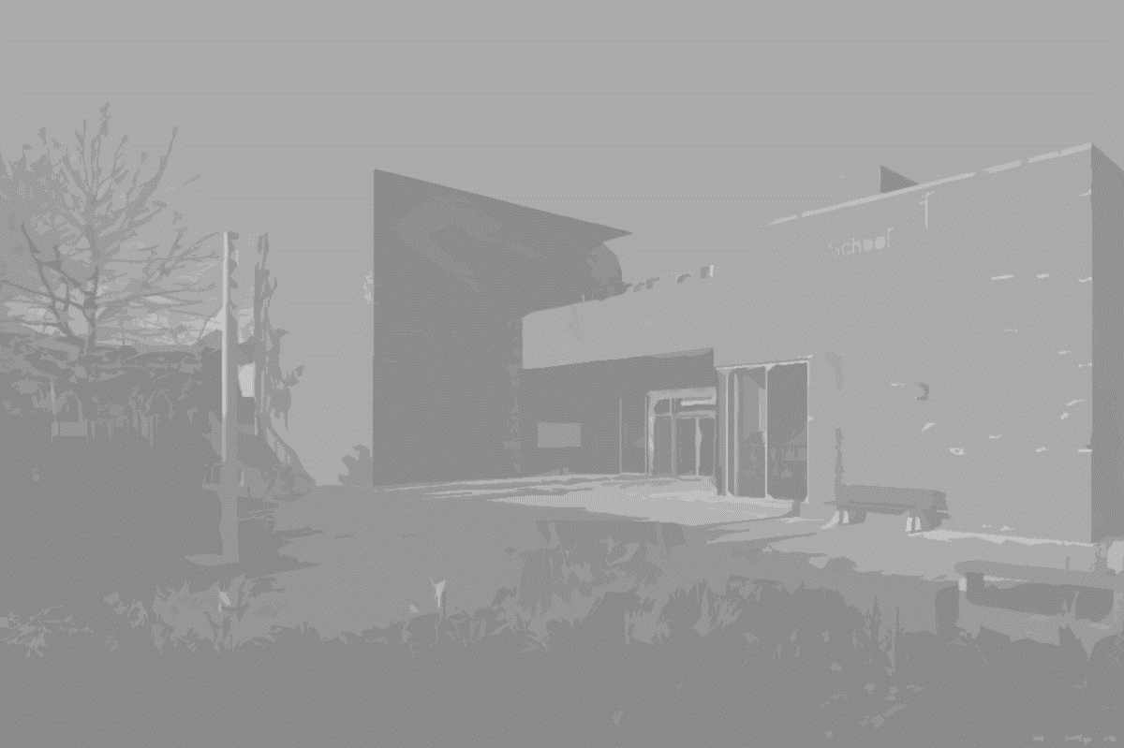
Mixed Community School in the London Borough of Lambeth
Local Authority Controlled School
Specialism in Performing and Visual Arts
Over subscribed with over 800 applicants for 180 places in year 7
130 students in the Sixth Form
P8 score of 0.25
Norwood Girls School
Falling roll (96 in year 11)
High rates of absence and persistent absence
23% 5 A – C inc E and M
8 permanent exclusions in one year and students regularly receiving 15 days worth of exclusions in a term

Slide 3
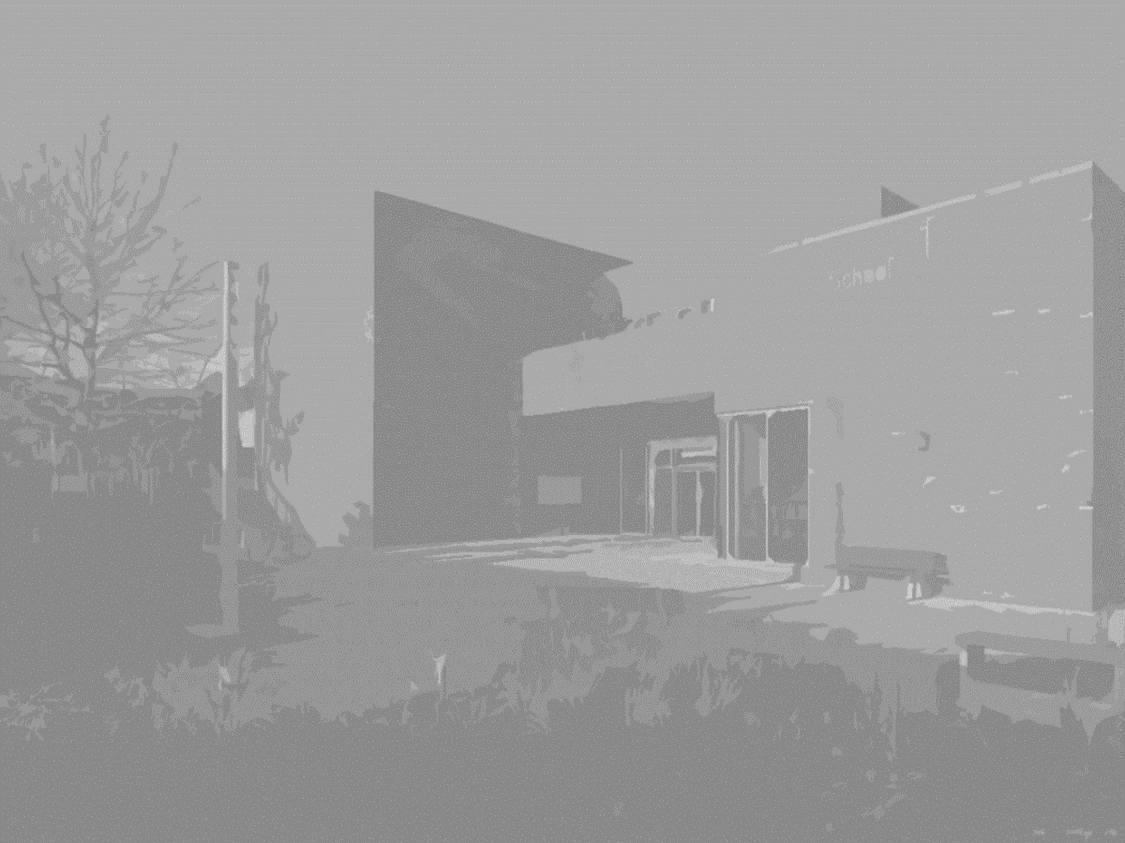
A number of factors were working against us:
1. Failure to establish strong relationships with parents;
The school needed a culture shift and complete reorganisation of its approach to supporting disaffected and disengaged students and their families
2. External influences and lack of engagement and aspiration;
3. Weakness in the provision offered by the school in terms of support;
4. Relatively vast sums of money being spent on external provision and support with limited or no impact
Notes:
Parents were disengaged – did not trust the school; would not even venture near it. Maybe 50% turn out for parents evenings
The lure or pull of friends, mostly older affected our pupils’ motivation to see school as important
Support was either in terms of ludicrously long sanctions or external agencies C44
4. No value for money –people came and went without following up

Slide 4
The Greenhouse
Pastoral Leader
Home / School Liaison Officer
Support Specialist
Support Specialist
Support Specialist
The hub of the school’s support system
Led by Pastoral Leader who oversees organisation of support
Line managed by Deputy Head
Works closely with SENCO and her team and Heads of Year
Structures the work of the Support Specialists
They are transient – work in The Greenhouse and in lessons
Each linked to a KS3 year group
Responsible for key students within the year group
The Greenhouse is multi purpose – is used for internal exclusion (where curriculum work is provided); restorative and reparation practices; parental engagement groups.
Integral part of the school – not an add on
High Expectations and no Excuses
Notes:
Edith, who is multi skilled, often not appreciated or well liked by parents, particularly early on – because she challenges and does not allow excuses. But she is often valued and highly regarded later on when the challenges students present in school are replicated at home. All staff trained to write CAFs, deal with external agencies, child protection etc

Slide 5
What happens when the support is not working?
Need for an alternative to FTEs and PEX. Myself and a colleague in a Lambeth school began the process of a reciprocal arrangement. This now involves ten schools.
FTEs:
Students are referred to a partner school for the length of the exclusion.
They are provided with work to complete in the withdrawal centre of the receiving school
PEX:
Students at risk of permanent exclusion will be offered a trial at a partner school.
This confirms our commitment to our own students and other young people in our community who attend neighbouring schools
Notes:
At least 8 potential pex saved over the last two years

Slide 6
It ensures pupils continue to learn and promotes their independence as learners.
It removes the burden from parents having to stay at home and look after the pupil, or pupils being left to their own devices at home.
It allows schools to ensure that their attendance targets are not unduly affected, by marking them under the B code.
No financial costs are incurred by the sending or receiving school.
It builds relationships between schools and colleagues.
It ensures that vulnerable pupils who might be on a CP plan are still monitored by professionals.
It allows schools to carry out investigations, into more serious matters without the victim being left vulnerable around school.
It shows parents that as a collective of schools we wish to support their child in succeeding in a mainstream setting.
It provides a platform to arrange a Managed Move between schools, in lieu of no Fair Access Panel.

Slide 7
Other successful strategies:
School opening hours 7am-6pm meet n greet from this time
Breakfast Club
MintClass Seating Plan
Clear behaviour systems, routines and structures
Extra curricular and enrichment activities
Greenhouse charity sports programme
Regularly scrutinise all data
Notes:
Some of the neediest children are in school early. Member of staff who does this knows the children and their families. Has a school phone that parents phone.

Slide 8
Attitudinal Data
Monitored across year groups every half term
Provides early indication of concerns re attendance, punctuality and behaviour
Clear link between attitudinal data and academic performance
Also highlights concerns re safeguarding etc
Identifies students who may need immediate intervention
Provides information for tutor and pastoral team
Notes:
Student 2, Student 19, Student 22

Slide 9
In conclusion:
The School maintained its ‘good’ judgement in its recent Ofsted, Dec 12 2017
Inspection showed that:
‘ the school is a strong learning community that works effectively with staff, parents, pupils and a wide range of stakeholders’
‘leaders’ detailed knowledge of the school makes a positive impact on the life chances of pupils’
‘central to your school’s work is the determination to ensure that all pupils, including those from disadvantaged backgrounds, succeed academically’
‘pupils, leaders, governors, and staff share high expectations of learning and the personal development of all pupils. This is also reflected within the range of extra curricular and enrichment opportunities about which pupils speak enthusiastically and from which they benefit’
‘effective use of assessment information by a range of teams across the school who make links between attendance, absence, safeguarding concerns and pupil progress’
‘I just wish others knew how good this school is’ Year 8 student

Slide 10
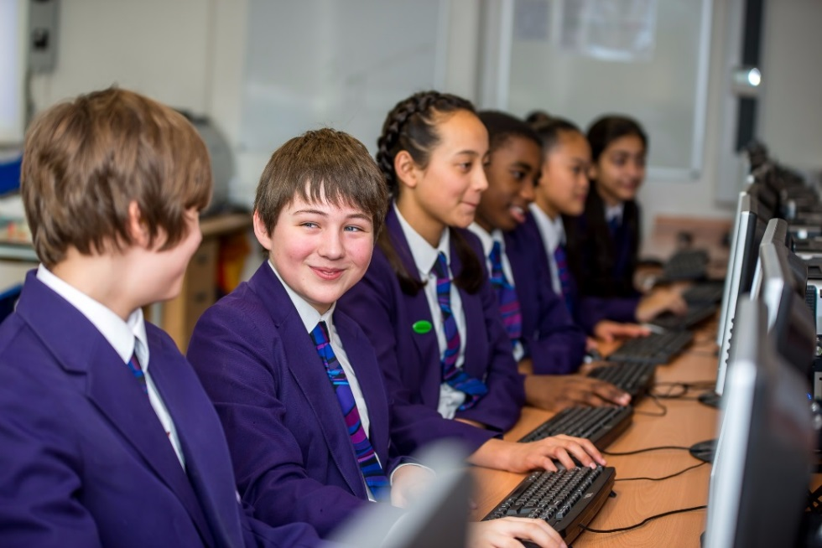


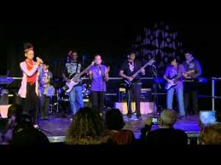


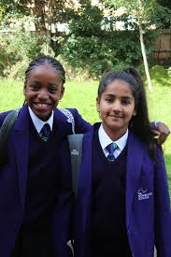
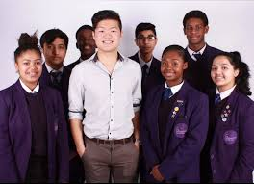


Our success has been built up over time. There was no quick fix and what has brought us to our current position is years of consistent application and continual tweaks. Adjusting as we went. Knowing our school. Knowing where we want it to be. Knowing our students’ needs. Plus, recognising that change requires a whole school approach and the investment in whole school training.
cole.r@thenorwoodschool.org

Slide 11
Successful Strategies in Closing the Achievement Gap
Question and Answer Session

Slide 12

Tea and Coffee Break

