Slide 1

Developing the Role of the EAL Coordinator/Lead
We are all language teachers
Lambeth
Amanda Bellsham-Revell February 28th 2019

Slide 2
The Iceberg Model – Jim Cummins
Stage A of English
Retelling, matching, describing
Up to 2 years
BICS
Basic
Interpersonal
Communicative
Skills
CALP
Cognitive and
Academic
Language
Proficiency
Hypothesising, generalising, evaluating critically
5 to 7 years
Stage E
of English
Notes:
Thinking skills and language functions closely related – go hand in hand.
Children may learn enough language to keep afloat in the classroom. This will affect thinking processes as language and thought are so closely linked.
Not step by step process. Learners will use prior linguistic, learned and world knowledge. They will learn when there is a need to communicate and to learn Progress doesn’t follow a smooth and equal pathway eg may make more progress in listening than speaking, KS2 and older may make more progress in writing than speaking

Slide 3

What are the issues for EAL learners?
              Accessing the content
              Learning the content through an unfamiliar language
              Learning the language at the same time as learning the content
              Participation
Notes:
Being able to access the content/curriculum
Having to learn the content through a language they don’t know
Having to learn English at same time as learning the content – so as teachers we need to be teaching them the language at the same time as the content.
Being able to participate when don’t speak English
CHALLENGE OF KEEPING COG LEVEL HIGH, NOT WATERING DOWN.

Slide 4
EAL Coordinator/Lead
Leadership and Management
Learning and Teaching
Curriculum
Partnerships
RAISE THE PROFILE OF YOURSELF AND THUS THE EAL LEARNERS IN YOUR SCHOOL!
Do all staff know who you are?
Is it on the school website

Slide 5
Leadership and Management Questions to consider
What do you know about pupils with EAL in your school?
Do you have an idea of where the school is in terms of developing EAL provision? ie what is in place and what needs to be developed?
Pupils with EAL are the responsibility of all staff so how can you support them to develop their EAL expertise?
Are the needs of the EAL learners reflected in the SDP?
Is there an EAL policy?
Do you have an action plan?

Slide 6
Leadership and Management
The EAL coordinator should lead in establishing EAL policy and practice across the school in order to accelerate progress and ensure high standards of learning and teaching for pupils with EAL.
Key to this is knowing your school.
ensure the children with EAL are identified and accurate background information is gathered
collect and analyse data to ensure standards and progress
use the data and your knowledge of the school provision:
to identify needs for developing this provision for pupils with EAL
work with SLT to ensure these are reflected in the SDP
create an action plan for yourself based on these needs
organise and monitor/review provision
Notes:
Children with EAL not just the responsibility of EAL lead but of all staff.

Slide 7
What do you know about your pupils with EAL?

Slide 8
Who are your pupils with EAL?
DfE definition:
‘A first language, where it is other than English, is recorded where a child was exposed to the language during early development and continues to be exposed to this language in the home or in the community.
Where a child was exposed to more than one language (which may include English) during early development, the language other than English is recorded, irrespective of the child's proficiency in English.
YOU MUST PUT THE LANGUAGE THAT IS NOT ENGLISH IN THE FIRST LANGUAGE FIELD ON SIMS!!

Slide 9
Children learning EAL …..
…. are a heterogeneous group.
Meeting their needs is dependent on gathering accurate background information.
Age
• First language educational history
• First language literacy
• English language proficiency
• English-medium schooling experience
Other schooling experience
• Academic track record
• Family and community circumstances.
Notes:
SO IMPORTANT KNOW THIS IE IDENTIFYING WHETHER DIFFICULTIES ARE DUE TO EAL OR SEN NEED TO KNOW HOW LONG LEARNING ENGLISH ETC

Slide 10

Gathering essential information
(Supporting Newly Arrived Bilingual Pupils – Reading Council)

Slide 11
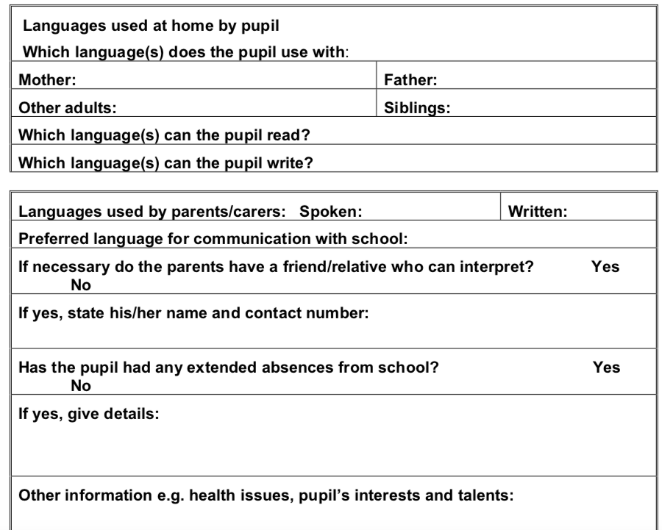
Gathering essential information
EMAS Team Wiltshire Council

Slide 12
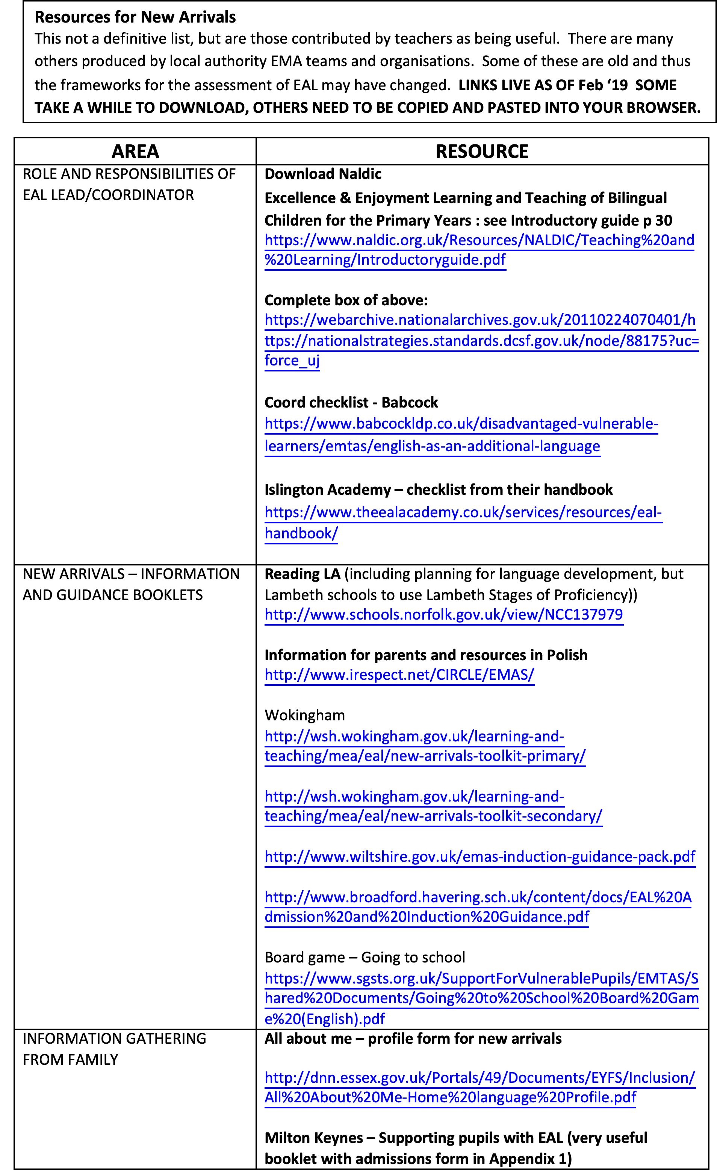
Resource List
1. Role & responsibilities of EAL Coordinator
2. New Arrivals info
& guidance
3. Info gathering from family
4. Information giving
5. Initial assessment
6. Classroom support strategies by stage of proficiency.
7. First days in class
8. First months in class
9. Bilingual Resources
10. Working with parents
11. Useful websites

Slide 13
Know your school
Once you have the information you can develop a school profile.
Who are our EAL learners?
What language are spoken, heard, written and read?
Where were these languages learnt?
What stage of EAL proficiency are they?
Are any groups under-performing?
It’s not enough to just gather this information.
Ensure it is shared with adults working with the children?
Ensure it is used to inform planning and teaching.

Slide 14

How will you gather this information?
Admissions and induction:
Who does this? How accurate is the information gathered?
  Can you establish the first language proficiency?
  Is information given to the parents/carers?
Preparation and planning for new arrival
  When will the child start? Who needs to know?
  Assessment – initial assessment of English but also in curriculum.
  First days and weeks, consider
    pastoral team/tutor
    buddies
    induction programme
    curriculum access
    - first language
    adult support
    pre-teaching
    in-class support
    arrangements where cannot take GCSEs
    ie alternative exams

Slide 15
Assessment of proficiency in English
Progression built into stage descriptors:
Note the qualifiers – some, occasionally, mostly, basic, widening,
Vocabulary
  Not just a single word!
  Affects reading fluency and understanding
  We talk about the children’s range of vocabulary but not about the depth of their vocabulary knowledge
In writing, in addition to common EAL errors ie tense, consider
Inappropriate use of conjunctions ie but and adverbs/adjectives
  Limited to basic subordinators ie because, if, so
  Detail added to end, rather than through noun/verb phrases or movement of clauses
  Overdependency on simple or compound sentences
  Cohesion and structure
Reading – development from decoding to reading with full understanding
Notes:
VOCABULARY HUGELY IMPORTANT. NOT ENOUGH JUST TO IDENTFY, OR TEACH AS LIST NEEDS TO BE IN CONTEXT AND HAVE VOCAB ACTIVITIES
Always related to the expectations for their age
Advanced - while, as soon as, until, after, whilst, what, before, even though.

Slide 16
Vocabulary – ‘fair’
Understand it
Choose when and how to use it
Position in sentence
Pronounce it
Spell it
Structure of it
Changing the meaning – fair/unfair/fairest
Meaning in context (multiple meanings)
Collocations (words that go with it)
Synonyms
Notes:
We tend to focus on ‘breadth’ of vocabulary rather than ‘depth’. Knows a meaning, not how can be used appropriately in sentence, how to change ie fair, fairness, fairly,

Slide 17

Acceptable/appropriate
Fair play
Play fair
Fair price
Fair question
Fair on somebody
Fair warning
It doesn’t seem fair
To be fair .. she was ..
Fair result
Quite large
Fair number
Fair bit to do
A fair way off
Quite good
Fair chance
Fair bet
Fair condition
Idioms
Fair and square
All’s fair in love and war.
Fair means or foul
Fair crack of the whip
Fair enough
Give … a fair hearing
Fairs fair
More than his fair share
It’s a fair cop
Fair game
Fair to middling
Fairest one of all
fair
Treating people equally
We have to be fair to both
Fair trial
It’s not fair
Fair test
Fair share
Weather
Fair wind behind them
Fair weather
Nouns
Funfair
Book fair
Craft fair
Fairground
Pale in colour
Fair hair
Beauty
Fair maiden
Fair of face

Slide 18
Progression in vocabulary
KS1 Speaking Stage B Stage C Stage D
Stage A
Has a wide vocabulary and is beginning to understand that a word can have more than one meaning ie cross and can be used in different ways – cross your fingers
Has very basic
vocabulary relating
to school and
activities
Is acquiring some topic/subject specific vocab but still very dependent on deictic language such as her/there/this and common verbs ie have, be, do, come, go, make
Has a fairly wide vocabulary, including subject-specific words
KS2 Writing
Stage B Stage C Stage D
Has basic vocabulary but may have become familiar with some subject-specific words/phrases
Uses a wider range of vocabulary across the curriculum but not always appropriately:
rapid animal, slammed open
duplication – big,vast, rapidly rushed
overdependent on common verbs make, do, have, be, come, go
Wide range and increasing depth of vocabulary, used appropriately, but needs support to further develop abstract vocabulary, ie envy, democracy
Notes:
Progression from increasing number of words ie range to increasing depth of vocabulary knowledge ie how it can be used in other ways, change meaning etc

Slide 19
Making an assessment
When assessing writing, use a top down approach: consider genre, structure, cohesion first, then sentence structure, vocabulary etc
Notes:
The top down approach is good when assessing any writing – EAL or non EAL
Demands for more academic language increase throughout these key stages, especially in KS2 so be wary of assigning a stage E to any child and look carefully at stage D in KS1
A child at stage D may be working at age related levels in KS1, but the expectation would therefore be that this child will be working above the ARL by the end of KS2 when they will be fluent.

Slide 20
Good practice for EAL assessment
Note qualifiers ie some, occasionally, most, starting,with support/scaffolding
Consider speaking/writing/reading across the curriculum, requiring pupils to use more academic language ie hypothesise, justify.
Pay heed to the influence of support/scaffolding
Reading – decoding progresses more quickly than understanding, particularly inferred. Ensure you use ‘think about’ questions.
Best fit - a child does not need to achieve all descriptors to be at that stage. (Unlike KS1/2 assessments)
Consider against peers with English only
Compare with attainment levels - a child at stage C in KS1/2 won’t be working at ARL in writing. If in doubt compare stage C descriptors with the outcomes for KS1/2 –there will be a mismatch!

Slide 21
Good practice for EAL assessment
Ongoing – build into school assessment cycle
Who is responsible for EAL assessment in your school? Who needs the information?
Ensure checked before submitted
What does the data show?
Do the assessments inform planning and teaching
Are teachers/all adults knowledgeable about effective EAL practice in order to move children forward?

Slide 22
Teaching and Learning - managing EAL provision
Using overview and data analysis to manage provision through:
Class/subject teachers
Work with colleagues to develop their language awareness and use of supportive strategies
EAL Teacher/Teaching Asst
Delivering interventions
ie new arrivals, specific
grammar focus, talking
partners
EAL Teacher/Teaching Asst
- In-class support
- Pre-teaching
Notes:
Classroom and subject teachers have the most significant impact on pupil outcomes via their subject-specific use of EAL teaching and learning strategies

Slide 23
We are all language teachers
Teachers should develop pupils’ spoken language, reading, writing and vocabulary as integral aspects of the teaching of every subject. English is both a subject in its own right and the medium for teaching; for pupils, understanding the language provides access to the whole curriculum. Fluency in the English language is an essential foundation for success in all subjects. NC 2014
.. demonstrate an understanding of and take responsibility for promoting high standards of literacy, articulacy and the correct use of standard English, whatever the teacher’s specialist subject. Teachers’ Standards 2011
Class/subject teachers should plan collaboratively with EAL support teachers or teaching assistants. There should be a focus on both language and subject content in lesson planning. Ofsted 2014
Creating implications for your role in supporting class/subject teachers to develop their own EAL expertise.
Notes:
Not just through training by also through planning/working together with them.

Slide 24
Previous key messages from the DfE
Every child has an entitlement to fulfilling their potential through access to the NC – in a whole school context where pupils are educated with their peers.
Good teaching in an inclusive curriculum provides
the best support for new arrivals.
Teachers should ... have a clear understanding of the needs of all pupils, including those with …….. English as an additional language ….. and be able to use and evaluate distinctive teaching approaches to engage and support them. (Teachers’ Standards)

Slide 25
Plan and monitor the support
  Data will identify pupils/groups needing support ie new to English, developing inference, pre-teaching, using advanced subordinators?
Are you teaching pupils with EAL? If so is this:
  in partnership with class/subject teachers?
  with groups - in class or through withdrawal?
Are you managing others who are teaching the pupils with EAL?
  plan the provision across the school and term, avoiding margarine effect
  ensure it is regularly reviewed and evaluated. Do the pupils transfer their learning into their class work?
Does the EAL teacher plan with the class/subject teacher to ensure the work
is aligned?
There is no EAL teaching/support, in which case the emphasis has to be on developing the EAL expertise of all staff.
  In all scenarios work with all staff to develop their language awareness, knowledge and expertise in teaching pupils with EAL.
Notes:
Make sure you know why you are you working with a particular group not just cos all have EAL or are underachieving. What are their specific needs? Have a clear language objective.
What are implications for your own training then?

Slide 26
Learning and Teaching
Notes:
Now you have collected all this information and data, what do you do with it?

Slide 27
Pupil with EAL
Access to curriculum
Learn English
through the curriculum
Identification and teaching of language demands of the curriculum and needs of the child
Group/partner talk
Scaffolding, orally or talk frames
Srategies
Activate prior knowledge, context, pictures, realia, modelling, graphic organisers, use of L1
Diversity
FOCUSED TALK
Notes:
TALK AND READING ALSO PLAYS A PART ESPECIALLY WITH OLDER CHILDREN.

Slide 28
Access
Don’t water down the content of the lesson in order to make it more accessible – elaborate and contextualise.
Starting points:
Develop the context through:
Linking to previous learning and experiences
  Providing activities and concrete experiences
  Support with visuals, realia, diagrams, tables, timelines videos, computer graphics, graphic organisers
Pre-teaching
Film
Visuals
Taped/translated stories
Use of L1

Slide 29
Learning and Teaching
Should incorporate explicit teaching and learning of language through meaningful interactions.
Identifies both language demands of the curriculum and the needs of the pupil to inform the objective and the language to be modelled by teaching adult/peers in context and used by pupils.
  Be mindful of your own use of language
  Require whole sentence responses
  Draw attention to specific forms/vocab in texts/speech
  Provide oral models and opportunities for use
  Provide talk frames to bridge oral into writing
  Compare languages to raise awareness of grammar
  Encourage children to reflect on own use of language

Slide 30
Identifying language learning objectives
Not just vocabulary, but also sentence structures
Language learning needs of the pupils – use the information from the assessment of the Stages of English to plan for progression.
The language demands of the curriculum – what are the language functions the lesson/activity requires the pupils to use?
Encourage subject teachers to develop language awareness of their subject including subject specific vocabulary, general academic vocabulary and common phrases.
Notes:
Activities:
Puppets
Town planning
Materials
Friction
Tick list to identify functions

Slide 31
Cummins Framework
Cognitive Demanding
Choose two objects and ‘Has the time come to ban plastic?’
explain the differences in Write an argument.
the materials.
Match the materials’ Copy the names of the materials.
names to the pictures
Label pictures
Context Embedded
Context reduced
Cognitively Undemanding
Notes:
Framework helps us plan activities which are suitably challenging whilst also consider access and contextual support at same time as embedding the English language teaching.
How can we plan to ensure the progress, in both language and curriculum learning?
Learning a language is more than just learning vocabulary, grammar and pronunciation
Need to use these appropriately for whole range of purposes in order to “do” Maths, Science, History etc e.g. Questioning, Analysing, Hypothesising. Linked to thinking and learning skills.
This framework can help us to identify the linguistic demands that a classroom activity places on EAL learners
Enables us to keep the cognitive challenge appropriately high through the provision of contextual and linguistic support.

Slide 32

Language Functions
High Cognitive Demand
Comparing/contrasting
Explaining
Classifying
Evaluating
Summarising
Reporting
Questioning
Giving instructions
Inferring/deducing
Persuading
Evaluating critically
Hypothesising
Justifying opinions/judgements
Arguing using evidence
Higher order questioning
Applies principles to new situations
The academic
The manipulator
Context Embedded
Context Reduced
Identifying
Matching
Naming
Describing
Sequencing
Narrating
Questioning
Expressing likes/dislikes
Agreeing/disagreeing
Parrots: repeats utterances of
adult or peer
Copies: reproduces information
from board or texts
The jigsaw puzzler
The parrot
Low Cognitive Demand

Slide 33
Pathway for thinking and language development
High Cognitive Demand
Context Embedded Context Reduced
Low Cognitive Demand
Suggest ways in which friction can be useful/problematic in everyday situations
Tell a friend how to make a ball using the playdoh
Compare results from two of your different trainers
The playdoh is too sticky. What should we do?
Show a friend how to make a ball using the playdoh
Identify rough/smooth surfaces on objects
Notes:
Never want activities which are context reduced and of low cognitive demand. This is pathway for those with EAL

Slide 34
Language Demands
Story telling Sequencing, describing, narrating, mostly past tenses | Town planning Instructions, explanation, cause and effect, present, future and modal tenses,
Materials Describing, explaining, comparison, past and past tense, some modals – it might break | Friction Prediction, hypothesising, comparison, present tense, passive – objects are slowed by – modals – it might
What might this sound like for your age group and for different Stages of English? ‘I think that …’ or ‘In our opinion …’

Slide 35
Teaching pupils with EAL
Identify language needs of the pupils
Identify language demands of the lesson
All support should have a language objective
Doesn’t have to be in literacy – language best learnt in context ie language of prediction in science, maths probability
Try and use this language objective across the curriculum so the pupil meets its many meanings and uses ie prediction in maths, science, when reading
Notes:
Not just a list of vocab

Slide 36
Planned talk as a strategy
Embedded in practical activities/context supports understanding
Provides opportunities to clarify understanding
Allows pupils with EAL to hear repeated models of target language
Requires pupils to use target language in meaningful contexts
Offers opportunities to scaffold the EAL learner’s response and help children to extend their contributions;
Oral language is more repetitive than written so not only gives the EAL learner will hear the target language, but also the same idea being expressed in different ways
Can provide a bridge into the form required for writing/presentation

Slide 37
Planned Talk
Best practice embeds across the curriculum. This is very important as different subjects offer opportunities for different kinds of talk
Needs modelling in context and stimulates pupil talk.
How?
Partner – good model of English/share first language
Group – not with pupils with SEN and should be with peers with good model of English/share first language
Role play
Drama
Whole sentence responses
Type
Exploratory
Guided
Notes:
Remember to talk about what modelling is and to model activity too

Slide 38
Plan both …..
Talk as process – exploratory talk – developing thinking
Interacting, sharing and building on others’ ideas, opinions,
feelings
Discussion and decision making whilst creating, inquiring,
investigating, problem solving, speculating, hypothesising,
reflecting. eg making new story setting, arguments in grid
Presentational talk – guided talk
Formal
Debating
Talk for writing (rehearsal before writing)
In role – storyteller, presenter, reporter, being an expert in history, maths …
Scaffolded by adults or talk planners/frames/sentence starters
Notes:
Presentational/Guided talk
This is the more formal type of talk in the styles and structures needed for writing and presentations.
A frame for presentation to partner, group, class etc
Allows demonstration of language patterns and structures both by adult and more able children
Allows the use of more sophisticated, literate language
NEXT STEPS IN ACTIVITIES
Puppets for bear story
Talk frame for materials
Talk frame for town planning
Talk frame for friction

Slide 39
Managing learning and teaching
What is your own level of EAL knowledge and expertise? Ensure that you continue updating and extending it.
Do you know what the EAL expertise of your teachers and support staff is?
Will you need to offer or organise training?
How can you support teachers new to your school to ensure effective EAL practice continues?
EAL Bilingual Group – good for help, knowledge, resources, training adverts
https://groups.google.com/forum/#!forum/eal-bilingual

Slide 40
Children new to English

Slide 41
Charlie/Willie Wonka
Label:
IMAGE
czarny kapelusz
black hat
Notes:
With support from dictionaries – bilingual or picture

Slide 42
Use labels to complete frame (transferring knowledge)
IMAGE
Willy Wonka has a black hat .
He has a __________________
He has a __________________

Slide 43
Character | Good | Bad | How do you know?
Picture of character | √ |  | Writing or drawing
Other activities:
Use information from grid to make books about character
Draw a story map for each character
Do a story for the settings

Slide 44
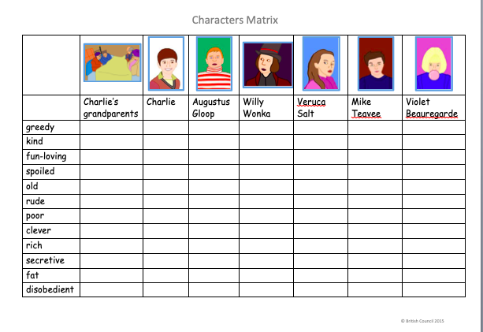
British Council: EAL Nexus resource

Slide 45
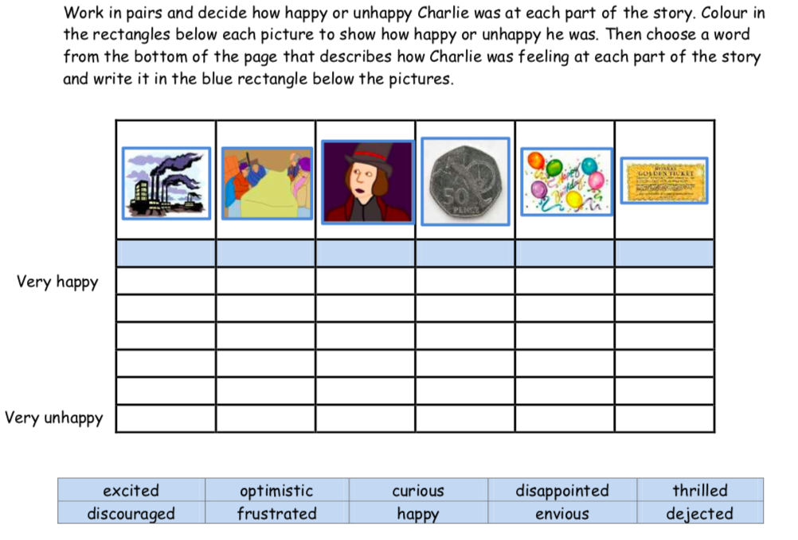
😀
🙁
British Council: EAL Nexus resource

Slide 46
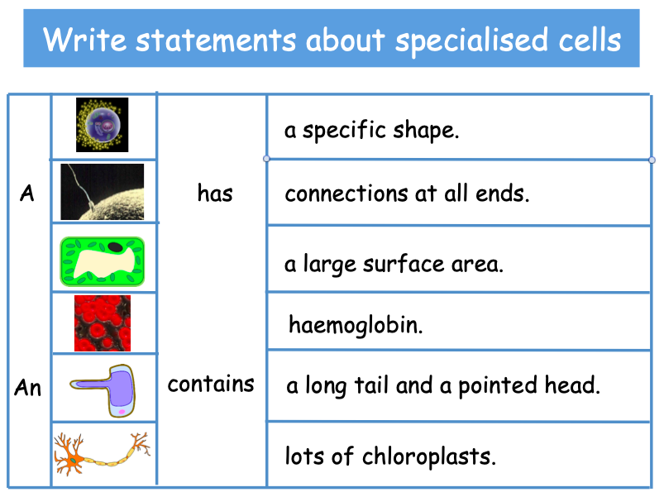
SUBSTITUTION TABLES
British Council: EAL Nexus resource

Slide 47
Guiding principles to enable participation
Start with the concrete – activities, experiences, film, pictures and activate prior knowledge
Model activity and language
Transfer information from one mode to another
  Talking about a picture/sequencing events
  Labelling it
  Using labels to complete a grid
  Using the grid to form a text or complete writing frame
  Finding/marking/copying
Included in plenary/feedback with scaffolding from teacher
Notes:
IMPORTANT POINT IS THAT
The key point of these activities is that they involve the pupil in transfer and processing of information in some way, not simply copying. It is this aspect of writing activities which is key, along with support which the activities provide as a framework for further language development.

Slide 48
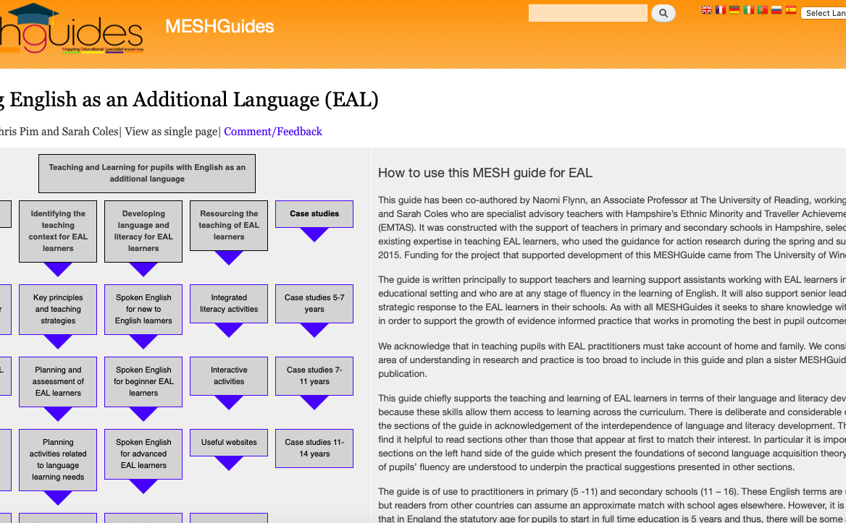
Links
EAL Mesh Guide
https://www.meshguides.org/guides/node/112
From Resource list

Slide 49
So learning and teaching should ….
Use strategies to ensure the content is accessible and build upon the pupil’s own knowledge.
Identify both language demands of the curriculum and the needs of the pupil to inform the objective and the language to be modelled by teaching adult/peers in context and to be used by pupils.
  Incorporate explicit teaching and learning of language through meaningful interactions.
  Use planned talk activities so that pupils extend their thinking and language through collaborative working
Scaffold learning though the use of modelling, graphic organisers, talk frames, first language

Slide 50
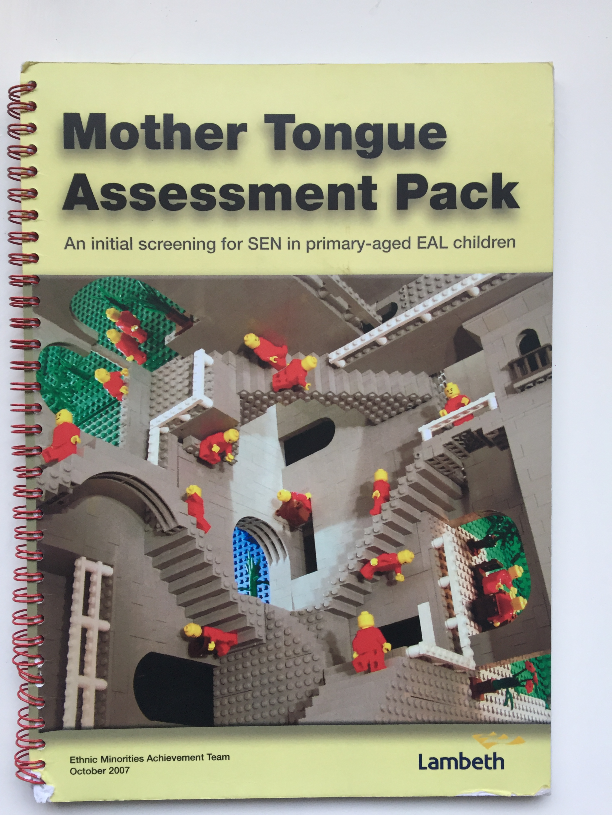
EAL and/or SEND?
Don’t automatically assume a difficulty lies
within the child, review the teaching first.
Ensure you have a full and accurate
language and educational background.
Talk to parents, with interpreter if required.
Assess the fluency of the first language,
both social and academic, using
materials designed for that purpose.
Look for cultural unfamiliarity and
bias in any SEN assessment process.
Make sure that any EHC plan
includes English language targets and
uses EAL appropriate strategies.

Slide 51
Leadership and Management Questions to consider
What do you know about pupils with EAL in your school?
Do you have an idea of where the school is in terms of developing EAL provision? ie what is in place and what needs to be developed?
Pupils with EAL are the responsibility of all staff so how can you support them to develop their EAL expertise?
Are the needs of the EAL learners reflected in the SDP?
Is there an EAL policy?
Do you have an action plan?

Slide 52
Developing the Curriculum
Collaborate with Curriculum Leads/Coordinators
Is it culturally inclusive and reflect the diversity of the school community?
Does it take into account the children’s different life experiences and needs?
Does it recognise diversity as a resource?
Does it require resources or adapting of existing resources?

Slide 53
Partnerships with parents/carers/families and communities
Support the school to develop an ethos whereby parents/carers from diverse cultural, linguistic and religious backgrounds feel welcome and respected, and confident to communicate with staff
Help parents/carers to understand the English education system, the school’s approach to learning and teaching and support them to participate in their children’s learning
Support the development of links with supplementary and community schools
Ensure that parents/carers from minority communities know that the first language has a significant and continuing role in their child’s learning, that the school values bilingualism and considers it to be an advantage.

Slide 54
Good practice for children learning English as an additional language is good practice for all children.
Join Naldic (National Association for Language Development in the Curriculum):
https://naldic.org.uk
EALforum: good source for events, training, resources and advice
https://groups.google.com/forum/#!forum/eal-bilingual
Good source for collaborative and talk activities
http://www.collaborativelearning.org/activities.html
Books:
Pim, C. (2018). 100 Ideas for Primary Teachers: Supporting EAL Learners. London: Bloomsbury A very practical and helpful guide for primary level teachers.
Driver, C. & C. Pim (2018). 100 Ideas for Secondary Teachers: Supporting EAL Learners. London: Bloomsbury. A very practical and helpful guide for secondary teachers.
abellsham@gmail.com

