Slide 1
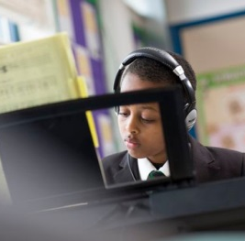
Whitefield School
Good practice in narrowing the achievement gap
Liz Rymer, Headteacher
Anna Matloch, EAL Teacher
February 2017
Live, Learn, Aspire, Achieve
Live, Learn, Aspire, Achieve

Slide 2
Introducing Whitefield School….
Whitefield School
Live, Learn, Aspire, Achieve

Slide 3
Whitefield School
Class of 2016
KS2 APS 24.3 (National 28)
54.4% FSM
91.0% from minority ethnic groups
72.1% student first language is not English
Speak 79 languages
Our EAL students out performed all students in every key measure
Our English KS2 to KS4 progress 20%+ above National
MFL A* to C = 85%, 15% above National
Live, Learn, Aspire, Achieve

Slide 4
Whitefield is a ‘challenging’ school…
Whitefield School
In an average classroom…
25/26 students
Many will have no data from KS2
They will all turn up (96%+ attendance, top 5% in UK)
Almost everyone speaks at least two languages, many speak 3, 4, 5 and many different dialects……
At least half with be Pupil Premium
One third will have SEN needs
Two thirds will be boys
50% of students at end of year will not be the students you started the year with
1 in 4 with have social issues
Many will have multiple needs….
Some may not have ever been to school before arriving in the UK, some will have been through an English system
Live, Learn, Aspire, Achieve

Slide 7
Whitefield School
Meet the Whitefield EAL team…
Director of Learning for EAL– vacancy
Anna Matloch - EAL Teacher
Linda Coleman - EAL Teacher
Dhanisha Tailor – SENCo (EAL LM)
Mumin Humayun - Deputy Headteacher i/c Standards and Inclusion
Plus the entire workforce of Whitefield School. Everyone is a teacher of EAL!
Live, Learn, Aspire, Achieve

Slide 8
Whitefield School
So why are we here?
Live, Learn, Aspire, Achieve

Slide 9
Success starts on arrival…
Whitefield School
Admissions interviews at least weekly
Get to know the student asap
Day 1 - assess on entry, then into lessons asap. Non teaching Pastoral Support Officer sorts this
Not put into bottom sets
Buddy allocated from day 1
Decisions made quickly by SENCo and class teachers re any support needed
Some EAL withdrawal classes but still teach the curriculum (up to 10 in EAL class, 3 dedicated EAL classrooms)
Share information to all staff asap
Set high targets for all subjects
Live, Learn, Aspire, Achieve

Slide 10
Getting the curriculum right…..
Whitefield School
EAL students being taught in mainstream lessons, but at the right level
EAL withdrawal lessons but still follow the curriculum
Carefully constructing EAL classes
One year GCSEs
Three year Sixth Form
Additional costs!
Live, Learn, Aspire, Achieve

Slide 11
Whitefield School
An EAL friendly classroom….
Dictionaries, language activators available
Differentiated resources (and that does not mean just easier)
Safe, supportive climate, where it is ok to take risks
Seating plan to support learning
Display that supports learning
Effective use of additional adults, buddies, sixth form volunteers
Pen Portraits so staff have to know their students
Teachers modelling correct use of grammar
Culture of high aspirations for all – no excuses!
Live, Learn, Aspire, Achieve

Slide 12
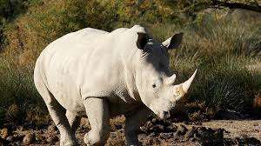
‘WE DON’T WANT ANY RHINOS’
Whitefield School
R = Really
H = Here
I = In
N = Name
O = Only
Live, Learn, Aspire, Achieve

Slide 13
Whitefield School
10 top tips for whole school success….
Treat every EAL student as an individual and avoid labelling
Accept that some students will have complex needs, but not all EAL students have SEN and many will be more able
Get the groupings right
Don’t neglect Advanced EAL learners
Use staff and students to translate
Utilise the power of effective partnerships with parents and local communities
Use learners home language if necessary
Demand the involvement of all staff, but this needs providing ongoing training
Celebrate diversity at every opportunity
Expand students’ cultural capital
Live, Learn, Aspire, Achieve

Slide 14
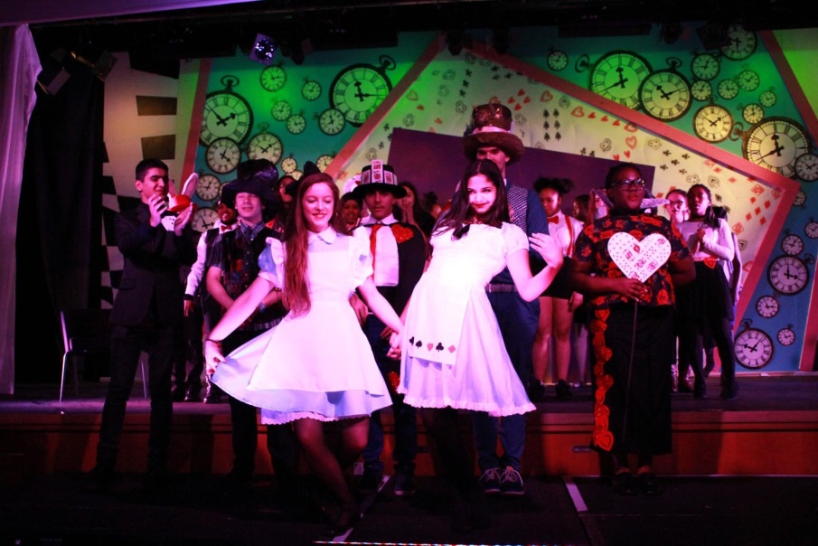
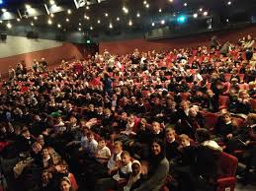
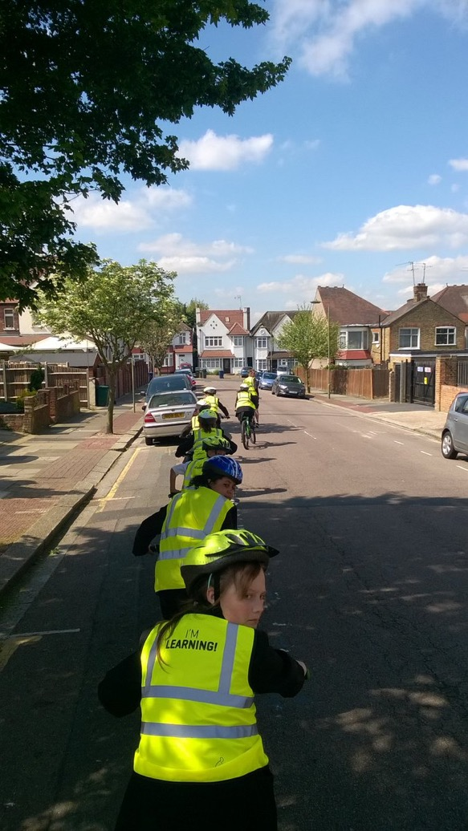
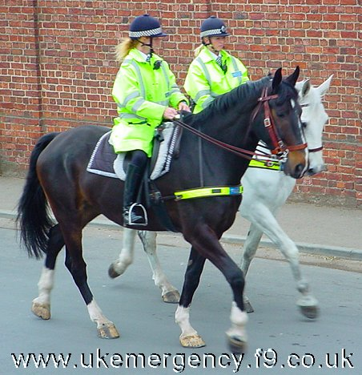
Live, Learn, Aspire, Achieve

Slide 15
Whitefield School
Lots of other EAL strategies I could
have talked about…..
Substitution tables
Google translator
Use of visuals
QFT
Parental Engagement
Writing Frames
Talk Mats
Show & Share EAL tips to all staff
CPL
Live, Learn, Aspire, Achieve

Slide 16
Whitefield School
Sometimes, things are tough for our students…..
Live, Learn, Aspire, Achieve

Slide 17
Whitefield School
But we have a culture of no limits….
Live, Learn, Aspire, Achieve

Slide 18
Come and see for yourselves…
Whitefield School
Liz Rymer, Headteacher
ery@whitefield.barnet.sch.uk
Anna Matloch, EAL Teacher
ama@whitefield.barnet.sch.uk
Live, Learn, Aspire, Achieve

