Slide 1
EAL and educational achievement in England: An analysis of the NPD Keynote to National EAL Conference, Jeffrey Hall, UCL-Institute of Education, London 23 February 2017 Professor Steve Strand University of Oxford, Department of Education steve.strand@education.ox.ac.uk 01865 611071

Slide 2
Research reports
https://educationendowmentfoundation.org.uk/uploads/pdf/EAL_and_educational_achievement2.pdf

Slide 3
Overview of this presentation
Brief overview of the main points from the summary report:
Demographics of EAL (size & distribution)
Achievement profile by age 5-16
Focus on Key Stage 2
Risk factors for low attainment of EAL pupils
Implications for policy & practice

Slide 4
Number of EAL pupils 1997-2016
From 7.6% of population in 1997 to 18.3% in 2016

Slide 5
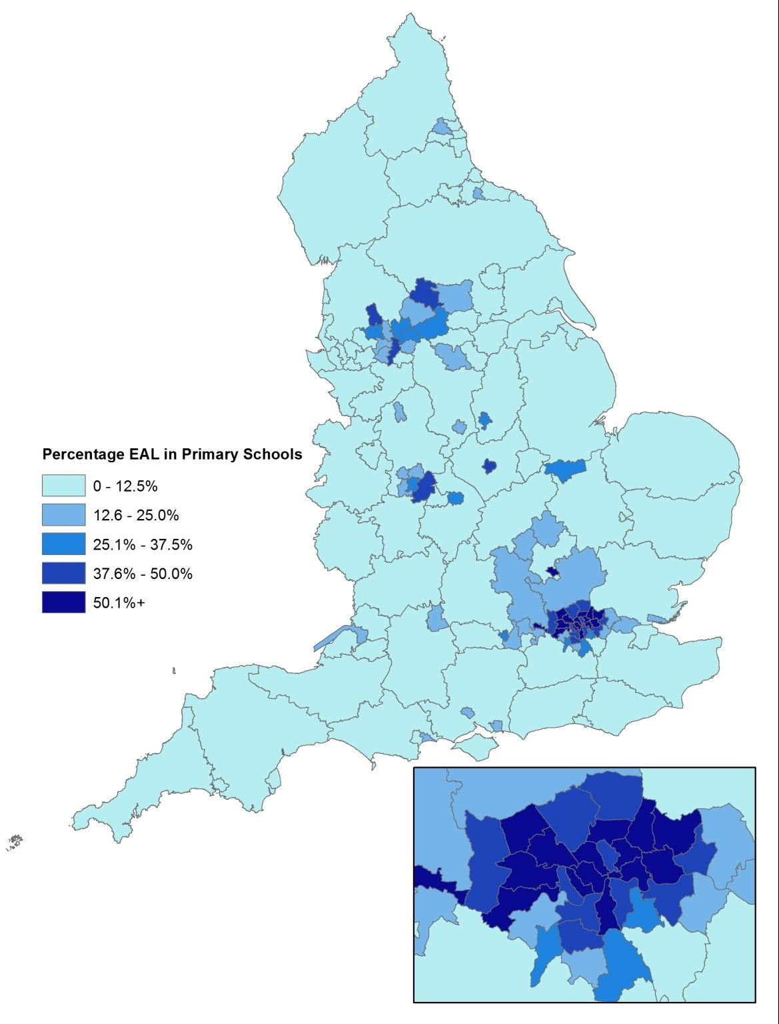
EAL demographics
Wide regional variation (6% in SW and NE, 20% West Midlands up to 55% in inner London)
Wide LA variation (17 of top 20 in London but also Slough, Luton & Leicester, plus high in Birmingham, Manchester)
But also very local with high concentrations in some schools outside London: (see next slide)

Slide 6
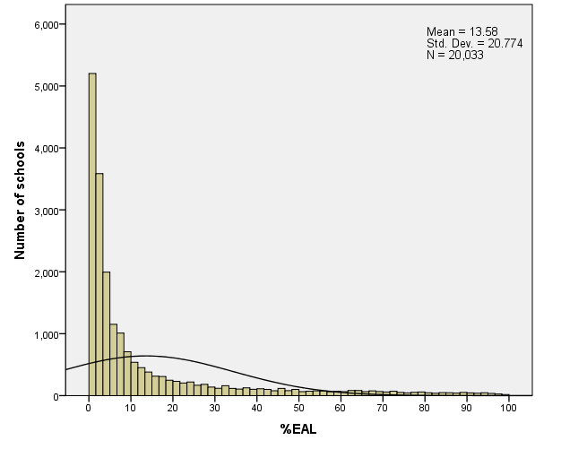
School Distribution %EAL
Very skewed: School average is 14%EAL, but around one-quarter (22%) of schools <1%EAL & over half (54%) <5%EAL
% EAL in school | N Schools | % Schools
0.0 - 1 | 4435 | 22.1
1.1 - 5 | 6346 | 31.7
5.1 - 10 | 2870 | 14.3
10.1 - 20 | 2240 | 11.2
20.1 - 30 | 1142 | 5.7
30.1 - 40 | 730 | 3.6
40.1 - 50 | 589 | 2.9
50.1+ | 1681 | 8.4
Total | 20033 | 100
Widely dispersed: of the 1,681 schools with >50% EAL, 762 outside London including NW, Yorks & Humber

Slide 7
EAL-FLE gap by age - England 2013
FLE= First Language English. (a) based on 241,545 students entered not whole cohort. Source: DFE SFRs (2013) .

Slide 8
EAL & Ethnicity
Ethnic group | EAL % | Total N
Bangladeshi | 96.1% | 9,410
Pakistani | 88.4% | 22,737
Any other ethnic group | 86.0% | 7,789
Any other Asian | 81.5% | 7,851
Indian | 79.1% | 13,437
Chinese | 78.6% | 1,758
White other groups | 73.6% | 22,579
Black African | 70.9% | 16,803
Traveller Gypsy/Roma | 42.2% | 1,451
Black other groups | 36.6% | 3,345
Other mixed background | 23.5% | 8,400
Mixed White & African | 22.8% | 2,703
Unclassified/Refused | 17.9% | 2,879
Mixed White & Asian | 16.5% | 5,080
Black Caribbean | 4.2% | 7,260
Mixed White & Caribbean | 2.2% | 7,130
Traveller Irish | 1.6% | 368
White Irish | 1.6% | 1,725
White British | .4% | 379,842
Total | 17.3% | 522,547
EAL closely correlated with ethnicity (except for Black Caribbean and MWBC) but on its own explains only 0.2% variance in KS2 score (ethnicity explains 1.8%)
But EAL can add a little (combined 2.2%) as within each ethnic group those with EAL consistently lower achieving (see next slide)

Slide 9
EAL and ethnicity – KS2 score 2013

Slide 10
Ethnicity % of students aged 5-16: 2003 & 2013
Ethnic group | 2003 | 2013 | Change
White British | 83.2% | 73.4% | -9.9%
White other groups | 2.6% | 5.0% | 2.3%
Irish | 0.4% | 0.3% | -0.1%
Traveller of Irish heritage | 0.1% | 0.1% | 0.0%
Gypsy/Roma | 0.1% | 0.3% | 0.2%
Any other White background | 2.1% | 4.3% | 2.3%
Mixed | 2.6% | 4.6% | 2.0%
White & Black Caribbean | 0.9% | 1.4% | 0.5%
White & Black African | 0.2% | 0.6% | 0.3%
White & Asian | 0.5% | 1.0% | 0.5%
Any other Mixed background | 0.9% | 1.6% | 0.7%
Asian | 6.8% | 10.2% | 3.4%
Indian | 2.4% | 2.6% | 0.3%
Pakistani | 2.7% | 3.9% | 1.3%
Bangladeshi | 1.1% | 1.6% | 0.5%
Chinese | 0.4% | 0.4% | 0.0%
Any other Asian background | 0.6% | 1.6% | 1.0%
Black | 3.6% | 5.3% | 1.7%
Black Caribbean | 1.5% | 1.4% | -0.1%
Black African | 1.7% | 3.3% | 1.7%
Any other Black background | 0.4% | 0.6% | 0.2%
Any other ethnic group | 0.8% | 1.5% | 0.7%

Slide 11
EAL and ethnicity
White Other & Black African key because:
Average EAL gap at KS2 is 2.5 mths, but for Black African 5 mths & White Other 10 mths. Also large EAL gap for these groups at KS4;
They are the two ethnic groups with the largest increase 2003 to 2013, both doubling in size
Over 70% are EAL and over 40% recent arrivals in UK (age 5-14) compared to 3% of all pupils (LSYPE)
Looked at the top 10 languages (other than English) within these two ethnic groups and compared achievement against the average for FLE from the same ethnic group

Slide 12
White Other groups by First Language
Note: Compared to White Other with FLE, adjusted for FSM, IDACI, migration & region (Full report p69-71).

Slide 13
Black African by First Language
Note: Compared to Black African with FLE, adjusted for FSM, IDACI, migration & region (Full report p69-71).

Slide 14
Other pupil risk factors
Most risk factors broadly the same for EAL and FLE - SEN, FSM, IDACI, age, gender
But four have a particular risk for EAL:
Ethnic group/First Language: as described earlier
International Arrival during the Key Stage (proxied by absence of prior attainment score): 15% of EAL vs. 2% FLE, no association with achievement for FLE but -12 NCmths for EAL
Pupil mobility: e.g. Y6 EAL entrant -12 NCmths, FLE Y6 entrant -4 NCmths
Region: EAL in regions on average 4 NCmths lower than London, but Yorkshire & Humberside 8 NCmths

Slide 15
School factors
Does a high %EAL impact negatively on achievement/progress of FLE pupils? (Green, 2010; Cho, 2012)? Answer = No.
KS2 achievement
KS1-KS2 Progress
Low, mean & high %EAL = 0%, 15% & 33% (-1SD, mean, +1SD of school distribution) (Strand et al, 2015, p54/55)

Slide 16
Implications
EAL in the NPD is a limited measure
“where a child was exposed to the language during early development and continues to be exposed to this language in the home or in the community. If a child was exposed to more than one language (which may include English) during early development the language other than English should be recorded, irrespective of the child's proficiency in English.” DCSF (2006).
Lack of fluency in English language is the real risk, this is what is proxied by international arrival, school mobility and first languages
Strand & Demie (2005) report a direct measure of stage of English fluency (Hilary Hester Scales) showed that EAL pupils who were fully fluent in English (over 40% of EAL pupils) actually had higher achievement than monolingual English.

Slide 17
Stage of fluency in English and achievement
Inner London LA using Hilary Hester CLPE scales. 42% of EAL pupils were rated as fully fluent.
[Source: Strand & Demie, 2005].

Slide 18
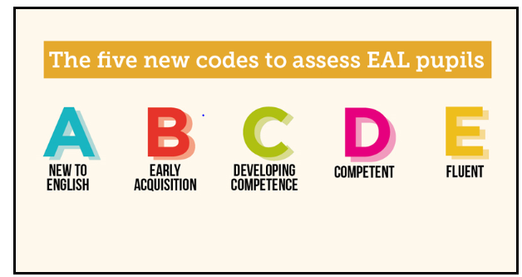
New DFE English Proficiency scale
DFE have responded by introducing Level of English Proficiency Scale in School Census from Jan. 17
"English proficiency statistics will provide for the first time important national statistics on the characteristics of this (high needs) group, along with their attainment and destinations & allow the Department to measure whether the individual pupils, or the schools they attend, face additional educational challenges".
(DFE, 2016, p62)

Slide 19
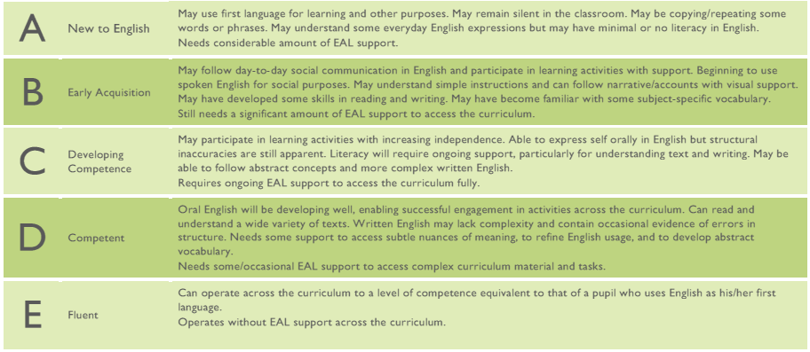
Detailed Guidance / Training
Bell EAL Assessment Framework: www.bell-foundation.org.uk/Work/EALAssessmentFramework/
10 detailed assessment descriptors for each stage A-E in each of the areas of listening, speaking, reading & writing

Slide 20
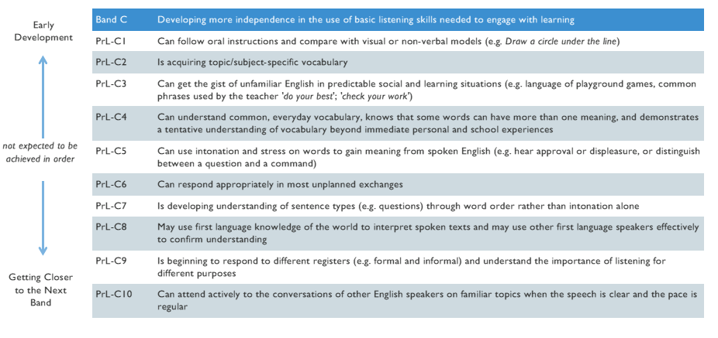
Example – Listening Stage C (Primary)

Slide 21
Other Implications (Cont.)
Teaching / Support materials - excellent resources from National Strategies e.g. Supporting pupils learning EAL (2002); New Arrivals Excellence Programme (2007); PNS Learning & teaching bilingual children in the primary years (2007)
Continued funding needed - Educational progress of EAL is high, but cannot be complacent as it reflects historically high levels of investment (Section 11, EMAG until 2012)
Current funding arrangements broadly well targeted on first three years at school or after international arrival (though literature suggests may take 5-7 years to acquire full fluency / academic writing)
Evaluate new Proficiency Scale: how is it working in practice (Funding being sort by Oxford)

Slide 22
References
Cho, R. M. (2012). Are there peer effects associated with having English Language Learner (ELL) classmates? Evidence from the Early Childhood Longitudinal Study Kindergarten Cohort (ECLS-K). Economics of Education Review, 31(5), 629-643.
DCSF (2006). Pupil Language Data: Guidance for local authorities on schools' collection and recording of data on pupils languages. London: DCSF.
Demie, F. & Strand, S. (2006). English language acquisition and educational attainment at the end of secondary school. Educational Studies, 32, (2), 215-231. http://dx.doi.org/10.1080/03055690701423184
DFES. (2007). Learning and teaching for bilingual children in the primary years: Teaching units to support guided sessions for writing in EAL (Ref 00068-2007). London: Department for Education and Skills.
Geay, C., McNally, S., & Telhaj, S. (2012). Non-native speakers of English in the classroom: What are the effects on pupil performance? Centre for the Economics of Education (CEE). London School of Economics, London. http://www.nuffieldfoundation.org/sites/default/files/files/ceedp137.pdf
Strand, S. (2010). Do some schools narrow the gap? Differential school effectiveness by ethnicity, gender, poverty and prior attainment. School Effectiveness and School Improvement, 21(3), 289-314. http://dx.doi.org/10.1080/09243451003732651
Strand, S., & Demie, F. (2005). English language acquisition and educational attainment at the end of primary school. Educational Studies, 31, (3), 275-291. http://dx.doi.org/10.1080/03055690500236613
Strand, S., Malmberg, L., & Hall, J. (2015). English as an additional language and educational achievement in England: An analysis of the National Pupil Database. London: Educational Endowment Fund. http://educationendowmentfoundation.org.uk/uploads/pdf/EAL_and_educational_achievement2.pdf

