Slide 1
Collecting and making efficient use of language, ethnicity and EAL proficiency data to support EAL pupils in schools.
Ann Horton:
EAL Coordinator, Lambeth Academy

Slide 2
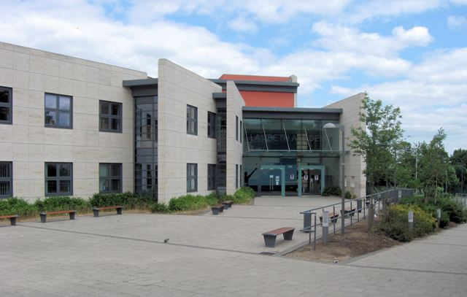
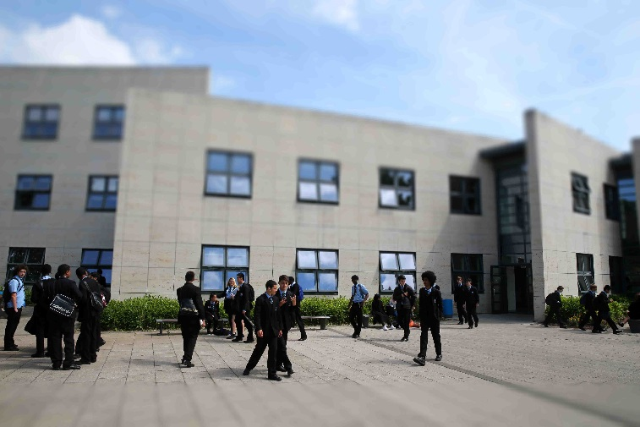
LAMBETH ACADEMY: 11-18 comprehensive school
Situated just off Clapham Common Southside, in south-west London
Number of pupils in the school: 945
% of EAL pupils: 48.57
Number (not %) of pupils at each level:-
Level A: 6
Level B: 15
Level C: 20
Level D: 110
Level E: 307

Slide 3
Assessment (introduction)
Early 2016: post NC levels, NASSEA EAL Assessment Framework adopted by Lambeth Academy for assessing EAL pupils
Summer 2016: DfE announces new English proficiency levels to be used by all schools
Lambeth never adopted the QCA steps but continued to assess using the “Lambeth Stages of English” – more or less the 4 Hilary Hester stages. This made the change to the 5 DfE proficiency levels comparatively painless!
Our decision: in addition to statutory DfE levels, retain NASSEA Framework for level A & B pupils, so that teachers can show progress more clearly.

Slide 4
Assessment (1)
Screening for EAL pupils in the new year 7 cohort: completed for most pupils on the induction days in July.
All year 7 EAL pupils are then assessed formally in the first couple of weeks of school
1 – 2 days off timetable, 2 or 3 staff assessing

Slide 5
Assessment (2)
Mid-term entries – EAL coordinator usually attends admissions interviews for new arrivals from overseas
Copy of school report seen, or questions asked about pupil’s approximate attainment in core subjects in their home language – this assists with setting recommendations

Slide 6
Practical use of data
All level A pupils automatically withdrawn from MFL (2 hours a week)
Initial induction programme if possible (key words / ideas in English, maths, science and geography).
2 hours a week then used firstly for teaching English grammar and structures
Then change to 1 hour English, 1 hour curriculum linked: usually pre-teaching or revising the mainstream science lessons
Some level B pupils can also be withdrawn, usually after consultation with the pupil and their parents.
Pupils have very successfully been returned to MFL even as late as the beginning of year 9, if they make enough progress with English
In-class support for neediest pupils, support timetables regularly reviewed as we do not have enough staff to provide all the in-class support that is needed.

