Slide 1
Pupil Census language data collection
Catharine Driver
EAL and Literacy Consultant
catharine.driver@btinternet.com

Slide 2
First language of pupils in state-funded schools in England (1) January 2016
 | Language Code | Language Name | Number of Pupils | Proportion of Pupils
 | ENG | English | 5,668,561 | 81.51%
 | URD | Urdu | 127,101 | 1.83%
 | POL | Polish | 105,569 | 1.52%
 | PNJ | Panjabi | 90,673 | 1.30%
 | OTH | Other than English | 81,852 | 1.18%
 | BNG | Bengali | 75,700 | 1.09%
 | SOM | Somali | 46,700 | 0.67%
 | ARA | Arabic | 45,553 | 0.66%
 | GUJ | Gujarati | 41,028 | 0.59%
 | POR | Portuguese | 31,804 | 0.46%
 | TAM | Tamil | 31,018 | 0.45%
 | OTB | Believed to be other than English | 29,236 | 0.42%
 | FRN | French | 27,349 | 0.39%
 | SPA | Spanish | 25,280 | 0.36%
 | RMN | Romanian | 24,793 | 0.36%
 | TUR | Turkish | 23,929 | 0.34%
 | ENB | Believed to be English | 22,276 | 0.32%

Slide 3
Flawed language data in one LA
In one primary school192 pupils speak a language called “Other than English”
In one secondary school 81 pupils are recorded as “Other than English”
In 2014, the proportion of EAL pupils in Year 6 was 37% The proportion of EAL pupils in Year 7 in 2015 was 29%
In 2014 there were 216 Panjabi speakers in Year 6 but in 2015 there were only 135 Panjabi speakers in Year 7.
In most secondary schools there are pupils listed as English speakers in Year 7 who were listed as Urdu or Panjabi speakers at primary school.
Raw data is deeply flawed and seriously underestimates EAL and key ethnic group numbers.

Slide 4
What should we be collecting?
Ethnicity – Statutory using Dfe codes. Extended code list is recommended.
Language – Details are still optional, but a full code list is recommended.
EAL proficiency stages (A-E) required since October 2016
Birth and Nationality data – contested: schools should not ask parents to show documents.

Slide 5
EAL Proficiency Stages Descriptors
A New to English May use first language for learning and other purposes. May remain completely silent in the classroom. May be copying/repeating some words or phrases. May understand some everyday expressions in English but may have minimal or no literacy in English. Needs a considerable amount of EAL support.
B Early acquisition May follow day to day social communication in English and participate in learning activities with support. Beginning to use spoken English for social purposes. May understand simple instructions and can follow narrative/accounts with visual support. May have developed some skills in reading and writing. May have become familiar with some subject specific vocabulary. Still needs a significant amount of EAL support to access the curriculum.
C Developing competence May participate in learning activities with increasing independence. Able to express self orally in English, but structural inaccuracies are still apparent. Literacy will require ongoing support, particularly for understanding text and writing. May be able to follow abstract concepts and more complex written English. Requires ongoing EAL support to access the curriculum fully.
D Competent Oral English will be developing well, enabling successful engagement in activities across the curriculum. Can read and understand a wide variety of texts. Written English may lack complexity and contain occasional evidence of errors in structure. Needs some support to access subtle nuances of meaning, to refine English usage, and to develop abstract vocabulary. Needs some/occasional EAL support to access complex curriculum material and tasks.
E Fluent Can operate across the curriculum to the level of competence equivalent to that of a pupil who uses English as his/her first language. Operates without support across the curriculum.

Slide 6
Who is doing this in your school?
Office or support staff
Class teachers
Subject teachers
Heads of year
EAL specialist staff
Any others?

Slide 7
Once an EAL pupil has been assessed as code ‘E’ Fluent it will not be necessary for the school to continue to re-assess the proficiency of that child …
However for all proficiency levels below fluent it will be expected that schools should continue to monitor proficiency on an ongoing basis to ensure adequate levels of EAL support are provided …
Whilst the proficiency scale should be straightforward to use and understand nationally, there will undoubtedly be variation amongst schools and teachers in how they interpret the stage descriptors and make a ‘best fit’ judgement …. receiving schools to make their own initial assessment of the English proficiency of incoming EAL pupils.

Slide 8
How or When ?
Admission forms
Admission interviews
Initial diagnostic assessment
Informal discussion with child / family
Subject lessons
English / Literacy lessons
Writing samples

Slide 9
EAL Proficiency in one Secondary School Oct 2016

Slide 10
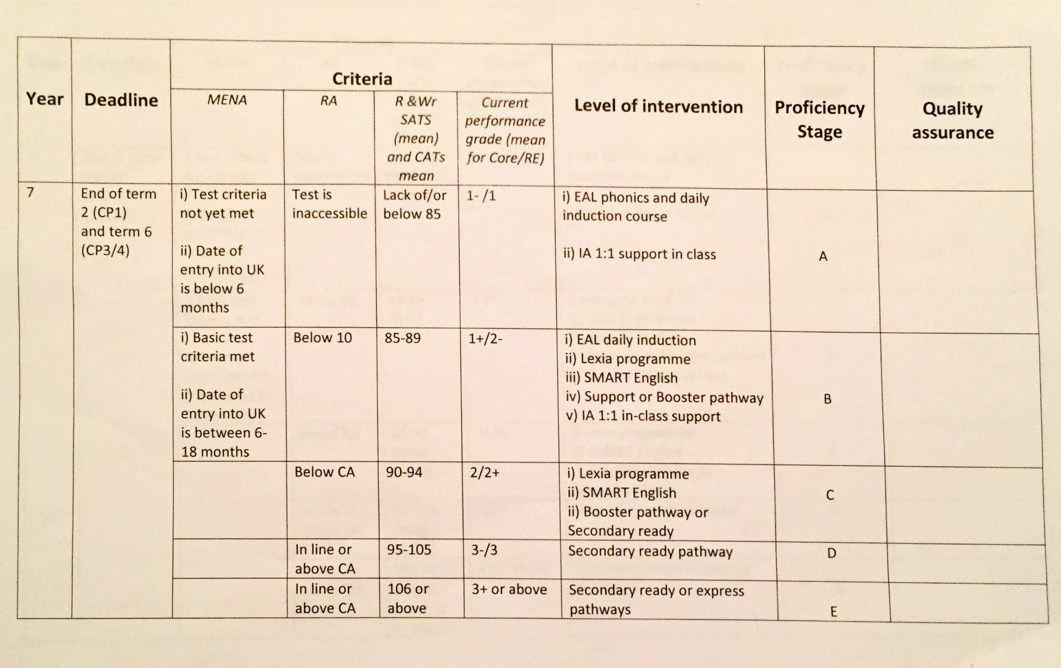
Assessment criteria of one Secondary school

Slide 11
Other issues arising
Primary Schools in this authority are assessing high numbers of primary pupils at stages A and B.
Secondary schools have high numbers at stages B and C. All these pupils are deemed to need additional support, yet there are no staff employed to provide it.
Schools may intentionally under-assess pupils’ EAL Stages if they believe the data will be used for allocating funding in future.
Similarly they may under assess to demonstrate more progress from a low starting point.
To counteract these practices someone has to monitor or moderate schools’ results. Who?

