Slide 1
Best Practice in EAL Assessment
Katherine Solomon

Slide 2
Assessment is an important part of educational provision. High quality assessment can help teachers and pupils to find out what has been achieved and what more needs to be done.
Leung, 2015

Slide 3

Why EAL Assessment?
Assessing EAL is not the same as assessing Literacy
EAL assessment helps both teachers and pupils
EAL learners have a double job to do:
learn English
and
learn through English
at the same time
Pupils need to know particular uses of language to be able to succeed in school subjects
EAL assessment spotlights the learner’s needs in a particular area of language
EAL assessment helps teachers teach all EAL learners
EAL assessment is fair and inclusive

Slide 4
The Changing landscape of schools
Forecast - continue to rise
EAL will be a key characteristic of student bodies
in many schools for the foreseeable future

Slide 5
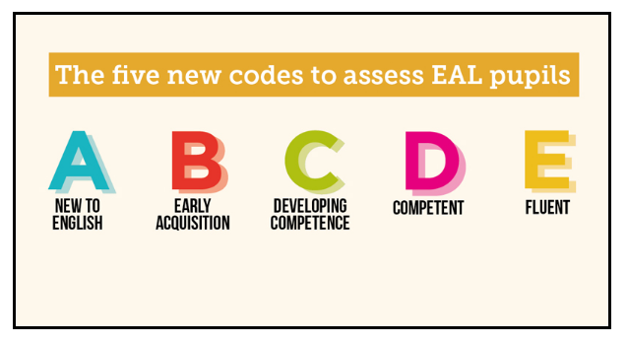
Assessment of EAL pupils
‘Proficiency in the English language is the major factor influencing the degree of support an individual student will require, and schools will need to be able to assess this need accurately.’
Strand, Malmberg and Hall (2015)

Slide 6
Effective EAL Assessment should:
Ensure all learners achieve their full potential with reference to English language development.
Consider that EAL learners have unique profiles
Age
First Language educational history
First language literacy
Academic track record
Individual and family circumstances

Slide 7
Effective EAL Assessment should:
include an initial profiling system and rating scales of performance
Initial profiling
Informing expectations
Orientation
Feedback into learning
Feedback into management

Slide 8

EAL Assessment is clearly important but …
“We know out about new arrivals 24-hours before. If we are lucky”
“We know the pupils’ name and nationality. That’s about it”
“we give new arrivals a maths paper and reading test”
“We place them in classes where there is space”
“We are desperate for help with EAL assessment. Can you give us a test?”

Slide 9
DfE Proficiency in English scales

Slide 10

Available now!
EAL ASSESSMENT FRAMEWORK
FOR SCHOOLS
Free download
https://www.bell-foundation.org.uk/Work/EALAssessmentFramework/

Slide 11
The EAL Assessment Framework for Schools
Robust and evidence-informed
Written by leading experts in assessment
Professor Constant Leung, King’s College London
Dr Michael Evans, Cambridge University
Dr Neil Jones, Language Consultant, formerly Cambridge English Language Assessment
Dr Yongcan Liu, Cambridge University

Slide 12
Fit with the DfE statutory reporting of EAL pupils’ Proficiency in English
The framework
adopts the same 5-band scale as the DfE (A-E)
supplements the DfE screener - assesses the 4 language domains
designed to support planning and target setting

Slide 13
Structure of the framework
2 scales - Primary and Secondary
Each scale - 4 domains:
Listening
Speaking
Reading and Viewing
Writing
Each domain - 5 bands (A, B, C, D and E)
Each band - 10 descriptors

Slide 14
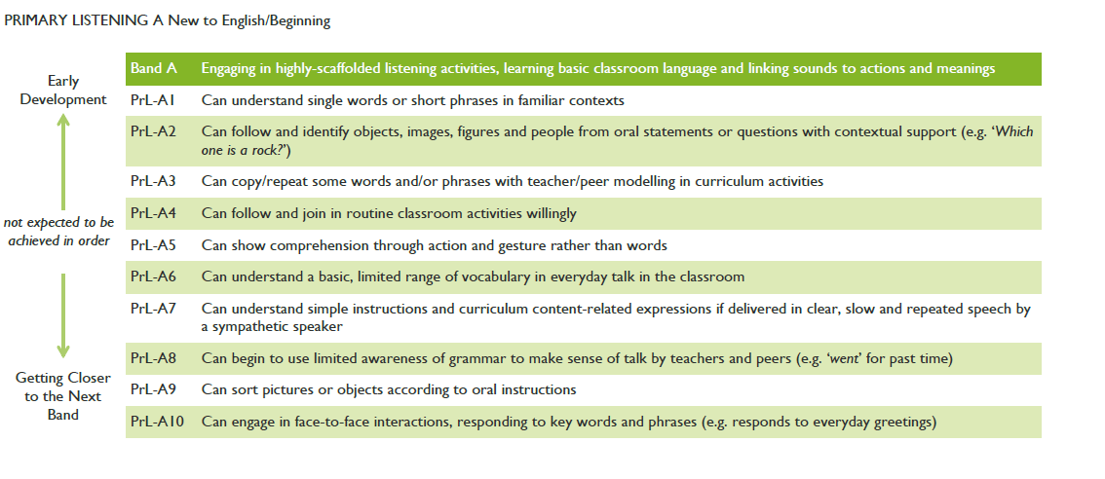
Setting Targets
Primary Listening A- New to English/Beginning
These descriptors
show early development
These are closer to the next band

Slide 15
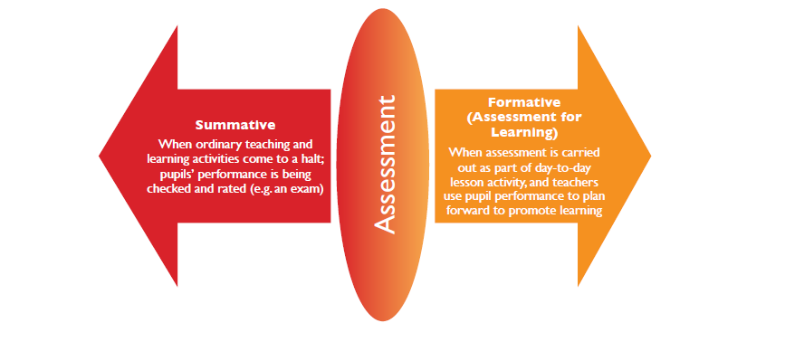
End of term, year or key stage assessments
Provide a road map for progress

Slide 16

Thank you for listening
https://www.bell-foundation.org.uk/
@BellFoundation

