Slide 1

Language Diversity and Attainment in Schools in England
Feyisa Demie
Head of Research and
Adviser for School Self-Evaluation
EAL Conference, UCL IOE
23 February 2017

Slide 2
Language Diversity and Attainment Research reports

Slide 3
Outline
The session aims:
  To examine why EAL matters, including policy concerns
  To look at the weaknesses of using EAL and Non-EAL and Ethnic Group Categories for monitoring EAL pupils attainment in England
  To explore a complementary approach of monitoring EAL pupils achievement by:
  Ethnic background
  Language diversity
  Stages of English language proficiency
4. Conclusions and Implications for policy and practice

Slide 4
The Data and Source of Evidence
1. The data: The data source is the National Pupil Database.
The sample size of the pupils who completed GCSE in summer 2014 is 558,432.
The sample size of the pupils who completed KS2 in summer 2014 is 550,969.
The dataset includes information on language spoken at home, ethnicity, free school meals, gender and results at KS2 and GCSE.
2. Measures of pupil performance
KS2 tests and performance- Pupils achieving level 4+ at Reading, Writing and Maths combined
KS4 performance is measured by 5+A*-C including English and Maths
3. Measures of EAL assessment
The data source is Lambeth LA. EAL proficiency and language spoken at home has been collected in Lambeth since 1990 at individual pupil level..
Lambeth EAL Stages were developed from Hilary Hester EAL Stages. 27 Years experience.
Four point levels of fluency in English assessment scale to indicate proficiency in English, ranging from beginner to fully fluent in English.
    Stage 1: New to English. Beginner, needs support to operate in English.
    Stage 2: Becoming familiar with English. Needs considerable support.
    Stage 3: Becoming confident as user of English. Needs only some support.
    Stage 4: Fully fluent in English.

Slide 5
Why English as an Additional Language (EAL) Matters - Policy Concerns
There is a growing EAL population in England and it has increased by 135% since 1997.
The 2015 School Census indicated there are over 1.2 million EAL pupils in England. This is about 18% of the school population (DfE, 2016)
The proportion of EAL pupils who are not fluent in English has also increased. In Lambeth’s case about 39% of EAL at KS1, 30% at KS2 and 10% at GCSE were classified as non-fluent in English.
Over 350 languages are spoken in England’s schools
There is a need for additional funding and targeted support for EAL pupils to improve their levels of fluency in English.
KS4

Slide 6
Policy Concerns: Misunderstanding about EAL pupils, language, migration and social cohesion
There is a misunderstanding about EAL pupils and fears around immigrants
“You only have to look at London, where almost half of all primary school children speak English as a second language, to see the challenges we now face as a country. This isn't fair to anyone: how can people build relationships with their neighbours if they can't even speak the same language?”
Primary Minister Theresa May, in a speech to think tank Policy Exchange in 2012, Source: The Guardian , 10 October 2016
Theresa May statements appears to confuse "speaking English as a second language" with "can't even speak the same language".
It is true that almost half of all primary school children in London speak English as a second language. But this doesn't mean that they, or their parents, can't speak English with their friends and neighbours
These are inaccurate, unhelpful and miss the point that EAL pupils need support in order to achieve academic success in the long-term.

Slide 7
Concerns about using EAL and non-EAL categories for monitoring EAL attainment
There are also concerns about using EAL and non-EAL categories for monitoring EAL attainment. Key question: ‘What does EAL and non EAL tell us about pupil performance?
Recent Headlines in “Education in England 2016” report by Centre Point asserts that ‘children with English as an additional language outperform others, leaving other children behind.’ (Centre point Think Thank, 4 April 2016)
These findings which failed to differentiate EAL attainment and progress by stages of fluency has led to a number of national newspapers to wrongly point out that:
    ‘Pupils who speak English as a second language are outperforming white native speakers (Press Association, 4 April 2016)
    White British students fall behind other ethnic groups.’ (Press Association, 4 April 2016)
    ‘Pupils with English as a second language 'outperform' white British at GCSE.’ (The Daily Telegraph, 4 April 2016)

Slide 8
Concern about using EAL and non-EAL categories for monitoring EAL attainment
The EAL data shows that nationally at Key Stage 4, pupils with English as an additional language achieved less well at GCSE than those with English as their first language.
We need to be cautious about these findings. EAL is a very heterogeneous group made up of pupils from many different ethnic and cultural backgrounds.
We would argue that meaningful analysis of EAL achievement is only achieved through a further analysis by fluency in English and language spoken at home and not by EAL or ethnic background.
GSCE | White British- pupils | EAL Pupils* | Gap
2006 | 44% | 42% | -2%
2007 | 46% | 44% | -2%
2008 | 49% | 45% | -4%
2009 | 51% | 48% | -3%
2010 | 55% | 52% | -3%
2011 | 59% | 56% | -3%
2012 | 59% | 56% | -3%
2013 | 61% | 58% | -3%
2014 | 56% | 55% | -1%
2015 | 57% | 55% | -2%
*All EAL pupils incl. fully fluent in English Source: DfE National Pupil Database 2014

Slide 9
Concerns about using Ethnic Group categories for monitoring EAL pupils attainment in England
Previous research has noted that the recording of ethnicity in England usually refers, confusingly, to a combination of national boundaries (Indian, Pakistani, Bangladeshi) but also colour (Black, White) and more general geographic distinctions, that supersede national boundaries (Black Caribbean, Black African).
Research shows collapsing into White Other makes comparison problematic as this group contains a range of other European ethnic groups such as Polish, Czech, Portuguese, Spanish, Turkish, Albanian, Russian etc.
Similarly the conflation of the Black African, Black Caribbean, Indian, Pakistani and Bangladeshi ethnic groups is not helpful and tells us little about the role of language.
However, we need to be cautious as ethnicity categorisation has not always been helpful to study achievement of the performance of all pupils in English schools.

Slide 10
Concerns about using Ethnic Group categories for monitoring EAL pupils attainment
There is a wealth of research into ethnic background and achievement in British schools. The data shows that White Other and Black Caribbean pupils are underachieving
Key questions are: who are
White Other?
Black African?
Indian?
Pakistani?
Any Other groups?
None of these ethnic categories are homogenous
3. Key questions for school and policy makers: Can language and English proficiency data help in unmasking differences in performance by ethnic background?
Ethnic Background | 5+A*-C | KS2 RWM
Chinese | 74% | 89%
Indian | 73% | 87%
Mixed White/Asian | 67% | 83%
White Irish | 66% | 83%
Asian Other | 62% | 85%
Mixed Other | 61% | 82%
Bangladeshi | 61% | 81%
Mixed White/African | 57% | 81%
White British | 57% | 79%
Black African | 57% | 79%
Any Other Group | 53% | 76%
White Other | 53% | 75%
Pakistani | 51% | 75%
Mixed White/Caribbean | 49% | 75%
Black Other | 47% | 75%
Black Caribbean | 47% | 73%
All Pupils | 57% | 79%
Source: NPD 2014

Slide 11
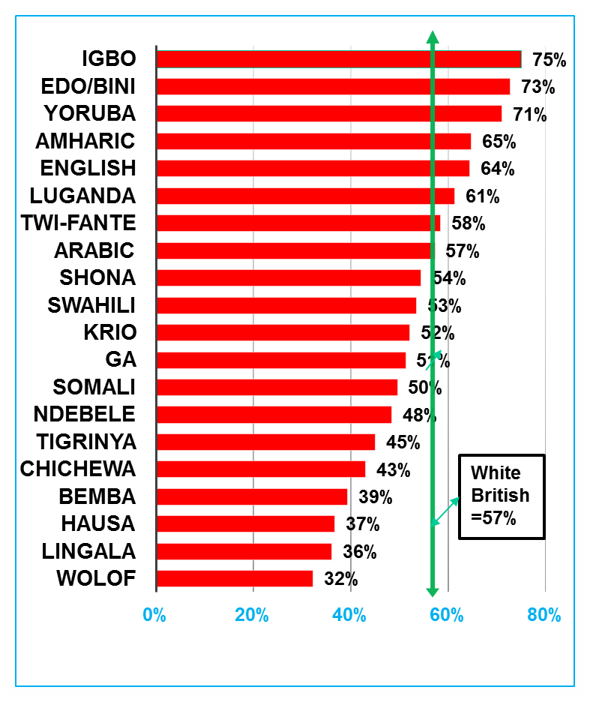
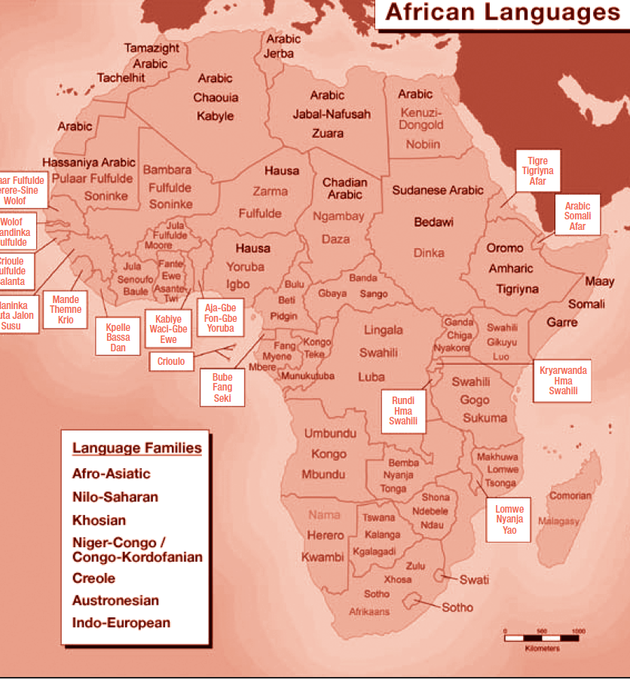
Black African Pupils GCSE Performance by Language Spoken at Home (20+ speakers)
Who are Black Africans?

Slide 12
Highest and Lowest Performing Black African Language Groups at KS2 (RWM Level 4+)
Highest Performing Black African groups |  |  | Underperforming Black African Groups
Igbo | 87% |  | Somali | 77%
Zulu | 87% |  | Ndebele | 74%
Yoruba | 85% |  | French | 73%
Amharic | 85% |  | Shona | 73%
Ewe | 83% |  | Krio | 73%
Ga | 83% |  | Dutch/Flemish | 72%
English | 82% |  | Fula | 70%
Spanish | 82% |  | Italian | 68%
Luganda | 81% |  | Portuguese | 66%
Tigrinya | 81% |  | Wolof | 65%
Twi-Fante | 80% |  | Lingala | 61%
National | 79% |  | Manding | 54%
 |  |  | National | 79%
Source: NPD 2014

Slide 13
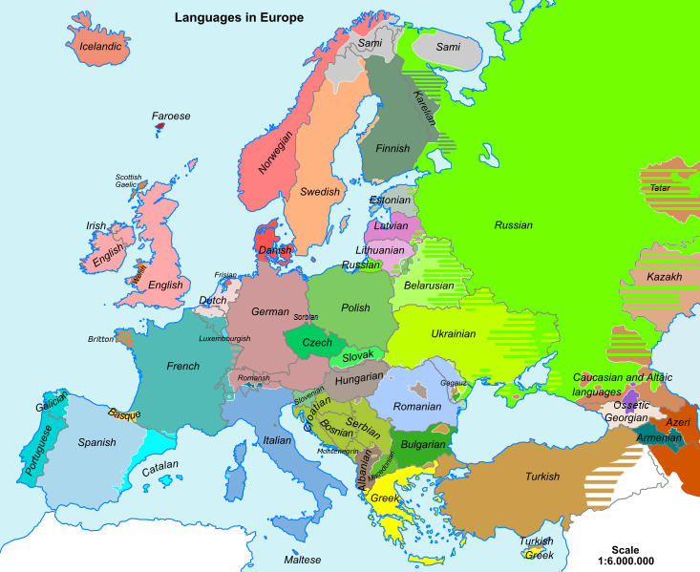
White Other Ethnic Group, Language Diversity and Attainment: White Other pupils GCSE performance by language spoken

Slide 14
Highest and Lowest Performing White Other Language Groups at KS2 (RWM Level 4+)
Highest Performing White Other Groups |  |  | Lowest Performing White Other Groups
Danish | 96% |  | Bulgarian | 75%
German | 94% |  | Russian | 74%
Swedish | 93% |  | Polish | 73%
Hebrew | 93% |  | Turkish | 71%
Dutch/Flemish | 90% |  | Romanian | 70%
Afrikaans | 90% |  | Persian/Farsi | 70%
French | 88% |  | Portuguese | 68%
Ukrainian | 87% |  | Lithuanian | 66%
English | 84% |  | Hungarian | 64%
Albanian/Shqip | 84% |  | Latvian | 62%
Greek | 84% |  | Kurdish | 62%
Italian | 82% |  | Slovak | 38%
National | 79% |  | Czech | 37%
 |  |  | National | 79%

Slide 15
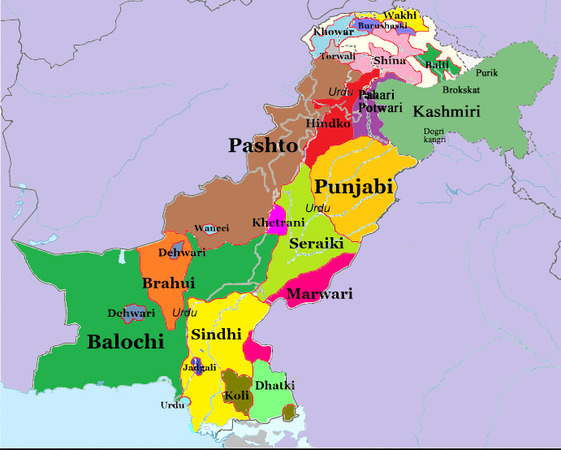
GCSE Performance of Pakistani Pupils by Language Spoken (cohort over 20)
Language | 5+ GCSE including English and Maths | Cohort
Urdu | 53% | 6297
English | 58% | 4162
Panjabi | 43% | 4855
Other than English | 52% | 2361
Pashto/Pakhto | 48% | 425
Pahari (Pakistan) | 41% | 117
Hindko | 59% | 56
Kashmiri | 45% | 33
Bengali | 56% | 36
Gujarati | 58% | 26
All Pakistani | 51% | 18517
National | 57% | 558432
Source: NPD 2014

Slide 16
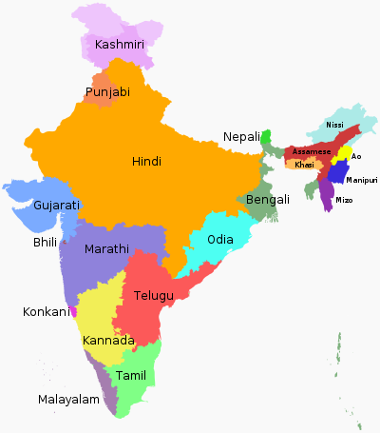
Key Stage 2 Performance of Indian Pupils by Language Spoken (Reading, Writing and Maths- Level 4+)
Indian Languages | RWM 4+ | Pupil No.
Gujarati | 86% | 3532
Panjabi | 82% | 3528
English | 89% | 3116
Malayalam | 93% | 878
Hindi | 93% | 773
Urdu | 88% | 392
Tamil | 89% | 360
Konkani | 83% | 151
Telugu | 97% | 151
Bengali | 93% | 123
Marathi | 94% | 88
Katchi | 89% | 61
Kannada | 98% | 43
All Indian | 87% | 14230
National | 79% | 550969
Source: NPD 2014

Slide 17
Stages of English Acquisition and EAL KS2 and GCSE Attainment in Lambeth
EAL Stages of English Fluency | KS2 Level 4+ | GCSE 5+A*-C
 | Primary 2015 | Secondary 2015
EAL Stage 1 (Beginners-New to English) | 0% | 0%
EAL Stage 2 (Becoming familiar with English) | 43% | 13%
EAL Stage 3 (Becoming confident as user of English) | 81% | 42%
EAL Stage 4 (Fully Fluent in English) | 96% | 66%
English Only | 85% | 54%
EAL Stage 1-3 (non-fluent in English) | 68% | 39%
All Pupils- National Average | 80% | 53%

Slide 18
EAL GCSE Attainment Gap Between EAL Fully and Non-Fluent (5+ A* to C including English and Maths)

Slide 19
School Funding and EAL Proficiency Issues: How long does it take to acquire English proficiency for EAL pupils?
One of the most commonly asked questions about the education of EAL students not fluent in English is how long they need special language support.
For pupils to have full access to the curriculum, they need to be fluent in English. Local Authorities and schools have an obligation to provide appropriate services to EAL students to learn English.
No previous research on how long it takes to acquire English fluency in UK because of lack of data but in Lambeth we tracked backwards 940 year 6-11 EAL pupils in the LA who were fully fluent in English, year by year, to establish how long each pupil was at a particular stage of English fluency and how long it took overall to become fully fluent from the time they were first assessed when they started school.
The Lambeth study suggests it takes about 5 to 7 years, on average, for EAL pupils to acquire academic English fluency.
However there is a variation how long it takes at each stage of fluency. Longitudinal data in the LA shows that it takes about 1.5 years to complete beginner stage 1 level of fluency, about 2 years to complete stage 2 in becoming familiar with English and another two-and-a-half years to complete stage 3-becoming a confident user of English.
It makes more sense to set aside the seven years of primary and secondary schooling as a reasonable time frame for students to gain English proficiency.

Slide 20
How long does it take to acquire English proficiency for EAL pupils? Length of time needed by languages spoken
Languages spoken by Year 6-11 EAL students in 2011 | Number of years at each stages of fluency in English |  |  |  | Number of speakers
 | Stage 1- Beginners and New to English | Stage 2 -Becoming familiar with English | Stage 3- Becoming confident as user of English | Total Years in Stage 1 – 3
Turkish | 1.8 | 3.0 | 2.8 | 7.6 | 25
Lingala | 1.9 | 2.9 | 2.8 | 7.5 | 14
Spanish | 1.5 | 2.6 | 2.7 | 6.8 | 91
Bengali | 1.6 | 2.3 | 2.8 | 6.7 | 65
Portuguese | 1.6 | 2.2 | 2.6 | 6.4 | 265
Chinese | 1.4 | 2.2 | 2.8 | 6.4 | 36
Twi-Fante | 1.4 | 1.5 | 3.0 | 5.9 | 42
French | 1.5 | 1.5 | 2.8 | 5.8 | 52
Yoruba | 1.5 | 1.8 | 2.3 | 5.6 | 38
Somali | 1.5 | 1.9 | 2.1 | 5.6 | 93
Polish | 1.4 | 1.4 | 1.8 | 4.6 | 22
Average | 1.5 | 2.1 | 2.6 | 6.2 | 940

Slide 21
New National EAL Proficiency Stages to Assess EAL pupils in England
Lambeth EAL Stage of English Proficiency | New National EAL Proficiency scale in English
Stage 1 - New to English | Stage A - New to English
Stage 2 - Becoming familiar with English | Stage B - Early Acquisition
Stage 3 - Becoming confident as user of English | Stage C - Developing Competence Stage D - Competent
- Stage 4 - Fully fluent in English | Stage E - Fluent

Slide 22
Conclusions
The EAL flag alone and ethnic background is an imperfect indicator, as it gives no indication of a child’s proficiency in English. We need to be cautious.
Language barriers remain the key factor affecting the performance of EAL pupils in English schools.
Underachievement of EAL pupils, particularly those not fully fluent in English, continues to be a concern for policy makers and schools.
The data suggests that pupils who spoke English as an additional language scored significantly lower than those who spoke English as their first language. The studies confirm that pupils in the early stages of fluency perform at very low levels, while EAL pupils who are fully fluent in English perform better, on average, than English-only speakers.
The NPD data suggests that language spoken at home and EAL proficiency provides a better means to understand the relationship between ethnicity and educational achievement.
This study confirms that the worryingly low achievement of a number of Black African and White Other ethnic groups has been masked by Government statistics which have failed to distinguish ethnic groups by language spoken at home and EAL Stages of English proficiency.

Slide 23
Recommendations and Policy Implications
EAL pupils need additional English language support for at least 5-7 years until they are fully fluent in English. This has implications for additional resources including additional targeted support for EAL pupils to improve their levels of fluency in English.
There is a need by central government to provide additional targeted funding for EAL pupils for at least 7 years.
We also need to use effectively the new National English Proficiency Assessment System to monitor EAL performance.
Finally I would like to pose three questions for you as my concluding remarks in light of the findings of my research-
    To what extent do you agree analysing EAL attainment by language spoken at home and level of English proficiency is useful to identify EAL groups which are underachieving for Black African and White Other groups?
    What are the lessons in your school or LA or Academy chain in collecting the new National Proficiency Scale data for monitoring EAL pupils?
    What can be done to improve the new DfE national EAL assessment scales?

Slide 24
End of Presentation - Thank You
Contact:
Contact: Email: fdemie@lambeth.gov.uk
Tel: 0207 926 9448

