Slide 1
English as an Additional Language Briefing and Workshop
Assessing English Proficiency of EAL Learners
Room 5,6,7 International House
12th June 2017

Slide 2
Outline
The aims of the workshop session are:
To look at the EAL profile of Lambeth and the attainment data of EAL pupils in Lambeth schools
To review the new national proficiency in English scales
To look at EAL writing assessment
To share good practice in schools and thoughts for the way forward

Slide 3
EAL and Attainment
in Lambeth

Slide 4
EAL in England
LA | % EAL
Tower Hamlets | 72.5%
Newham | 70.6%
Westminster | 64.9%
Harrow | 63.1%
Brent | 62.3%
Redbridge | 61.6%
Ealing | 60.1%
Hounslow | 58.8%
City of London | 56.3%
Camden | 55.7%
Slough | 53.6%
Haringey | 52.2%
Kensington and Chelsea | 52.1%
Luton | 51.4%
Waltham Forest | 50.5%
Leicester | 50.4%
Hackney | 50.3%
Barking and Dagenham | 49.0%
Enfield | 47.2%
Lambeth | 47.1%
ENGLAND | 18.0%
INNER LONDON | 52.6%
In the top 20 LAs (of 152) with highest EAL pupil population
17 of the top 20 LAs are in Inner London
National - very skewed – over half of all schools <5% EAL, with 8% of all schools >50%
Lambeth – over half of all schools >50% EAL, with 12% of schools >70% EAL
Why it is particularly important to track and monitor EAL in Lambeth – major factor in pupil achievement.

Slide 5
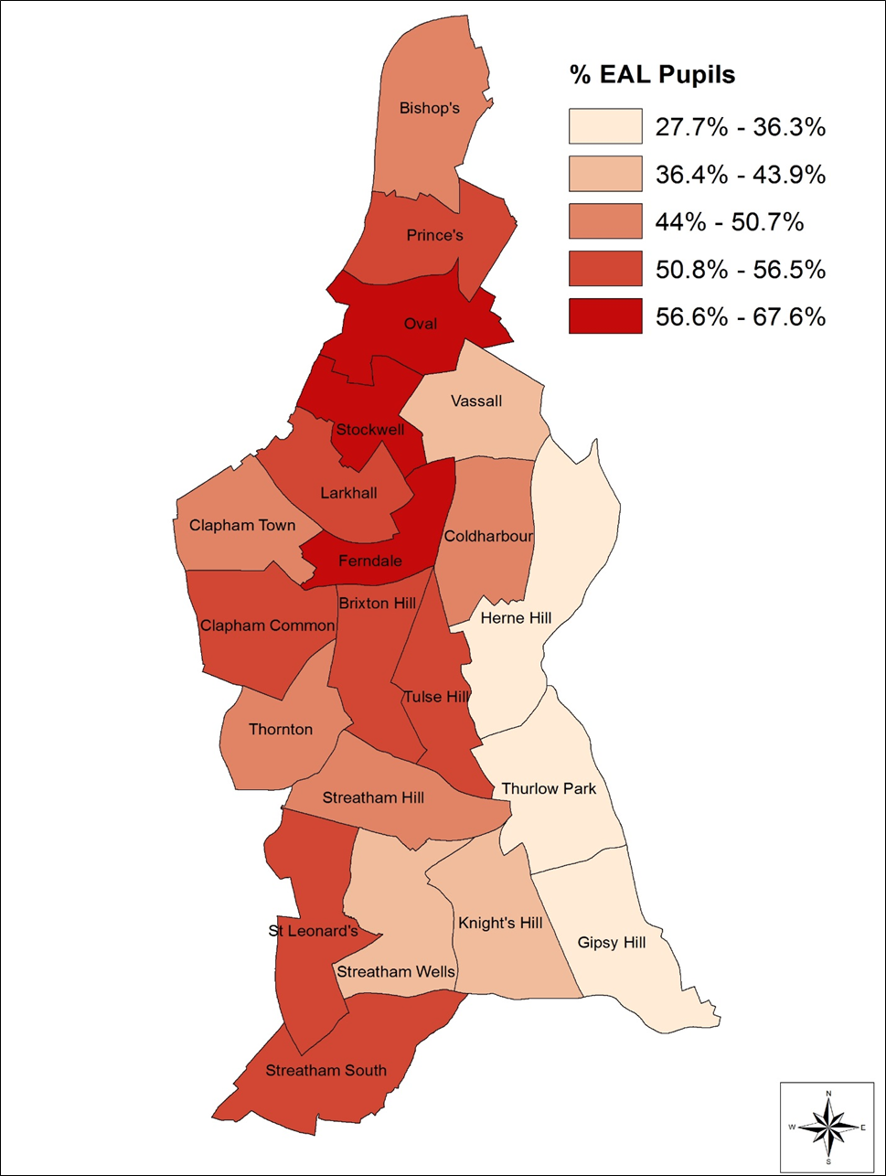
EAL in Lambeth – Ward Map
Schools in the centre and north – high levels of EAL, particularly Ferndale, Stockwell and Oval (>50% EAL)
Schools in the east of the borough – lower levels of EAL, particularly Herne Hill, Thurlow Park and Gipsy Hill (<40% EAL)
Commensurate with levels of ethnic minority pupils in schools
83% of Lambeth pupils are from an ethnic minority background – 11% increase since 2000
50% of Lambeth pupils classed as EAL – 14% increase since 2000

Slide 6
Ethnicity % of pupils aged 5-16: 2007-2016
Black African remains the largest ethnic group in Lambeth
White Other has the largest rise in numbers in the last 10 years
Black Caribbean and White British pupil levels have been falling in the last 10 years
Black African and White Other are key because:
They are the largest ethnic groups in Lambeth making up 38% of the pupil population
The predominance of these ethnic groups have English as an additional language
Both contain language groups who are achieving below both the LA and national average at key stage tests
Ethnicity | 2007 | 2016 | Change
Black African | 23.3% | 23.1% | -0.2%
White Other | 11.4% | 15.2% | +3.8%
Black Caribbean | 19.1% | 15.0% | -4.1%
White British | 17.2% | 14.4% | -2.8%
Mixed Other | 4.4% | 5.8% | +1.4%
Any Other Group | 3.8% | 4.8% | +1.0%
Black Other | 5.8% | 4.6% | -1.2%
Mixed White/Black Caribbean | 4.5% | 4.5% | 0.0%
Mixed White/Black African | 1.3% | 2.1% | +0.8%
Bangladeshi | 1.6% | 1.4% | -0.2%
Asian Other | 1.1% | 1.3% | +0.2%
Pakistani | 1.1% | 1.3% | +0.2%
Mixed White/Asian | 0.7% | 0.9% | +0.2%
Chinese | 1.0% | 0.8% | -0.2%
Indian | 0.8% | 0.7% | -0.1%
White Irish | 0.7% | 0.4% | -0.3%
Turkish | 0.4% | 0.3% | -0.1%
Vietnamese | 0.3% | 0.2% | -0.1%
Greek | 0.1% | 0.2% | +0.1%
Gypsy/Roma | 0.2% | 0.1% | -0.1%

Slide 7
Languages spoken in Lambeth 2017
Around half of the pupil population are monolingual English speakers. 18465 pupils in Lambeth speak or understand another language other than English
Largest EAL language group is Portuguese (7.2%).
Then Spanish (5.7%), Somali (4.6%), French (3.7%), Polish (3.2%)
Yoruba (2.8%) next but numbers decreasing steadily. Akan Twi-Fante also falling.
Polish had biggest increase in absolute numbers in the past year.
Main Pupil Languages in Lambeth 2017 (excl English)

Slide 8
Main language groups entering primary school Year 1 2011-2017

Slide 9
Main language groups entering secondary school Year 7 2011-2017

Slide 10
EAL-FLE Gap by Key Stage 2016
Comparing the attainment of EAL pupils with English-only pupils through the key stage tests in 2016
Foundation Stage – EAL pupils attainment lower than English-only speakers by 7 percentage points
By KS1 and KS2 the overall gap had narrowed to 4% with EAL pupils beginning to excel at Maths at KS2. The gap at Writing had closed at KS2 but the gap at Reading remained.
At GCSE the performance gap between EAL and English-only speakers had closed with EAL pupils achieving 7% higher than English-only peers
Age | Stage | Measure | EAL | FLE | Gap
5 | EYFSP | Reading | 71% | 78% | -7%
 |  | Writing | 69% | 74% | -5%
 |  | Numbers | 75% | 80% | -5%
 |  | Shapes, Space | 73% | 78% | -5%
 |  | Overall (GLD) | 65% | 72% | -7%
7 | KS1 | Reading | 75% | 81% | -6%
 |  | Writing | 71% | 73% | -2%
 |  | Maths | 75% | 78% | -3%
 |  | Overall (RWM) | 64% | 68% | -4%
11 | KS2 | Reading | 69% | 75% | -6%
 |  | Writing | 79% | 79% | 0%
 |  | Maths | 81% | 77% | +4%
 |  | GPS | 80% | 77% | +3%
 |  | Overall (RWM) | 59% | 63% | -4%
16 | GCSE | A*-C EM | 68% | 58% | +10%
 |  | EBAcc | 30% | 21% | +9%
 |  | Attainment 8 | 52.3 | 47.5 | +4.8
 |  | Overall (5+ A*-C inc EM) | 60% | 53% | +7%

Slide 11
EAL-FLE Progress 2016
KS1 - 2 progress of EAL pupils greater than that of English-only speakers particularly for writing and maths – closing the gap by KS2
KS2 – 4 progress of EAL pupils also greater than that of English-only peers - caught up with English-only by age 16.
Although English may not be the main language of the home, this can cause lower attainment on starting school, but impact reduces through age and is gone by Year 11, achieving higher at GCSE than English-only speakers.
Stage | Measure | Lambeth |  | National
 |  | EAL | FLE | EAL | FLE
KS1-2 | Reading | 1.5 | 2.5 | 0.3 | -0.1
 | Writing | 2.4 | 1.5 | 1.5 | -0.3
 | Maths | 2.7 | 1.6 | 2.0 | -0.4
KS2-4 | Progress 8 | 0.38 | -0.16 | 0.4 | -0.09

Slide 12
EAL Indicator Limitations
EAL is a heterogenous group – many cultures, nationalities, ethnicities and backgrounds
EAL status takes no account for a pupil’s proficiency in English
Lack of fluency in English is the real risk and can be indicative of international arrival, pupil mobility and a pupil’s language

Slide 13
Fluency in English by Key Stage 2016
At all key stages, as fluency in English increased, attainment increased
At all key stages, fully fluent in English pupils outperformed English-only speaking pupils
Notable that this trend starts as early as EYFS and KS1 when EAL attainment overall lags behind English-only speakers

Slide 14
New Proficiency in English by Key Stage 2016
Expected Standard at Key Stage 1&2 2016
No attainment for this year to match to new proficiency stages yet, but can match to pupils prior attainment at KS1 and KS2 data from last year
Pattern of attainment appears to continue through the new stages of proficiency although evidence of errors in assessment
Proficiency Stage | KS1 | KS2
A | 14.8% | 40.0%
B | 31.2% | 11.8%
C | 64.4% | 42.7%
D | 82.0% | 46.8%
E | 88.5% | 59.7%
English Only | 71.4% | 62.5%

Slide 15
English Proficiency Data - Issues
COLLECT validation didn’t always identify mismatches between stages of English and language
1802 pupils with English as a first language but also recording EAL Stage
3582 pupils with non-English language and blank EAL stage
265 pupils with not-yet assessed, most was 45 from one school
Schools with 100% EAL and no monolingual children. Monolingual pupils are not Stage E

Slide 16
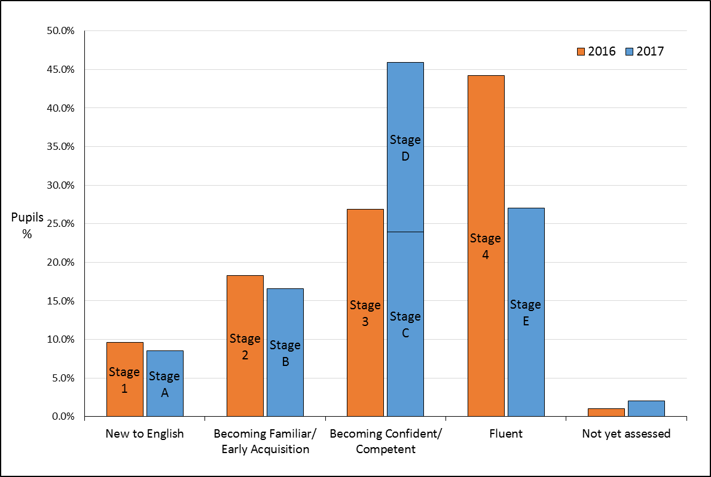
How does the proficiency data compare to last year? (*EAL only. % does not include English Only)

Slide 17
Breakdown of old and new stages
Matched new proficiency stages data in 2017 to old Lambeth Fluency in English stages in 2016
Stages A (New to English) and B (Early Acquisition) consistent with old Stages 1 and 2 accounting for pupils progressing from the previous year – expected
Most Stage C (Developing Competency) were previously recorded as Stage 3 but a high number were previously recorded as Stage 2 - expected
Most Stage D (Competent) were previously recorded as Stage 4 and only 34.9% previously recorded as Stage 3 – unexpected
Stage E (Fluent) were almost all Stage 4 – expected
Suggests that there are also differences between the new proficiency model and the old fluency model occurring in stages D and E and not stages C and D.

Slide 18
Pupils recorded as English-only in 2016
Matched pupils who were recorded as English-Only (non-EAL) in 2016 to their proficiency in 2017 cohort
Most were recorded as English-Only in 2017
10% were recorded with a proficiency in English Stage A-E, which indicates EAL??
Reasons:
EAL pupils incorrectly coded as English Only in 2016
Differences in identifying whether a pupil is EAL or not EAL, particularly when changing school / secondary transfer
Some schools misinterpreted proficiency in English as a measure for all pupils. Only pupils with EAL should be assessed for proficiency in English
English Proficiency 2017 | No. with English Only in 2016 | % with English Only in 2016
English Only | 12720 | 88.7%
A | 4 | 0.0%
B | 29 | 0.2%
C | 44 | 0.3%
D | 76 | 0.5%
E | 1277 | 8.9%

Slide 19
Implications and Conclusions
Important to continue to assess EAL pupils’ proficiency in English and assess new starters in school
Schools should review their proficiency in English data submitted in the Spring to ensure data is accurate, including the language recorded for the pupil.
Ensure that pupil language and EAL proficiency match (work with school office staff)
When pupils have moved from another school (such as secondary transfer) use English proficiency data from previous school to inform English proficiency assessment. Available through the school’s common transfer files.

Slide 20
Guidance and support
All EAL materials and guidance will continue to be uploaded on the Research and Statistics website at this address:
https://www.lambeth.gov.uk/rsu/eal-fluency-survey
Questions about collection of proficiency in English data:
E-mail: ahau@lambeth.go.uk
Tel: 0207 926 9454

Slide 21
Language and attainment
Language | Cohort | Pupil % RWM 4+
Chinese | 118 | 92.4%
Vietnamese | 37 | 91.9%
Italian | 118 | 90.7%
Urdu | 167 | 90.4%
Amharic | 107 | 87.9%
German | 49 | 87.8%
Panjabi | 40 | 87.5%
Tagalog/Filipino | 39 | 87.2%
Igbo | 106 | 85.8%
Bengali | 205 | 84.9%
Ga | 46 | 84.8%
Arabic | 313 | 84.7%
Polish | 243 | 83.5%
Yoruba | 501 | 83.4%
Gujarati | 36 | 83.3%
Albanian/Shqip | 90 | 82.2%
English | 6185 | 79.9%
Akan/Twi-Fante | 427 | 79.9%
Luganda | 74 | 79.7%
Somali | 647 | 78.8%
Turkish | 58 | 77.6%
French | 485 | 77.3%
Krio | 30 | 76.7%
Spanish | 700 | 74.6%
Tigrinya | 169 | 74.6%
Portuguese | 1038 | 70.9%
Lingala | 97 | 66.0%
5 years of KS2 attainment 2011-2015
Chinese-speaking pupils highest overall
Yoruba and Polish achieved higher than English only speakers
Somali, French, Spanish and Portuguese achieved lower than their English-speaking peers

Slide 22
Language and attainment - GCSE
Language | Cohort | Pupil % 5+ A*-C
Tagalog/Filipino | 50 | 84.0%
Igbo | 58 | 79.3%
Greek | 64 | 78.1%
Italian | 47 | 76.6%
Bengali | 153 | 71.2%
Ga | 31 | 71.0%
Yoruba | 409 | 70.4%
Polish | 140 | 70.0%
Albanian/Shqip | 50 | 70.0%
Chinese | 83 | 69.9%
Arabic | 131 | 69.5%
Akan/Twi-Fante | 204 | 68.1%
Urdu | 41 | 65.9%
Tigrinya | 69 | 65.2%
Carib Creole French | 31 | 64.5%
Somali | 267 | 61.0%
Krio | 53 | 60.4%
Spanish | 359 | 58.5%
English | 5044 | 57.9%
French | 225 | 56.4%
Lingala | 52 | 53.8%
Portuguese | 690 | 51.3%
Turkish | 42 | 50.0%
5 years of GCSE attainment 2011-15
Tagalog-speaking pupils best performing
English-only speaking pupils relatively low performing language group
Much higher number of EAL language groups performing better than English-only pupils than at KS2
French speakers and Portuguese speakers continue to show lower levels achieving expected levels

