Slide 1
Assessing English Proficiency and Using Language Data for EAL Learners
EAL Briefing
22nd November 2018
Lambeth Civic Centre
Brixton

Slide 2
Session Agenda and Aims
10.00am | EAL Achievement and Language Diversity in Secondary Schools in Lambeth and England Feyisa Demie, Head of Research and Statistics and Adviser for School Self-evaluation Why EAL matters Language Diversity and Attainment in England Proficiency in English and Attainment in Lambeth
10.25am | Good Practice in Assessment of English Proficiency in Children with EAL – WORKSHOP Amanda Bellsham-Revell, EAL Consultant EAL or not EAL Good practice assessment Breadth of vocabulary and developing reading and writing 180 degree moderation of secondary pupils with EAL
11.50am | The Trinity Academy – Centre of EAL Excellence Hannah Sharma, Assistant Principal, Trinity Academy

Slide 3
Why EAL Matters
EAL population in England is growing.
EAL has seen a dramatic rise, from 500,000 in 1997 to 1.5 million in 2018. This is about 20% of all pupils in England (About 50% of Lambeth pupils).
Over 350 different languages spoken in England’s schools (141 languages in Lambeth)
Accordingly, levels of pupils who are not proficient in English has also increased
Research has shown pupils not proficient in English perform significantly lower than national expected standards at all Key Stages. However, EAL pupils who are fully fluent in English perform significantly higher than monolingual English speakers and the national average.
EAL Population in State-funded Schools in England 1997-2018

Slide 4
EAL in Secondary Schools in England 2018
In secondary schools across England, Lambeth are in the top 20 LAs with highest EAL pupil population
17 of the top 20 are in London, 8 are in Inner London
National - very skewed:
40% of secondary schools less than 5% EAL
9% of secondary schools more than 50% EAL
Lambeth:
70% of secondary schools more than 40% EAL
25% of secondary schools more than 50% EAL
Local Authority | % EAL
Tower Hamlets | 68.2
Newham | 64.5
Harrow | 60.9
Westminster | 58.4
Brent | 56.7
Redbridge | 56.6
Hounslow | 55.4
Ealing | 54.0
Leicester | 52.6
Camden | 51.6
Luton | 49.1
Kensington and Chelsea | 46.4
Enfield | 46.2
Hackney | 46.1
Slough | 46.1
Haringey | 45.2
Waltham Forest | 44.9
Lambeth | 44.6
Islington | 44.0
Wandsworth | 43.7
INNER LONDON | 48.6
ENGLAND | 16.6

Slide 5
Policy Concerns: Misunderstanding about EAL pupils, language, migration and social cohesion
There is a misunderstanding about EAL pupils and fears around immigrants
“You only have to look at London, where almost half of all primary school children speak English as a second language, to see the challenges we now face as a country. This isn't fair to anyone: how can people build relationships with their neighbours if they can't even speak the same language?”
Primary Minister Theresa May, in a speech to think tank Policy Exchange in 2012, Source: The Guardian , 10 October 2016
Theresa May statements appears to confuse "speaking English as a second language" with "can't even speak the same language".
It is true that almost half of all primary school children in London speak English as a second language. But this doesn't mean that they, or their parents, can't speak English with their friends and neighbours
These are inaccurate, unhelpful and miss the point that EAL pupils need support in order to achieve academic success in the long-term.

Slide 6
What does the data tell us about EAL English Proficiency?

Slide 7
English Proficiency in Lambeth Secondary Schools 2018

Slide 8
Stages of English Proficiency by Year Group 2018

Slide 9
EAL Pupils Only by Year Group

Slide 10
What does the data tell us about EAL Attainment and Language Diversity?

Slide 11
Attainment by Region
Regions with largest gaps in EAL/non-EAL attainment have much lower levels of EAL
EAL pupils in these regions achieving below the national average for all pupils.
Both Inner London (56.8%) and Outer London (42.4%) have the highest levels of EAL pupils and the gap is much narrower.
Inner London, EAL pupils perform as well as or better than non-EAL pupils and above the national average for all pupils.
More established ethnic minority communities = higher proficiency in English for many EAL pupils?
Good practice and targeted support by schools with high EAL
London schools are better funded and the extra funding has helped to provide the extra specialist support for pupils with EAL
Notes:
Lambeth research published a few years ago, and this particular finding was picked up and reported in the Times Educational Supplement.
Regional analysis of national data showed that regions with low EAL numbers, such as the North of England and the South-west showed EAL achievement was well below national average and had the largest attainment gaps between EAL and non-EAL pupils.
Inner London and Outer London, however, have significantly higher levels of EAL and EAL achievement appears to buck the trend. The gap is much narrower and in the case of Inner London, EAL pupils actually outperformed non-EAL pupils. Nowhere else in England has this happened.

Slide 12
Concerns about using EAL and non-EAL categories for monitoring EAL attainment
A need to be cautious when talking about EAL/Non-EAL and attainment
EAL is a very heterogeneous group made up of pupils from many different ethnic and cultural backgrounds. Some of these sub-groups of EAL pupils do very well academically, others perform very poorly.
Conflating all of these pupils into a single group, masks underachieving groups of pupils
Ethnicity and EAL map together very well and has allowed research to analyse different ethnic groups of pupils with EAL.
However, previous research has noted that the recording of ethnicity in England usually refers, confusingly, to a combination of national boundaries (Indian, Pakistani, Bangladeshi) but also colour (Black, White) and more general geographic distinctions, that supersede national boundaries (Black Caribbean, Black African).
Language data instead can help to identify specific groups of pupils who may be high performing or underachieving
Notes:
As above
As above
By aggregating all of these groups of children into one pot called “EAL”, we are essentially masking certain underachieving groups of pupils which we cannot then identify and monitor.
Ethnic group and EAL are very closely related and map together very well, with the exception of Black Caribbean and White British. 96% of Bangladeshi pupils, 88% Pakistani, 88% of Chinese, 79% of Indian, 74% of White Other and 71% of Black African pupils are recorded as EAL. Much research has been undertaken to examine the performance of these ethnic groups as sub-groups of EAL.
However, the ethnic categories themselves are relatively generic and confusing. Some refer to nationality e.g Indian, Pakistani and Bangladeshi. Some refer to colour e.g. Black/White. Some refer to broader geographical distinctions e.g. Black Caribbean, Black African.
Language data is an extremely useful tool for directly identifying specific groups of children within the EAL and Ethnic minority categorisation. Particularly they could help identify groups of underachieving children who have otherwise remained hidden with DfE reporting.

Slide 13
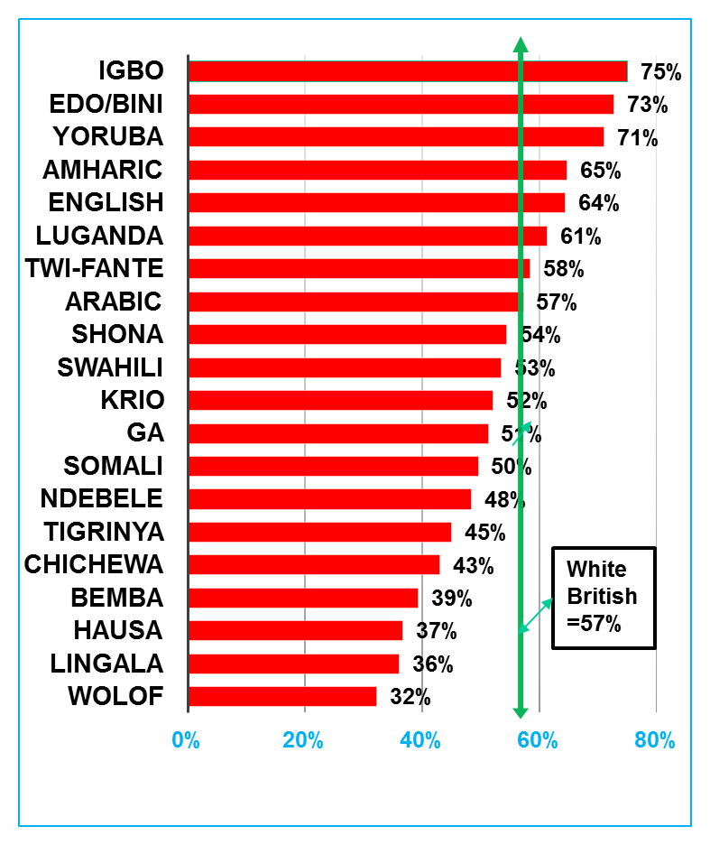
Black African Pupils GCSE Performance by Language Spoken at Home (20+ speakers)
Who are Black Africans?

Slide 14
White Other Ethnic Group, Language Diversity and Attainment: White Other pupils GCSE performance by language spoken

Slide 15
GCSE Performance of Pakistani Pupils by Language Spoken (cohort over 20)
Language | 5+ GCSE including English and Maths | Cohort
Urdu | 53% | 6297
English | 58% | 4162
Panjabi | 43% | 4855
Other than English | 52% | 2361
Pashto/Pakhto | 48% | 425
Pahari (Pakistan) | 41% | 117
Hindko | 59% | 56
Kashmiri | 45% | 33
Bengali | 56% | 36
Gujarati | 58% | 26
All Pakistani | 51% | 18517
National | 57% | 558432
Source: NPD 2014

Slide 16
Key Stage 2 Performance of Indian Pupils by Language Spoken (Reading, Writing and Maths- Level 4+)
Indian Languages | RWM 4+ | Pupil No.
Gujarati | 86% | 3532
Panjabi | 82% | 3528
English | 89% | 3116
Malayalam | 93% | 878
Hindi | 93% | 773
Urdu | 88% | 392
Tamil | 89% | 360
Konkani | 83% | 151
Telugu | 97% | 151
Bengali | 93% | 123
Marathi | 94% | 88
Katchi | 89% | 61
Kannada | 98% | 43
All Indian | 87% | 14230
National | 79% | 550969
Source: NPD 2014

Slide 17
School Funding and EAL Proficiency Issues: How long does it take to acquire English proficiency for EAL pupils?
One of the most commonly asked questions about the education of EAL students not fluent in English is how long they need special language support.
For pupils to have full access to the curriculum, they need to be fluent in English. Local Authorities and schools have an obligation to provide appropriate services to EAL students to learn English.
No previous research on how long it takes to acquire English fluency in UK because of lack of data but in Lambeth we tracked backwards 940 year 6-11 EAL pupils in the LA who were fully fluent in English, year by year, to establish how long each pupil was at a particular stage of English fluency and how long it took overall to become fully fluent from the time they were first assessed when they started school.
The Lambeth study suggests it takes about 5 to 7 years, on average, for EAL pupils to acquire academic English fluency.
However there is a variation how long it takes at each stage of fluency. Longitudinal data in the LA shows that it takes about 1.5 years to complete beginner stage 1 level of fluency, about 2 years to complete stage 2 in becoming familiar with English and another two-and-a-half years to complete stage 3-becoming a confident user of English.
It makes more sense to set aside the seven years of primary and secondary schooling as a reasonable time frame for students to gain English proficiency.

Slide 18
How long does it take to acquire English proficiency for EAL pupils? Length of time needed by languages spoken
Languages spoken by Year 6-11 EAL students in 2011 | Number of years at each stages of fluency in English |  |  |  | Number of speakers
 | Stage 1- Beginners and New to English | Stage 2 -Becoming familiar with English | Stage 3- Becoming confident as user of English | Total Years in Stage 1 – 3
Turkish | 1.8 | 3.0 | 2.8 | 7.6 | 25
Lingala | 1.9 | 2.9 | 2.8 | 7.5 | 14
Spanish | 1.5 | 2.6 | 2.7 | 6.8 | 91
Bengali | 1.6 | 2.3 | 2.8 | 6.7 | 65
Portuguese | 1.6 | 2.2 | 2.6 | 6.4 | 265
Chinese | 1.4 | 2.2 | 2.8 | 6.4 | 36
Twi-Fante | 1.4 | 1.5 | 3.0 | 5.9 | 42
French | 1.5 | 1.5 | 2.8 | 5.8 | 52
Yoruba | 1.5 | 1.8 | 2.3 | 5.6 | 38
Somali | 1.5 | 1.9 | 2.1 | 5.6 | 93
Polish | 1.4 | 1.4 | 1.8 | 4.6 | 22
Average | 1.5 | 2.1 | 2.6 | 6.2 | 940

Slide 19
EAL/non-EAL Gap by Key Stage (2018)
Stage | Measure | Lambeth |  |  |  | National
 |  | EAL | non-EAL | Gap |  | EAL | Non-EAL | Gap
EYFSP | Overall (GLD) | 69% | 76% | -7% |  | 66% | 74% | -8%
KS1 | Reading | 77% | 80% | -3% |  | 73% | 77% | -4%
 | Writing | 74% | 75% | -1% |  | 69% | 71% | -2%
 | Maths | 79% | 80% | -1% |  | 75% | 77% | -2%
 | Overall (RWM) | 69% | 71% | -2% |  | 64% | 66% | -2%
KS2 | Reading | 75% | 82% | -7% |  | 70% | 77% | -7%
 | Writing | 81% | 84% | -3% |  | 77% | 79% | -2%
 | Maths | 81% | 80% | +1% |  | 77% | 75% | +2%
 | GPS | 82% | 85% | -3% |  | 79% | 77% | +2%
 | Overall (RWM) | 68% | 72% | -4% |  | 63% | 65% | -2%
GCSE | 9-5 EM | 42% | 36% | +6% |  | 44% | 43% | +1%
 | Attainment 8 | 47.0 | 42.2 | +4.8 |  | 47.9 | 46.3 | +1.6
 | Progress 8 | +0.32 | -0.43 | +0.75 |  | +0.49 | -0.10 | +0.59
 | 5+ A*-C inc EM | 58% | 50% | +8%
Performance gap between EAL and non-EAL pupils varies between key stages.
Biggest performance gap is at EYFS.
By Key stage 1 and 2, the gap has narrowed but remains larger in Reading. EAL pupils beginning to excel at Maths.
By GCSE, the gap has completely closed and EAL pupils perform significantly better than their monolingual English speaking peers.

Slide 20
GCSE by Stage of English Proficiency
EAL indicator does not tell the full story. Achievement varies considerably when examining pupil’s stage of English proficiency.
Pupils in the early stages of English proficiency did not achieve any of the headline measures. No Stage A pupils achieved 9-5 English and Maths.
As stage of proficiency in English improves, so does performance.
Stage C pupils are still underperforming when compared to English-only peers.
By Stage D and Stage E, EAL pupils are outperforming English Only pupils by a considerable margin
Stage E (fully fluent) pupils achieve several percentage points above the national average for all pupils.
Proficiency | 9-5 English and Maths | Attainment 8 | 5+A*-C/9-4 English and Maths
Stage A | 0% | 18.7 | 0%
Stage B | 3% | 26.5 | 10%
Stage C | 22% | 40.0 | 39%
Stage D | 48% | 49.6 | 68%
Stage E | 47% | 49.4 | 65%
English Only | 34% | 41.2 | 49%
Lambeth | 39% | 44.4 | 55%
National | 43% | 46.4

Slide 21
GCSE Attainment by Proficiency in English 2005-2018

Slide 22
Conclusions and implications for policy and practice
EAL pupils overall do not perform as well as their non-EAL peers in English schooling because of English language barriers.
In particular EAL pupils not fluent in English achieve significantly below the national average compared to monolingual English speakers in English schools.
There is a wide variations in performance and in the achievement gap between EAL not fluent in English and monolingual pupils.
What is even worrying is that low achievement of EAL pupils not fluent in English has been masked by the failure of government statistics to monitor and distinguish EAL pupils by stages of proficiency in English.
EAL pupils in the early stages of English proficiency, performed at low levels, while the achievement of EAL pupils who were fully fluent in English far outstripped that of pupils for whom English was their only language.
Overall the findings of the research confirm that there is a strong relationship between stage of proficiency

Slide 23
Policy Implications
The above empirical evidence by the stages of English proficiency has far reaching implications for policy and practice. The government uses the data on the English proficiency of EAL pupils to inform policy as stated below
‘The information will help the department understand how effective the education sector is for EAL pupils and will provide valuable statistical information on the characteristics of these children and, together with their attainment, will allow us to measure whether the individual pupils, or the schools they attend, face additional educational challenges.’ (DfE, 2017:65)
There are also overall resourcing implications for national policy makers. In England the Government uses EAL as an additional factor to fund schools through the national schools funding formula. The national education policy guideline suggests that:
‘EAL status increases costs for schools and that there is a strong relationship between a pupil’s fluency in English and their educational attainment. …The Government believe that allocating funding to those pupils with EAL who entered the state education system at any point during the previous 3 years would target funding to schools likely to have pupils in need of targeted support to increase language proficiency.’ (DfE 2016, pp 27- 28).
The EAL factor could be included in local funding formulae to enable schools in England to meet the needs of EAL pupils. This factor is limited to bilingual pupils who have been enrolled in English schools for a maximum of three years at present despite research evidence which suggest 5-7 years to acquire English proficiency in a UK context (see Demie 2013).

