Slide 1
Damp and Mould
Housing Services
MARCH 2023

Slide 2
Housing Services have implemented a suite of strategic, preventative, and reactive measures and initiatives to tackle damp and mould in homes. These measures are summarised in our strategy timeline.

Slide 3
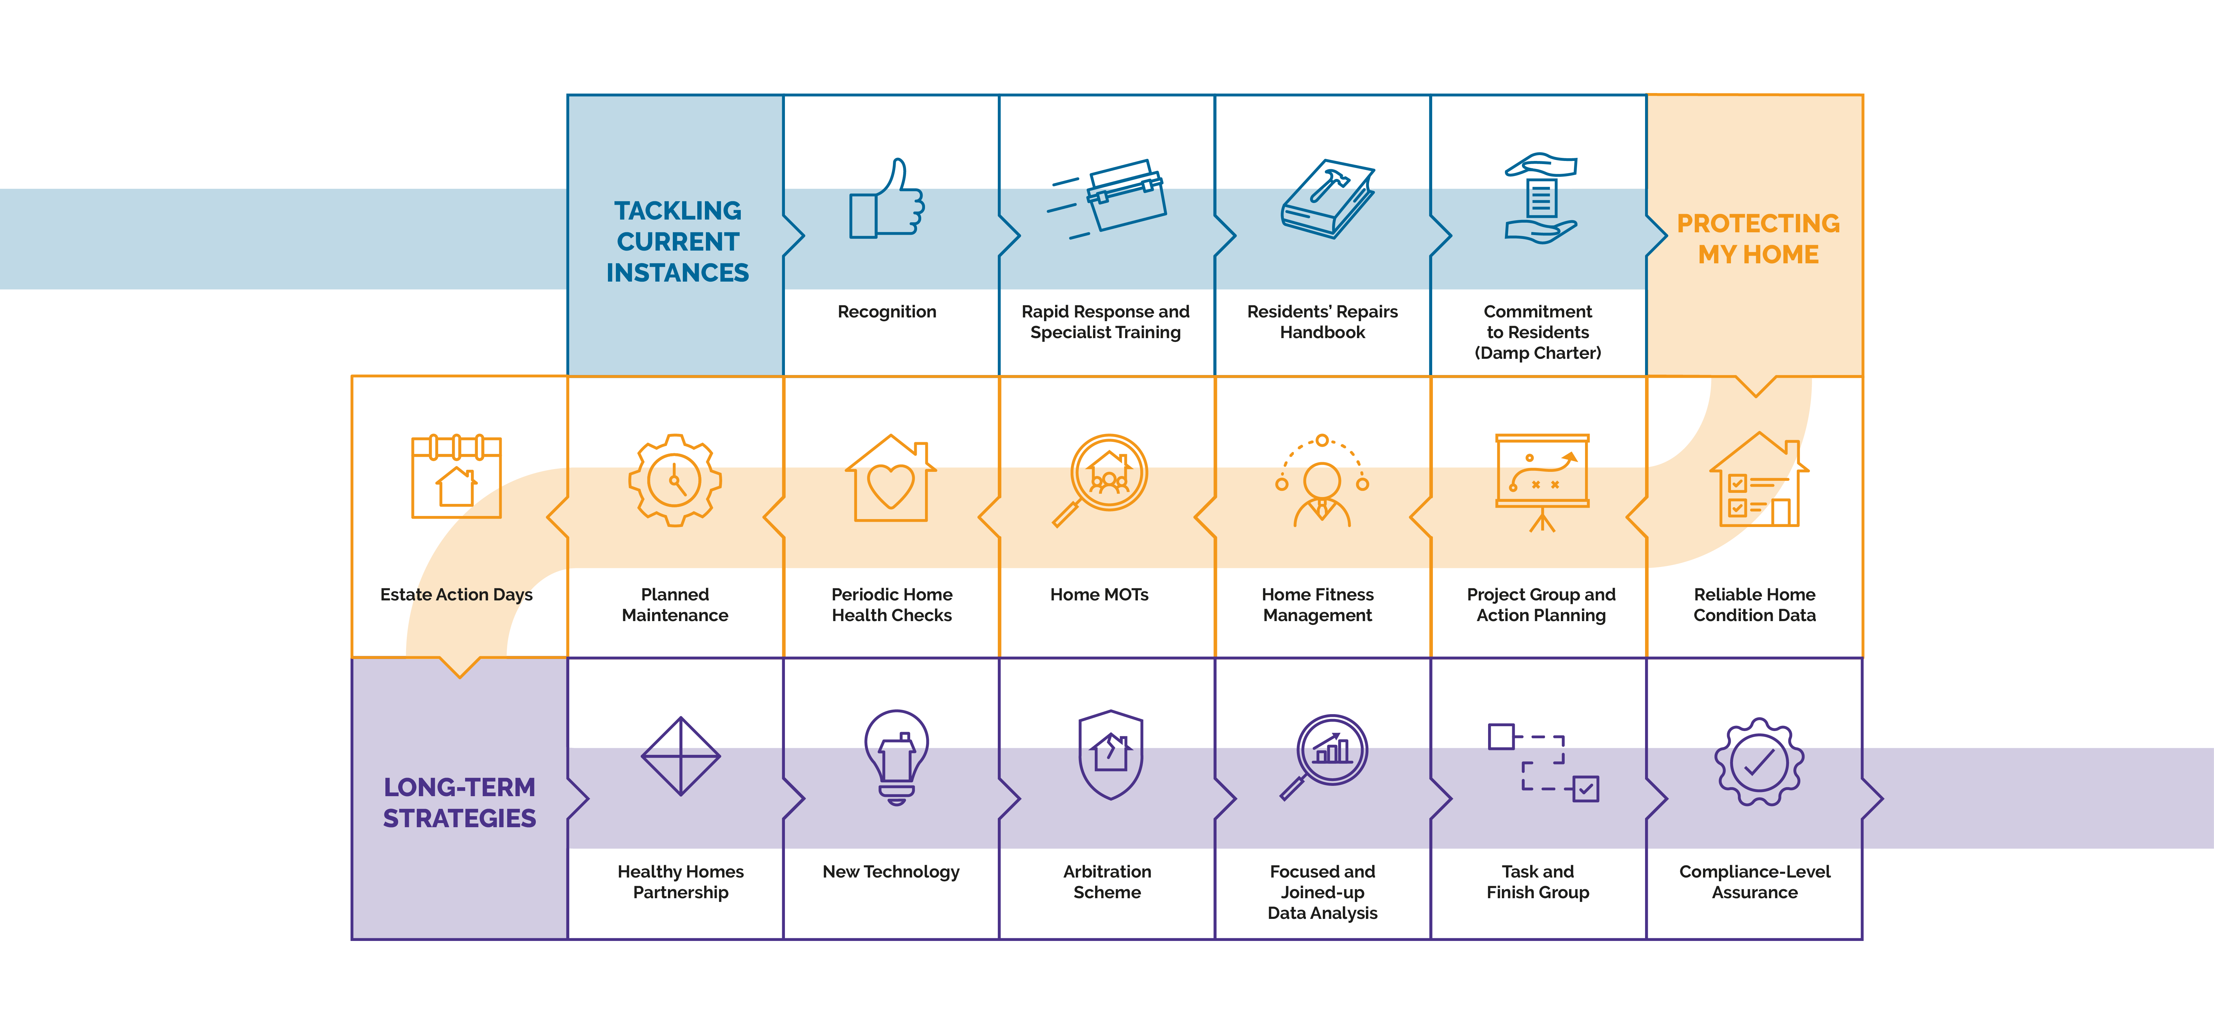

Slide 4
Damp and Mould Strategy
Tackling Current Instances

Slide 5
Recognition
Damp and mould is still a problem for too many of our residents – something the council recognises and is determined to correct. Tackling damp and mould was an integral part of designing the new repairs service and commenced with a clear decision to survey all of our homes and formally assess the presence of damp and mould risks in each home surveyed. Specialist training, the formation of a project group and reinforcing a no-blame culture in our documentation and interactions with residents was also put in place early on.
Damp and Mould Housing Services | Tackling Current Instances

Slide 6
Rapid Response and Specialist Training
We have put in place a rapid response mould removal and treatment service within our flagship in-house repairs team – Community Works. All operatives have now been trained on the removal and treatment of mould. Surveyors have also undertaken specialist training on the diagnosis and prevention of damp and mould.
Damp and Mould Housing Services | Tackling Current Instances

Slide 7
Residents’ Repairs Handbook
The council’s Repairs Handbook was updated in 2022 to change some of the language to reflect the current work being done around damp and mould – and to better support vulnerable residents, and create a more empathetic and accountable culture. It will be updated again following the resident Damp and Mould Task and Finish Group project.
Damp and Mould Housing Services | Tackling Current Instances

Slide 8
Commitment to Residents
Armed with the biggest home condition survey to date and HHSRS assessments (which assesses the most vulnerable category of resident), damp and mould will now receive a compliance level of assurance.
Damp and Mould Housing Services | Tackling Current Instances

Slide 9
Damp and Mould Strategy
Protecting my home

Slide 10
Reliable Home Condition Data
The first part of our strategy to make sure our homes are of a good standard and meet the fitness standard for housing was to physically survey all of our residents’ homes – ensuring hazards are identified, and Decent Homes 2 criteria is met.
This physical survey includes (1) the condition of the resident’s home and the age of its components under the Decent Homes 2 criteria; (2) the identification of any hazards under the Housing Health and Safety Rating System (HHSRS); (3) an energy efficiency survey using industry standard assessment criteria; (4) any other urgent issues.
17,000 individual homes have been physically surveyed so far and all of this information is being recorded on the council’s housing management database and being used to inform reactive, planned and capital investment maintenance programmes.
Damp and Mould Housing Services | Protecting my Home

Slide 11
Project Group and Action Planning
In response the council’s prioritisation of disrepair and the Housing Ombudsman’s Spotlight Report on Damp and Mould, a Disrepair Project Group was formed in November 2021 which developed a 16-point action plan that will drive down and better manage instances of disrepair, damp and mould. This Group meets weekly to drive the actions and develop new initiatives.
Damp and Mould Housing Services | Protecting my Home

Slide 12
Home Fitness Management
We have appointed a dedicated Housing Fitness Manager who coordinates – with the support of two experienced building surveyors – all of the HHSRS Hazards (damp and mould growth being the foremost hazard) into work programmes. Urgent Category 1 work is undertaken by the council’s existing responsive repair contractors and in-house repairs team – Community Works; less urgent Category 2 hazards are packaged into work programmes and delivered by smaller dedicated contractors.
Damp and Mould Housing Services | Protecting my Home

Slide 13
Home MOTs
Home MOTs have commenced. This again involves a physical survey of residents’ homes with a focus on vulnerable residents and where we are seeing a disproportionately high volume of repair requests.
Damp and Mould Housing Services | Protecting my Home

Slide 14
Periodic Home Health Checks
After any damp and/or mould treatment work works, the council will undertake an annual survey of those homes to check that the remedial work/treatment continues to be effective.
Damp and Mould Housing Services | Protecting my Home

Slide 15
Planned Maintenance
The council is moving to a more proactive and long term approach to the maintenance of its housing stock – reducing reliance on its responsive repairs service. This will ensure complex damp and mould cases are better managed and prevented. To do this the council needed a better understanding of the condition of its homes – informed through the individual home condition surveys. Now completed, this is the council’s biggest stock condition survey programme to date. This will inform a well-considered and evidence-based long term programme of cyclical, planned and major work schemes to keep homes in good condition and reduce instances of damp and mould.
Damp and Mould Housing Services | Protecting my Home

Slide 16
Estate Action Days
A series of Estate Action Days are being planned for 2023 that will have a focus on damp and mould – with operatives at the events to remove and treat mould, and undertake repairs that may be contributing to the damp and mould. Surveyors will also be at the events to answer queries, diagnose damp and arrange more fundamental preventative work.
Damp and Mould Housing Services | Protecting my Home

Slide 17
Damp and Mould Strategy
Long-term Strategies

Slide 18
Healthy Homes Partnership
The council has launched a Healthy Homes Partnership that will create an over-arching commitment from all of the council’s repair teams and contractors to work together to improve the health of residents’ homes – together with a commonly-held manifesto.
This will involve a range of initiatives but tackling damp and mould prevention will be a central commitment. A dedicated Healthy Homes Manager is in place to drive these commitments; and to give assurance and oversight over HHSRS risks, legal disrepair and the Damp Charter.
Damp and Mould Housing Services | Long-term Strategies

Slide 19
New technology
As part of the council’s overall strategy to tackle damp and mould growth, and its commitments under its Damp Charter, it is reviewing and implementing new technology to help reduce instances of damp and mould. This includes the installation of smart home meters in all new lettings that will provide a platform to identify condensation, damp and mould risk; and flags potential fuel poverty. It also helps residents to optimise their energy use. We are also installing whole-home ventilation systems to homes where their physical characterises make it difficult for the council and residents to prevent condensation forming.
A Repairs Innovation Group has been established and the first event – a Dragon’s Den style day, to be held at the Assembly Hall – will be a damp and mould special with suppliers presenting innovative solution and prevent and/or manage damp and mould.
Damp and Mould Housing Services | Long-term Strategies

Slide 20
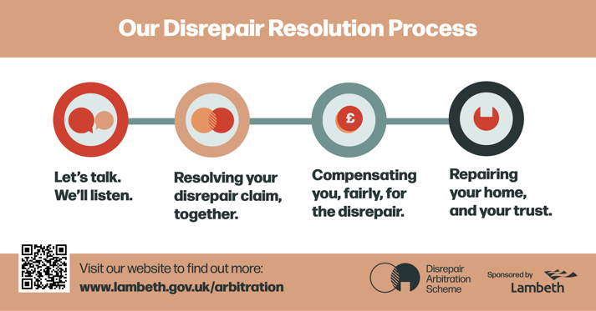
Arbitration Scheme
In response to the Housing Ombudsman’s Spotlight Report and a national trend of rising disrepair claims, the council has sponsored a new, independent Disrepair Arbitration Scheme – the first of its kind in the country. The new service will follow a residents-first approach to resolving disrepair claims.
Disrepair claims involving damp and mould will be resolved in a quicker and fairer way – and residents will get to keep one hundred per cent of their compensation award through the new Disrepair Arbitration Scheme. Legal firms often require residents to enter into conditional fee arrangements that can result in them not receiving all of their compensation award. The new scheme provides residents with a free, independent, and straightforward way to resolve disrepair claims – ensuring residents get the compensation they deserve.
The Scheme is part of the radical transformation of the repairs service, which is now focused on providing healthy homes for residents and proactively addressing any past issues.
Damp and Mould Housing Services | Long-term Strategies

Slide 21
Focused and Joined-up Data Analysis
All the home condition survey data (condition and energy) will be overlaid with our responsive repair data to ensure our planned and capital investments programmes optimise budget allocations and proactively design out HHSRS hazards and instances of damp and mould.
The detailed home condition survey has identified 5% of homes have a damp or mould hazard. This information is allowing the council to more accurately prioritise investment that will prevent instances of damp and mould.
Damp and Mould Housing Services | Long-term Strategies

Slide 22
Task and Finish Group
A Damp and Mould Task and Finish Group will be formed in 2023. The Group will primarily involve residents with a live damp and/or mould issue who will work with trained surveyors to trial, research and monitor a series of solutions. The outcomes of these case studies and research will inform a suite of new actions to further improve the council’s approach to tackling damp and mould in a resident-focused way.
Damp and Mould Housing Services | Long-term Strategies

Slide 23
Compliance-level Assurance
Armed with the biggest home condition survey to date and HHSRS assessments (which assesses the most vulnerable category of resident), damp and mould will now receive a compliance level of assurance.
Damp and Mould Housing Services | Long-term Strategies

Slide 24
Thank you for listening
As you can see we’ve come a long way already. But our journey is just beginning, and we’ve got big plans for the future.

