Slide 1

My Views
The next few slides will ask you questions about school and help to find out more about your strengths and skills, and the kind of help you need. This will be shared with the headteachers at the Fair Access Panel so they can understand more about you.
What you need to do:
Please fill in the gaps or drag the pictures / words into the right boxes.
At the end, save the PowerPoint with your name at the end, for example: “My Views – Amy Smith.ppt”
If you have any questions, or don’t understand anything, you can ask the adult who is working with you.

Slide 2

My Strengths and Skills…
Drag the red circles around the 10 words or phrases that describe you best:

Slide 3


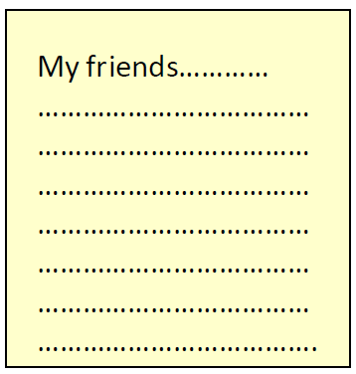


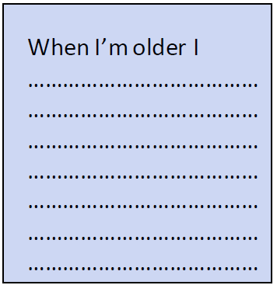

All about me…
Type a sentence in each of the boxes (replacing the “XXXX”) with information about yourself:
XXXX
XXXX
XXXX
XXXX
XXXX
XXXX
XXXX
XXXX

Slide 4
People in my life…
Type names of the people in your life and drag into the circle…
In the inner circle: put people who are really important
In the middle circle: put people you like / are kind of important
In the outer circle: put people you don’t like
People at school
Name?
Name?
Name?
Friends / neighbours / other people
Me
Family / Relatives / People at home
Name?
Name?
Name?
Name?
Name?
Name?

Slide 5
How I feel about school…
Drag the X’s on the scale from 1-10 to show how you feel about school on your worst ever day, your best ever day and now.
Worst day
Now
Really dislike /
It is awful
Best day
Really like /
It is great
1 | 2 | 3 | 4 | 5 | 6 | 7 | 8 | 9 | 10
Now write a couple of sentences (replacing the XXXX) to say more about your best and worst days at school:
My best ever day at school was when….XXXX
My worst ever day at school was when…XXXX

Slide 6
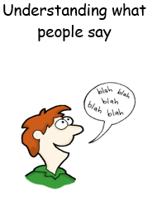


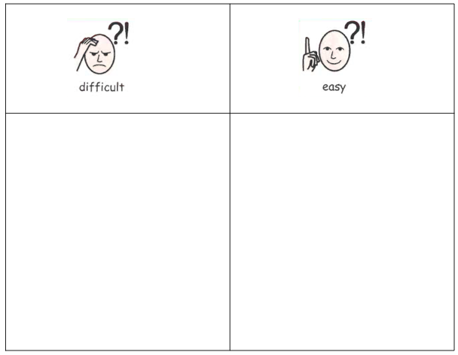




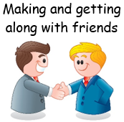



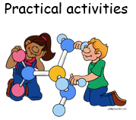

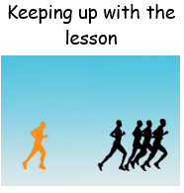
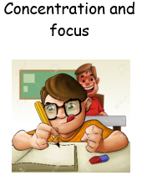

What is difficult and easy for me at school…
Drag the pictures into the boxes to show which things you find difficult and easy about school, you can also add your own ideas too by typing in the ‘something else…?’ text boxes:.
Something else…?
Something else…?
Something else…?

Slide 7




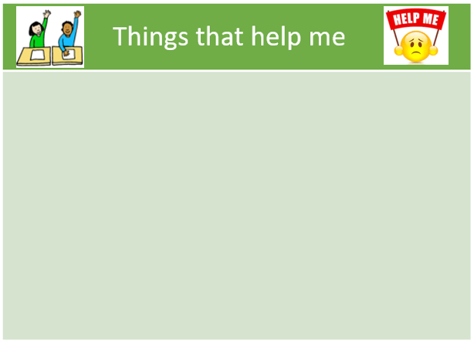








Things that help me…
Drag the pictures into the boxes to show what would help you the most at school, you can also add your own ideas too by typing in the ‘something else…?’ text boxes:.
Something else…?
Something else…?
Something else…?

Slide 8



What bothers me and how I cope…
We all get annoyed and worried about different things, and we all have our own ways to relax and feel calm.
Fill in the boxes below (replacing the XXXX) to say a bit about your feelings right now:
The top 3 things that annoy me most are: | The top 3 things I am worried about right now are: | The top 3 things that help me to feel calm are:
XXXX XXXX XXXX | XXXX XXXX XXXX | XXXX XXXX XXXX

Slide 9


Imagine your alarm clock goes off tomorrow morning and when you wake up, a genie has granted your three greatest wishes overnight. What three things would be different in your life?
One last question…
1. XXXX
2. XXXX
3. XXXX
Notes:
A year from now…what will be different at school?

Slide 10


Thank you ☺
This information will be shared with the headteachers at the Fair Access Panel so they can learn more about you.
Is there anything else you would like them to know about you?
I would like you to know….
XXXX

